Slide 1
Cross-linguistic influence and sibilant production: An acoustic analysis of voiceless retroflex and non-retroflex sibilants in L1 Polish, L2 English, L3 Norwegian learners
Tristan Czarnecki-Verner, Jarek Weckwerth & Magdalena Wrembel
Notes:
Verify that title matches title in plm schedule

Slide 2
Cross-linguistic influence and sibilant production in L3 learners of Norwegian
Tristan Czarnecki-Verner, Jarek Weckwerth and Magdalena Wrembel
Notes:
Verify that title matches title in plm schedule

Slide 3
Notes:
Funded by CLIMAD and ADIM projects
NTNU: The norwegian university of science and technology in trondheim
UIT: The arctic university of Norway in Tromso

Slide 4
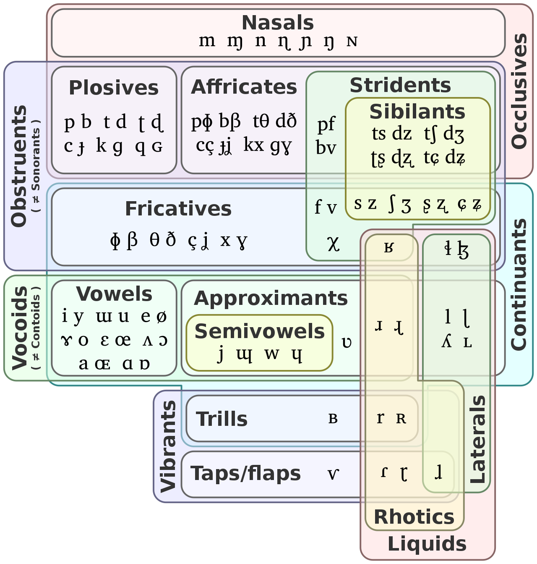
Sibilant fricatives
Sibilant fricative sounds produced by the tongue tip or tongue blade
Constricted, turbulent airstream
Possess higher amplitude and pitch than other fricatives by directing the at the teeth.
Notes:
Euler diagram showing a typical classification of sounds (in IPA) and their manners of articulation and phonological features
Sources for the classification include Zsiga (2013), Gussenhoven & Jacobs (2011) and Ladefoged & Maddison (1996).

Slide 5
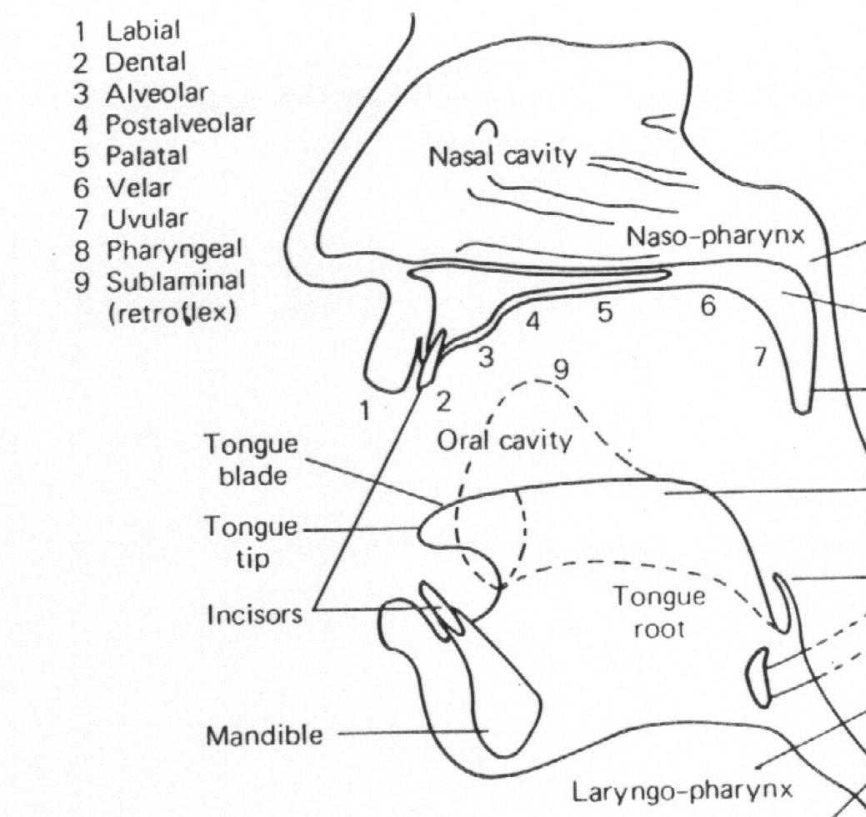
Places (of articulation) of interest
[s̪]
[s]
[ʃ] ([ʂ])
[ɕ] [ç]
Modified from Clark & Yallop (1994)

Slide 6
Descriptions of sibilant inventories in Polish, Norwegian and English
/ʃ ~ ʂ/ in Polish:
/s/, /ʃ/, /ɕ/ (in traditional representations, e.g., Jassem, 2003)
/s/, /ʂ/, /ɕ/ (Czaplicki et al. 2016)
/ʂ ~ ʃ/ in Norwegian:
/s/, /ʂ/, /ç/ (Kristoffersen, 2000)
/s/, /ʃ/, /ç/ (in other sources, e.g., van Dommelen, 2019).
/ʃ/ in English:
/s/, /ʃ/
Notes:
The languages we are interested in are PL NO and EN
Polish and Norwegian maintain a 3-place distinction in their sibilant inventories, whereas English has a two place distinction.
Accounts of sibilant inventories vary in both Polish and Norwegian, and there are ongoing debates discussing how the post-alveolar sibilants in these languages should be interpreted. Either as retroflex or postalveolar.
Which led us to the following questions:
At least one reference for Engliush
Curattinden 2008
Make a disclaimer we are referring to these non-coronal, non-palatal sounds as laminal/post-alveolar

Slide 7
Research Questions
Q1. Do learners of Norwegian have distinct categories for /ʃ~ʂ/ (the non-alveolar, non-palatal sibilants) across their languages?
Q2. Does transfer occur between the phonological systems of multilinguals?
Q3. Is Norwegian /ç/ distinct from Polish /ɕ/ in Polish learners, or is there a one-to-one mapping, as described for Polish learners of German (Morciniec & Prędota, 2005)?
Notes:
Morciniec & Prędota 2005 is a contrastive handbook of german learner by L1 Polish

Slide 8
Research Questions
Q4. What are the acoustics of /s/ in the speech of multilinguals across the three languages?
Q5 What is the influence of spelling (with three different spellings for Norwegian /ʃ/), vowel context, and proficiency in both English and Norwegian on sibilant production in the three languages?

Slide 9
Predictions
Retroflexion: If the L1 Polish sibilant is retroflex (/ʂ/), we expect to see forward transfer during L3 production of the Norwegian retroflex sibilant(/ʂ/).
Proficiency level:
Lower Norwegian proficiency: participants will display transfer from L1 Polish sibilants
Higher Norwegian proficiency: participants will display reduced amounts of transfer from L1 Polish sibilants into L3 Norwegian.
Notes:
Proficiency level will influence whether we see converging phonemic categories between Polish and Norwegian in our learners. At low proficiency there will be direct transfer from Polish and at high proficiency transfer will be reduced, and there will likely be more clearly norwegian categories for sibilants in L3 norwegian

Slide 10
Assessing sibilant inventories via spectral moments
We will assess the sibilants according to acoustic measures grounded in previous literature (Jongman, Wayland & Wong, 2000; Nirgianaki, 2014; Lee, 2020)
Spectral moments:
Center of gravity (spectral mean)
Spread (variance)
Skewness
Kurtosis
Schematic distribution of sibilants according to spectral mean (from Boersma & Hamann, 2008)
Notes:
Retroflex > post-alveolar > ppalatalized > alveolar > dental

Slide 11
Methodology (participants)
39 (f=35) L1 Polish, L2 English, L3 Norwegian learners (Poznań, Szczecin)
10 (f = 8) out of 13 (f=9) L1 Norwegian, L2 English controls (Tromsø), 2 excluded due to uvular /R/ and 1 excluded due to gaps in language proficiency tests.
 | Age
Mean | 21.26
Stdev | 1.94
Range | 9.0
 | Gender
Male | 3
Female | 34
Other | 2
 | Stage of Norwegian
Year I | 17
Year 2 | 13
Year 3 | 9

Slide 12
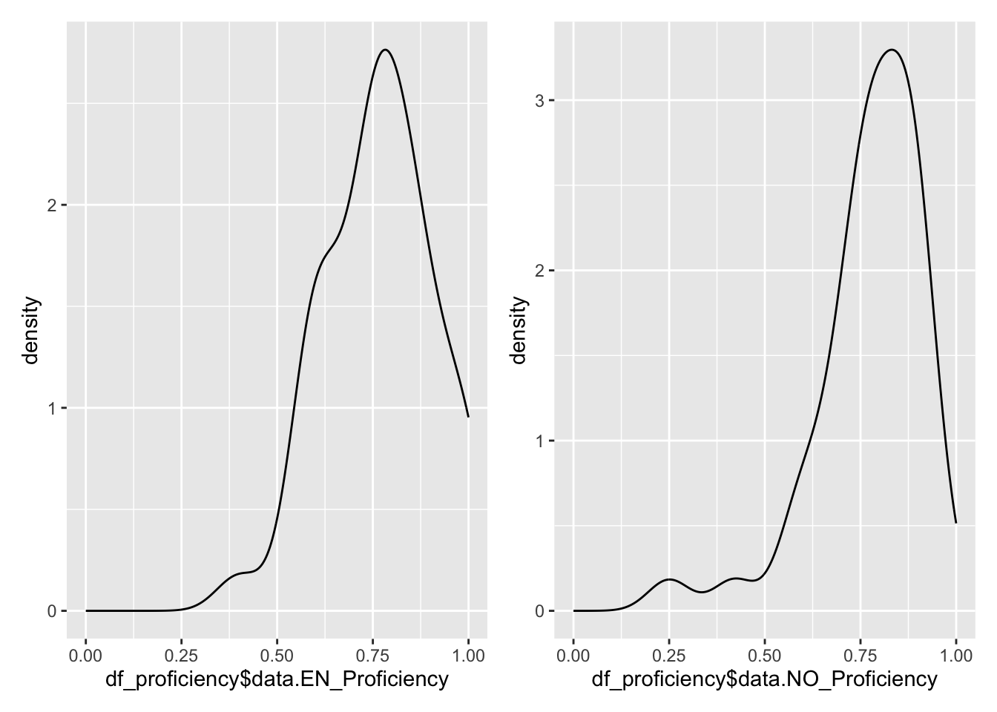
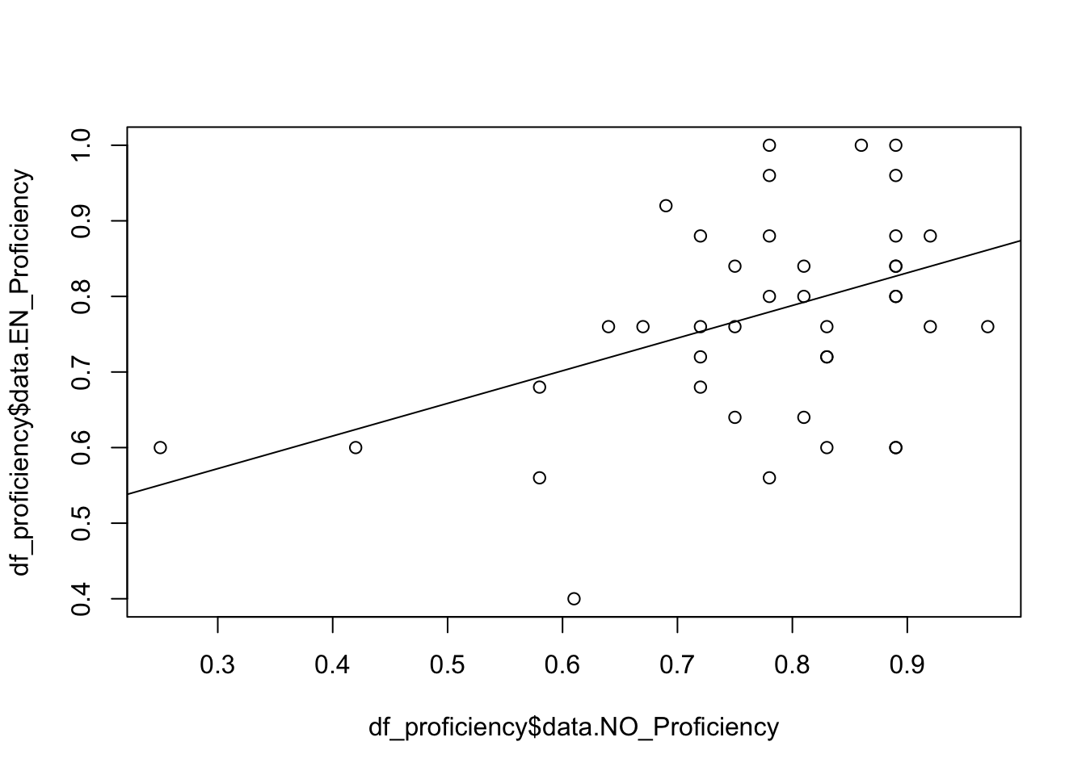
L1 Polish proficiency scores in L2 English and L3 Norwegian
L2 English proficiency
L3 Norwegian proficiency
Notes:
Proficiency score were collected using a languistic proficiency test; EN test ranging from A2-C1 proficiency? Norwegian scale corresponding to A2-B2? VERIFY THE SCALING OF PROFICIENCY TESTS

Slide 13
Methodology (sibilant tokens)
20 tokens per target phone per participant (n_{learner} = 7800, n_{control} = 2000)
Polish: /s/, /ʃ~ʂ/, /ɕ/ (<s>, <sz>, <si> )
English: /s/, /ʃ/ (<s>, <sh> )
Norwegian: /s/, /ʃ~ʂ/, /ç~ʂ~ɕ/ (<s>, <rs>,<sj>,<skj>, <kj>)
Notes:
Comment that we have more for norwegian /S/ to tease apart the influence of orthography (during presentation)

Slide 14
Methodology (sample tokens per phoneme)
Language | Phoneme | Word | Sentence
PL | s₁ | rysuje | Pisarz rysuje słowami.
PL | sz | myszy | Sowy słyszą myszy z daleka.
PL | si | prosi | Szofer prosi o klucze do samochodu.
EN | s₂ | viruses | The doctor sees viruses with the microscope.
EN | sh | fishing | Our family goes fishing twice a year.
NO | s₃ | leser | De leser nyheter i sosiale medier.
NO | rs | forsøkte | Jeg forsøkte å reparere bilen min selv.
NO | sj | drosje | Jeg tok en drosje til flyplassen.
NO | skj | teskje | Jeg vil ha en teskje sukker i kaffen min.
NO | kj | bekjente | Jeg traff min gamle bekjente på gaten.

Slide 15
Procedure (sentence creation)
Selected 20 natural words for each phoneme across a variety vowel contexts
For Norwegian we prioritised high frequency words that would likely be recognised by the L3 Norwegian learners
using a variety of resources, i.e., high frequency lists containing the top 6000 words , learner textbooks, etc.
Embedded away from the edges (2 or more syllables)

Slide 16
Methodology (carrier sentences)
All stimuli consisted of naturalistic sentences in Norwegian, English and Polish
Generated via ChatGPT (ChatGPT, personal communication, March 01, 2023)
Evaluated and modified by native speakers of each respective language
Notes:
Credit goes to
Norwegian: Kjetil Berge, Marit Westergaard
English: Tristan Czarnecki-Verner
Polish: Zuzanna Cal, Jarosław Weckwerth, Magdalena Wrembel

Slide 17
Methodology (stimuli presentation)
Stimuli were presented in 3 language blocks (L3 Norwegian > L2 English > L1 Polish)
Sentence lists were randomized for each participant
Target sentences (Total: n=200; PL: n=60; EN: n=40; NO: n=100) were intermixed with sentences from a VOT investigation (Total: n=305; PL: n=120; EN: n=120; NO: n=165) as distractors.
Notes:
How many sentences did zuza have for her VoT study?

Slide 19
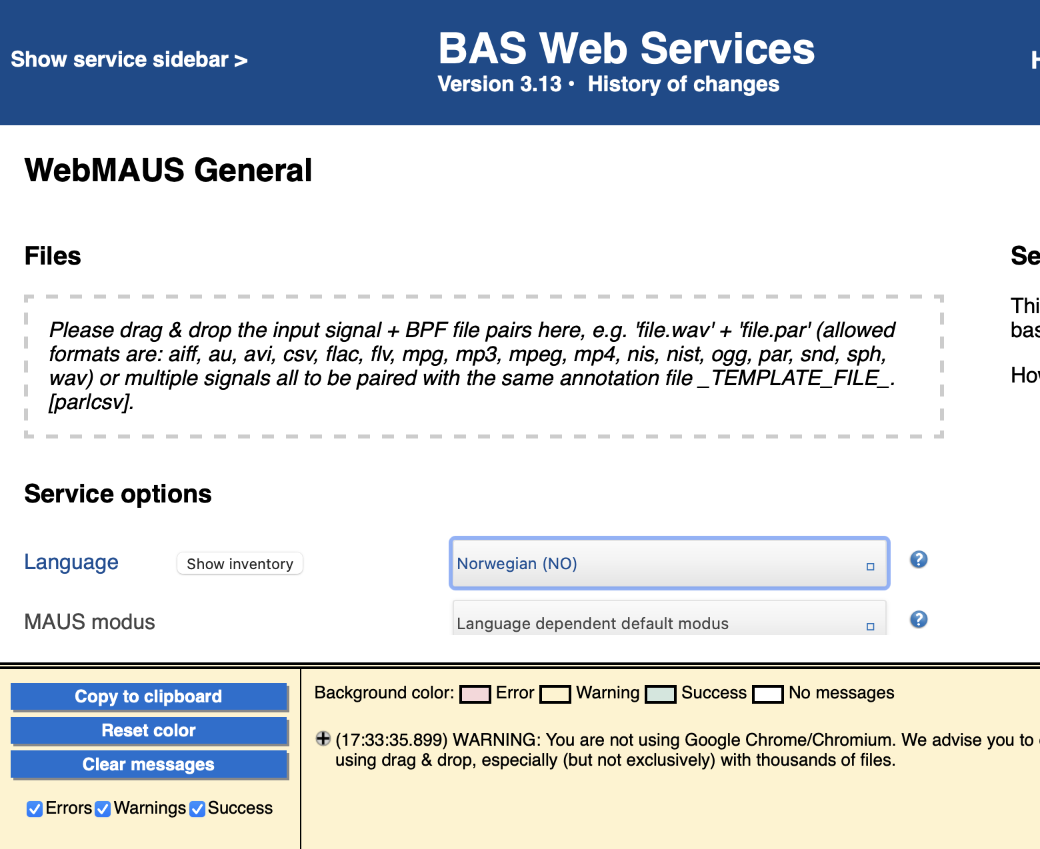
Data Processing (force alignment)
Force aligned participants’ audio files with their corresponding text files using BAS
Clarin BAS Web Services: WebMAUS General (Kisler, Reichel, and Schiel, 2017)

Slide 20
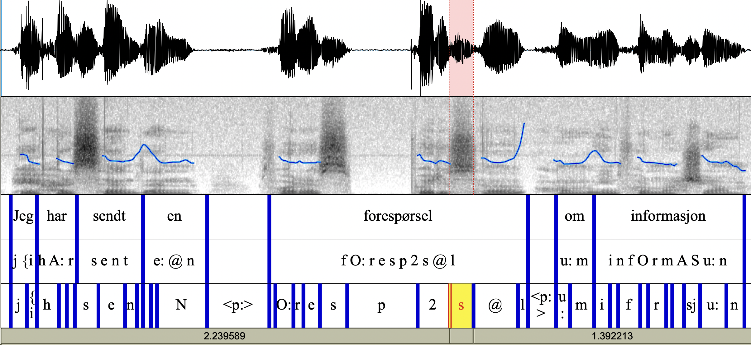
Data Processing (Norwegian Sample)

Slide 21
Extracting acoustic details
spectral moments from participants’ production recordings using a pre-existing script (2013, Christian DiCanio, Haskins Laboratories & SUNY Buffalo.)

Slide 22
Results

Slide 23
Q1. Do L3 Norwegian learners have distinct categories for /ʃ~ʂ/ across their three languages? (…and do these differ from categories in L1 Norwegian controls?)
Notes:
Verify that title matches title in plm schedule

Slide 24
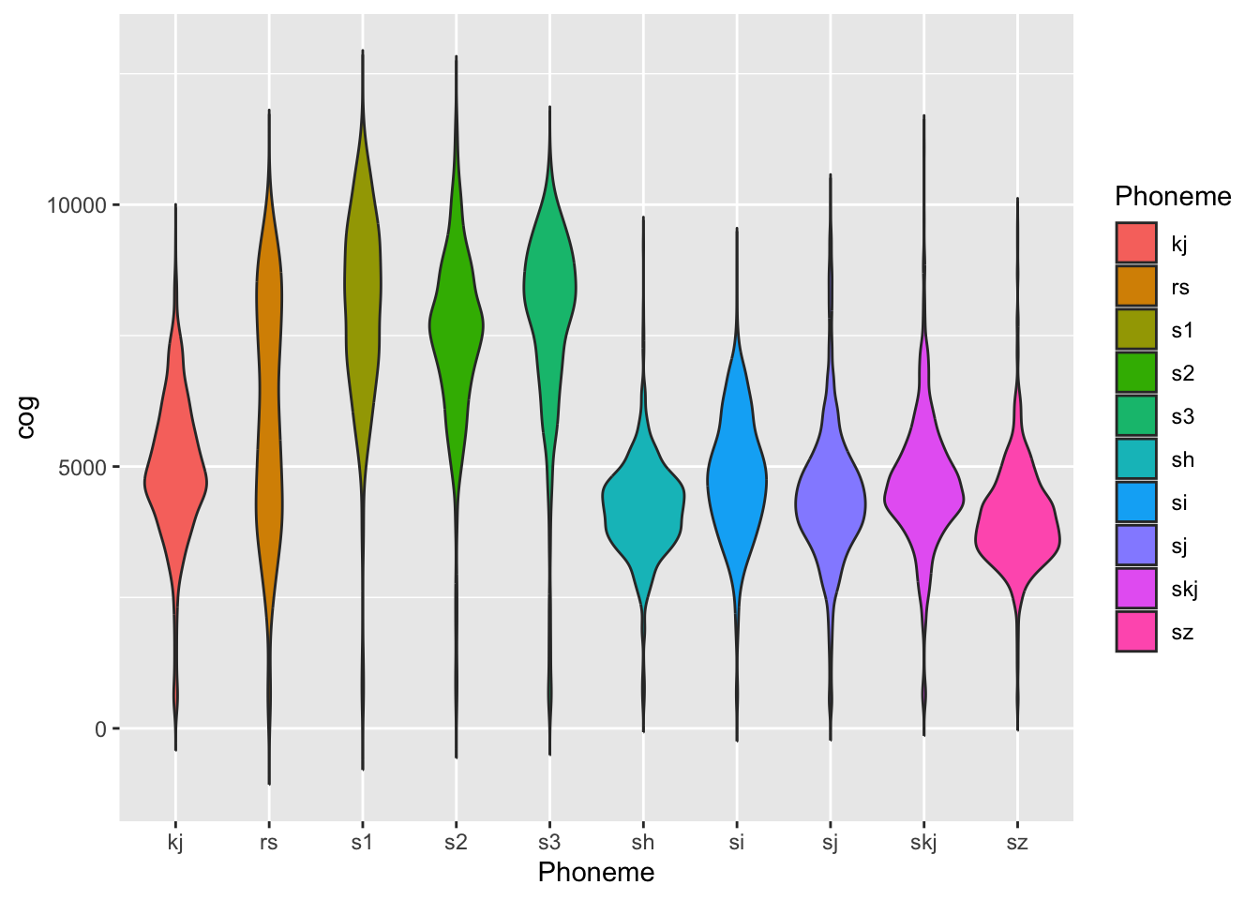
CoG vs Phoneme (/ʃ~ʂ/)
L1 Polish Learner Group L1 Norwegian Controls
Notes:
Si – sj – skj overly similar; suggesting transfer since <si> is palatal /ś/ and <sj> and <skj> should be /S/
Assuming:
English is post alveolar
Polish and Norwegian are retroflex,
Do not comment about the bimodality of the norwegian /rs/, some speakers had uvular /r/ + /s/; they should be excluded for the article (KL????, SH????, )
(Potentially remove them from the ‘r’ analysis prior to PLM but more likely before publication submission)
Magda suggests I talk to Witosz to schedule an appointment to exclude uvular /r/ norwegian controls (to see if it affects the /rs/ violin plot)

Slide 25
Within-group pairwise comparisons of L1 Polish postalveolar sibilants by CoG
L1 Polish /ʃ~ʂ/ (<sz>) significantly differs from L3 Norwegian /ʂ~ʃ/ (<skj>, <sj>, & <rs>)
No significant differences between L1 Polish /ʃ~ʂ/ and L2 English /ʃ/
⬅
⬅
⬅
⬅
Notes:
***LARGE DISCLAIMER*** This is all based on a forced alignment which does have its errors, we have not yet corrected the errors, we are still deciding whether to correct the alignments by hand, or throw out the outliers in prior to statistical reanalysis.
We must take these results with a grain of salt because

Slide 26
Within-group pairwise comparisons of L1 Norwegian postalveolar sibilants by CoG
L1 Norwegian /ʂ~ʃ/ does not* differ from L2 English /ʃ/ (for orthographic sequences: <skj>, <rs>)
…but L1 <sj> significantly differs from L2 <sh> /ʃ/
⬅
⬅
⬅
Notes:
sh-skj: not significant
Sh-sj: significant
sh-rs: not significant
Skj-sj: not significant
Skj-rs: significant
Sj-rs: highly significant

Slide 27
Between group pairwise comparison for post-alveolar sounds
Significant differences between:
L1-L3 NO <rs> /ʂ~ʃ/
L1-L3 NO <skj> /ʂ~ʃ/
L1-L3 NO <sj> /ʂ~ʃ/
L2 EN <sh> /ʃ/
Notes:
This should be a table right?

Slide 28
Q2. Does transfer occur between the phonological systems of the three languages?
Notes:
Verify that title matches title in plm schedule

Slide 29
Q2. Does transfer occur between the phonological systems of the three languages?
Yes*, and it seems to depend on proficiency level and phoneme/orthography.
Notes:
Chaotically.

Slide 30
LME Norwegian Proficiency
nullmodel: cog ~ Phoneme + EN_Proficiency + (1 | ID)
fullmodel1: cog ~ Phoneme + NO_Proficiency + Phoneme:NO_Proficiency + EN_Proficiency + (1 | ID)
npar AIC BIC logLik deviance Chisq Df Pr(>Chisq)
nullmodel1 24 148881 149051 -74417 148833
fullmodel1 172 148137 149355 -73897 147793 1040 148 < 2.2e-16 ***
Signif. codes: 0 '***' 0.001 '**' 0.01 '*' 0.05 '.' 0.1 ' ' 1

Slide 31
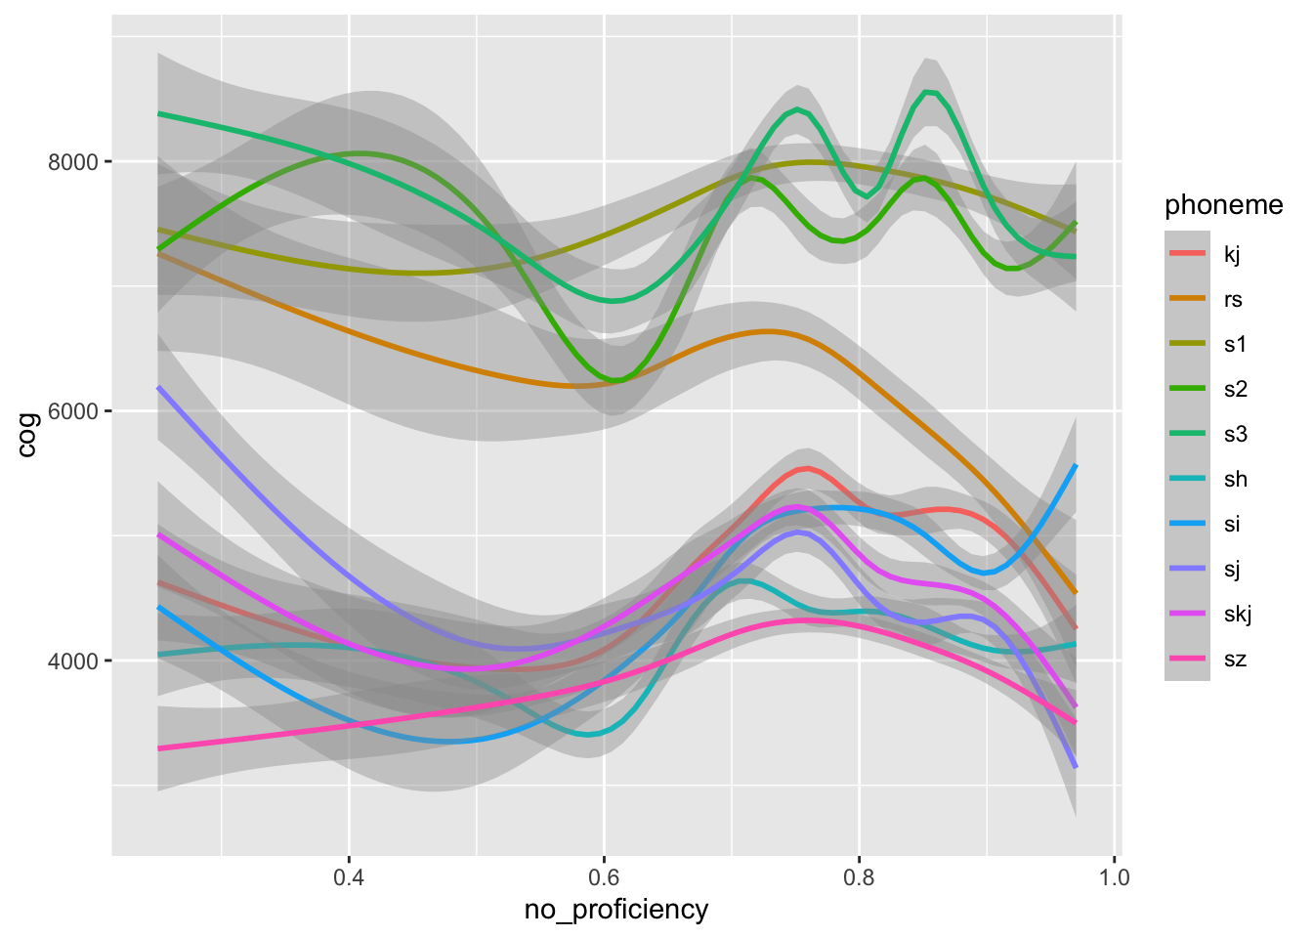
Phoneme trajectories of L1 Polish learners of Norwegian across proficiency
L3 <rs> at various levels of Norwegian proficiency

Slide 32
Effect of phoneme on CoG across Norwegian proficiency levels (<rs>)
L1 Polish Learners L1 Norwegian Controls
Notes:
Put letter labels under each tick for each box (there appears to be a leveling effect; in higher proficiency people, they are developing a system where all of the laminals fall into one basket); in lower proficiency spelling seems to be the driving force

Slide 33
Phoneme trajectories of learners with and without Norwegian controls
L1 Polish L1 Polish + L1 Norwegian

Slide 34
Phoneme trajectories of learners with and without Norwegian controls
L1 Polish L1 Polish + L1 Norwegian
Low Proficiency
High Proficiency
Native Proficiency
Notes:
Talk to Kamil (ask him whether the points from norwegian should be imposed onto the model right image, or should they be added as points to the left image?)
Keep the left Learner groups and add the dot points from the Native controls
Convert to bark scale? / or normalize using log transform? It looks like the space between coronal phonemes is similar to the space between laminal+ palatal but that is not true perceptually… So this figure could be misleading

Slide 35
Q3. Is Norwegian /ç/ (<kj>) distinct from Polish /ɕ/ (<ś/si>) in learners, or is there one-to-one mapping?
Notes:
Verify that title matches title in plm schedule

Slide 36
Q3. Is Norwegian /ç/ (<kj>) distinct from Polish /ɕ/ (<ś/si> in learners, or is there a one-to-one mapping?
Phoneme by CoG in L3 Norwegian learners

Slide 37
Within group pairwise comparisons (L3:/ç/ vs L1:/ɕ/) in L1 Polish learners of Norwegian
Slight differences in CoG for L3 [ç] <kj> and L1 [ɕ] <si>
Notes:
Keep

Slide 38
Effect of phoneme and proficiency on CoG in L1 Polish learner group
Effect of Norwegian proficiency on phonemes in learner group
A. Possibly?* There does seem to be a correlation between proficiency and in CoG for /ç/ and /ɕ/.
Notes:
*Depends on the statistical comparison of kj with si

Slide 39
Q3. CoG of /ç/ (<kj>) and /ɕ/ (<ś/si> by Norwegian proficiency
L1 Polish learner group
L1 Norwegian controls
Notes:
*Depends on the statistical comparison of kj with si

Slide 40
Within group L1 Norwegian pairwise comparisons (L1 /ç/ vs L1 /ʃ~ʂ/)
Significant differences in CoG between palatal [ç] and postalveolar [ʃ~ʂ] (<sj>, <skj>)
Notes:
This should be a table right?

Slide 41
Between group pairwise comparison: CoG of palatals in L1 Polish learners and L1 Norwegian controls
Significant differences between:
L1-L3 NO <kj>
Notes:
This should be a table right?

Slide 42
Q4. What are the acoustics of /s/ across the three languages of learners?
Notes:
Verify that title matches title in plm schedule

Slide 43
CoG vs Phoneme (/s/)
Learner Group Native Controls
Notes:
Si – sj – skj overly similar; suggesting transfer since <si> is palatal /ś/ and <sj> and <skj> should be /S/
Assuming:
English is post alveolar
Polish and Norwegian are retroflex,
Do not comment about the bimodality of the norwegian /rs/, some speakers had uvular /r/ + /s/; they should be excluded for the article (KL????, SH????, )
(Potentially remove them from the ‘r’ analysis prior to PLM but more likely before publication submission)
Magda suggests I talk to Witosz to schedule an appointment to exclude uvular /r/ norwegian controls (to see if it affects the /rs/ violin plot)

Slide 44
Pairwise comparisons (/s/)
Notes:
Keep

Slide 45
Pairwise comparisons (/s/)
Notes:
Keep but make it brief

Slide 46
Between group pairwise comparison: CoG of coronals in L1 Polish learners and L1 Norwegian controls
No significant differences between:
L2 English /s/
L1-L3 Norwegian /s/
Notes:
This should be a table right?

Slide 47
Q5. What are the influences of spelling (with three different spellings for Norwegian /ʃ/) & proficiency in both English and Norwegian?
Notes:
Verify that title matches title in plm schedule

Slide 48
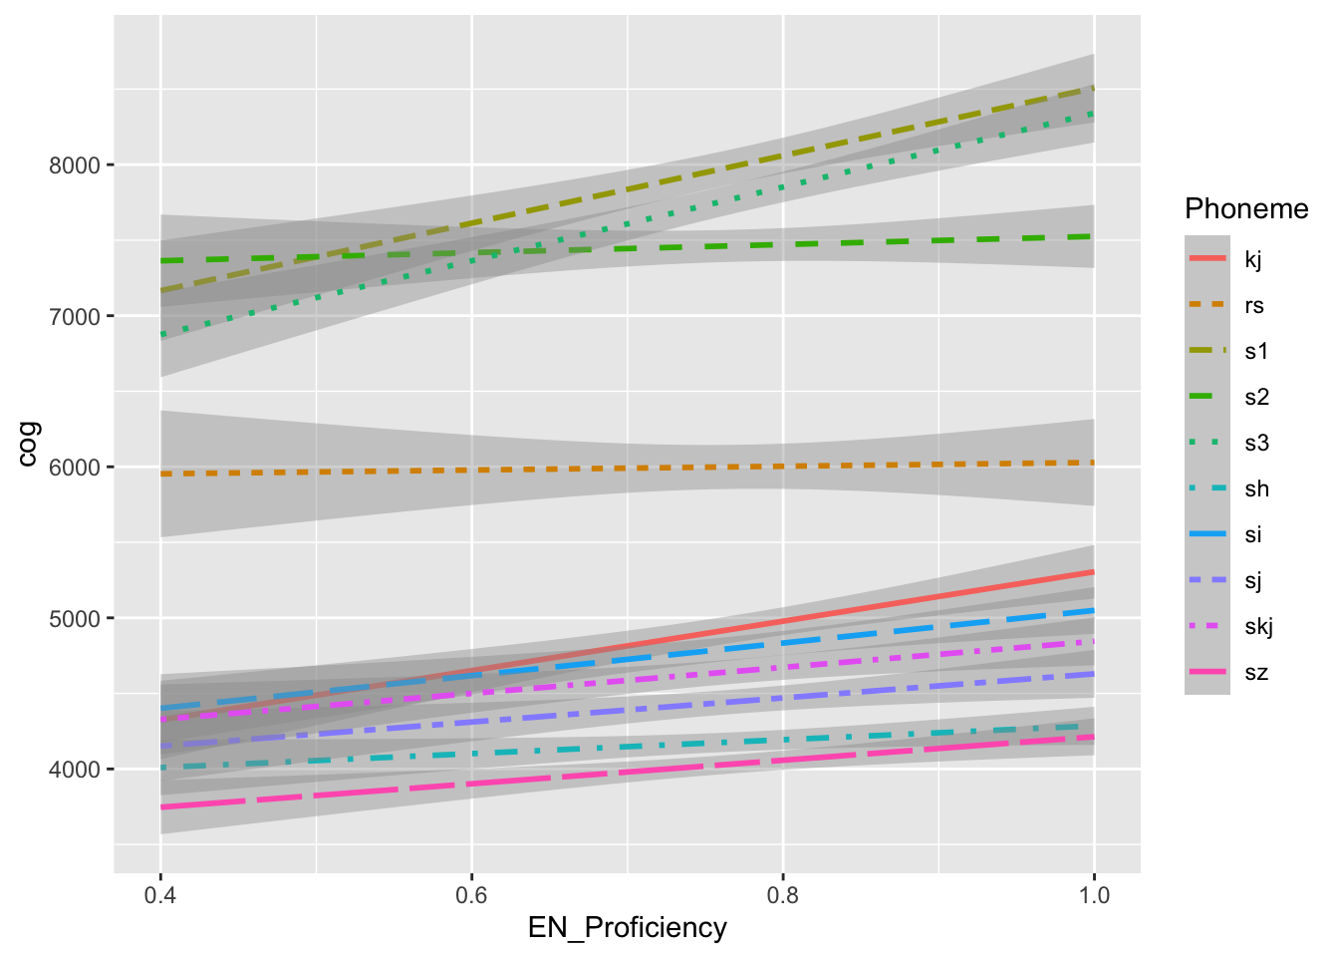
L1 Polish: CoG vs L2 EN proficiency across phonemes
(Without data points) (With points)
Notes:
Assuming:
English is post alveolar
Polish and Norwegian are retroflex,
Plot L1 Norwegian once you have coded 9/11/13 of the EN proficiencies

Slide 49
CoG vs L2 EN proficiency across phonemes
Learner Group
Places of Articulation:
Dental
Alveolar
Palatal
postalveolar
Notes:
Assuming:
English is post alveolar
Polish and Norwegian are retroflex,
Plot L1 Norwegian once you have coded 9/11/13 of the EN proficiencies

Slide 50
CoG vs L2 EN proficiency across phonemes
Learner Group Native Controls

Slide 51
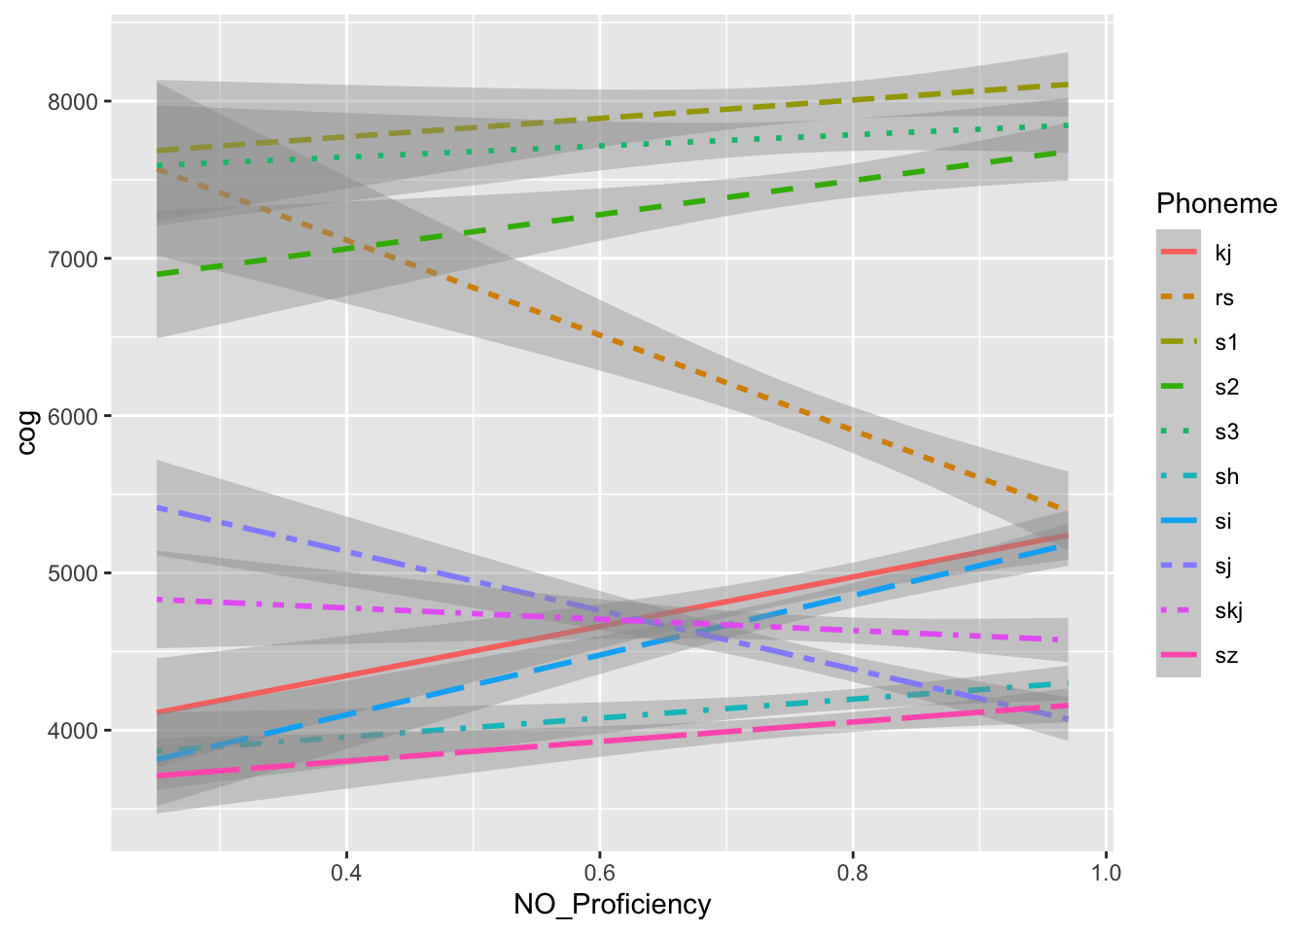
Phoneme trajectories by Norwegian proficiency
Learner Group Native Controls
Notes:
Fix the scaling

Slide 52
Phoneme trajectories by Norwegian proficiency
L1 Polish learners L1 learners + Norwegian ccontrols
Low proficiency
High proficiency
Native proficiency
Notes:
Issue with rs trajectory: it is a representation nof the ratio of /s/ to /S/; need to verify from L1NO speakers that all 20 /rs/ words were pronounced as /S/ lexically, and not /rs/ lexically. If some were pronounced as /rs/ then that would raise the cog of /<rs> above the cog range for /S/ towards /s/

Slide 53
Discussion
Q1. Do learners have distinct categories for /ʃ~ʂ/ (the non-alveolar, non-palatal sibilants) across the three languages?
Possibly? One caveat is spelling, the other is proficiency (1 on the test equates to roughly B1~B2; 1 for Learners =/= 1 for Norwegian)
There are statistically significant differences
Q2. Does transfer occur between the phonological systems of the three languages?
Yes, with caveats. It depends on proficiency, and phoneme/orthography.

Slide 54
Discussion
Q3. Is L3 Norwegian /ç/ distinct from L1 Polish /ɕ/, or is there a one-to-one mapping, as described for Polish learners of German (Morciniec & Prędota, 2005)?
They are acoustically distinct (p <0.039).Whether or not learners are aware (they perceive) that the sibilant productions are distinct in the separate languages of learners.
Q4. What are the acoustics of /s/ across the three languages of the multilingual learners?
The evidence seems to suggest that Polish and Norwegian are more acoustically similar (dental) whereas the CoG of English /s/ is significantly lower, (possibly, alveolar)

Slide 55
Discussion
Q5 What is the influence of spelling (with three different spellings for Norwegian /ʃ/), vowel context, and proficiency in both English and Norwegian?
In the non-linear regression, the rust-orange-brown line suggested that there was an orthographic effect /s/ at low proficiency, and /ʃ/ at high proficiency levels, converging towards the native controls which preferred /ʃ/
Yes. There is inference from spelling (Polish <rs> /rs/ vs Norwegian <rs> /ʃ/; Polish <si> /ɕ/ vs Norwegian <sj> <skj> /ʃ~ʂ/ and yes, it improves with exposure/language experience.

Slide 56
References
Czaplicki, B., Żygis, M., Pape, D., & Jesus, L. M. (2016). Acoustic evidence of new sibilants in the pronunciation of young Polish women. Poznan Studies in Contemporary Linguistics, 52(1), 1-42.
van Dommelen, W. A. (2019). IS THE VOICELESS PALATAL FRICATIVE DISAPPEARING FROM SPOKEN NORWEGIAN?. In Proceedings of the 19th International Congress of Phonetic Sciences, Melbourne, Australia.
Jassem, W. (2003). Polish. Journal of the international Phonetic Association, 33(1), 103-107.
Jongman, A., Wayland, R., & Wong, S. (2000). Acoustic characteristics of English fricatives. The Journal of the Acoustical Society of America, 108(3), 1252-1263.
Kisler,T., Reichel, U., & Schiel, F. (2017). Multilingual processing of speech via web services. Computer Speech & Language, Volume 45, September 2017, p. 326–347.
Kristoffersen, G. (2000). The phonology of Norwegian. OUP Oxford.
Lee, S., & Lee, S. (2020). Spectral analysis of English fricatives /s/ and /ʃ/ produced by people with profound hearing loss. Clinical Archives of Communication Disorders, 5(3), 147-153.
Morciniec, N., & Prędota, S. (2005). Podręcznik wymowy niemieckiej [A handbook of German pronunciation]. Warsaw: Wydawnictwo Naukowe PWN.
Nirgianaki, E. (2014). Acoustic characteristics of Greek fricatives. The Journal of the Acoustical Society of America, 135(5), 2964-2976.

Slide 57
Acknowledgement
This research is supported by a grant from the Polish National Science Center (NCN) OPUS-19-HS (UMO-2020/37/B/HS2/00617) CLIMAD: “Cross-linguistic influence in multilingualism across domains: Phonology and syntax”

Slide 58
Thank you! Dziękuję! Tusen takk!
Notes:
Check zuza’s paper / presentation to include

Slide 59
Supplemental Slides

Slide 60
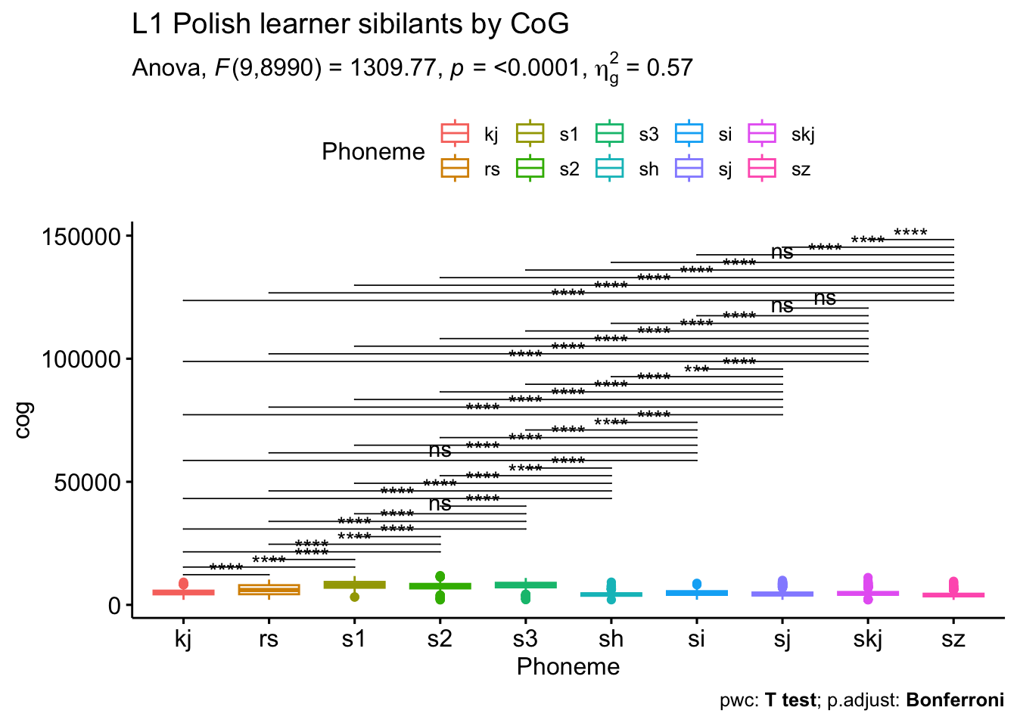
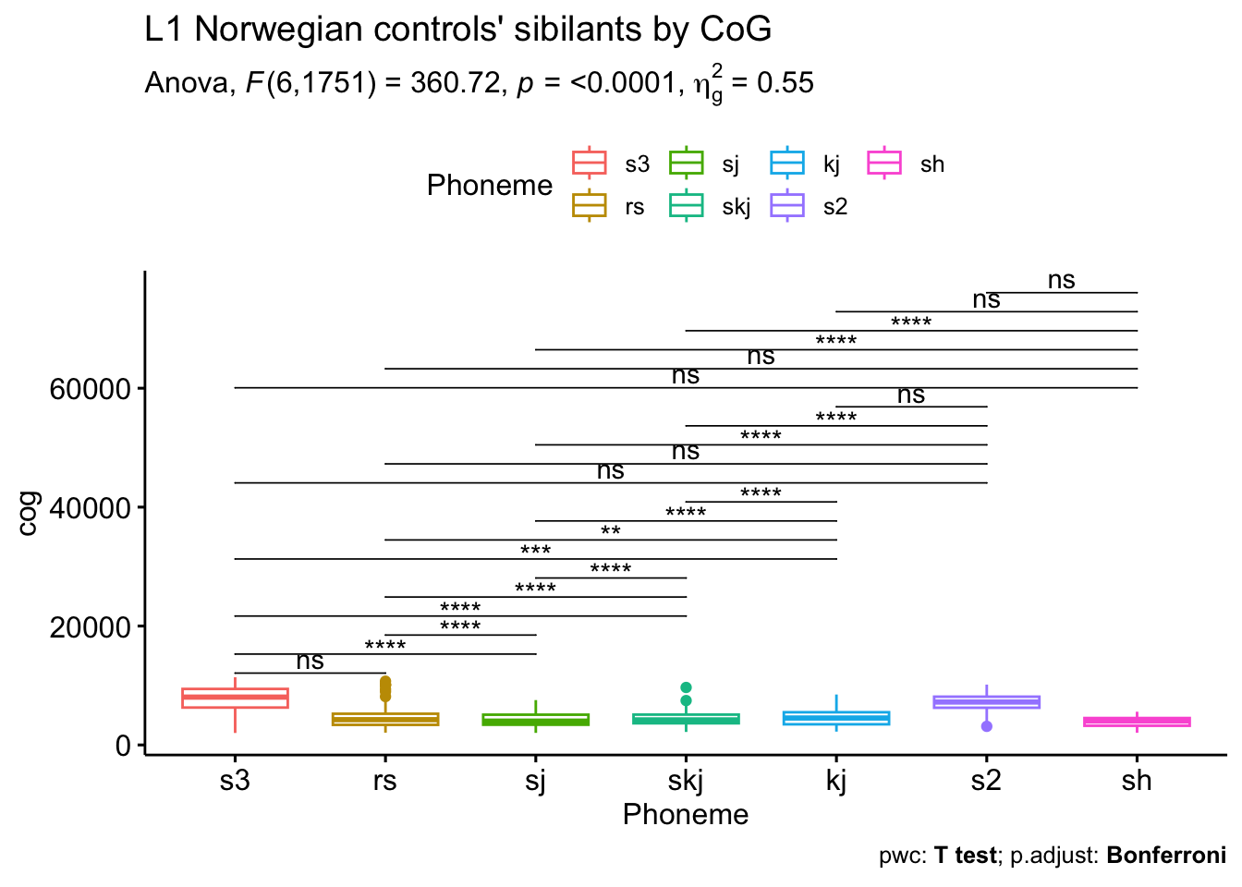
Figures if we exclude outliers <2000 Hz

Slide 61
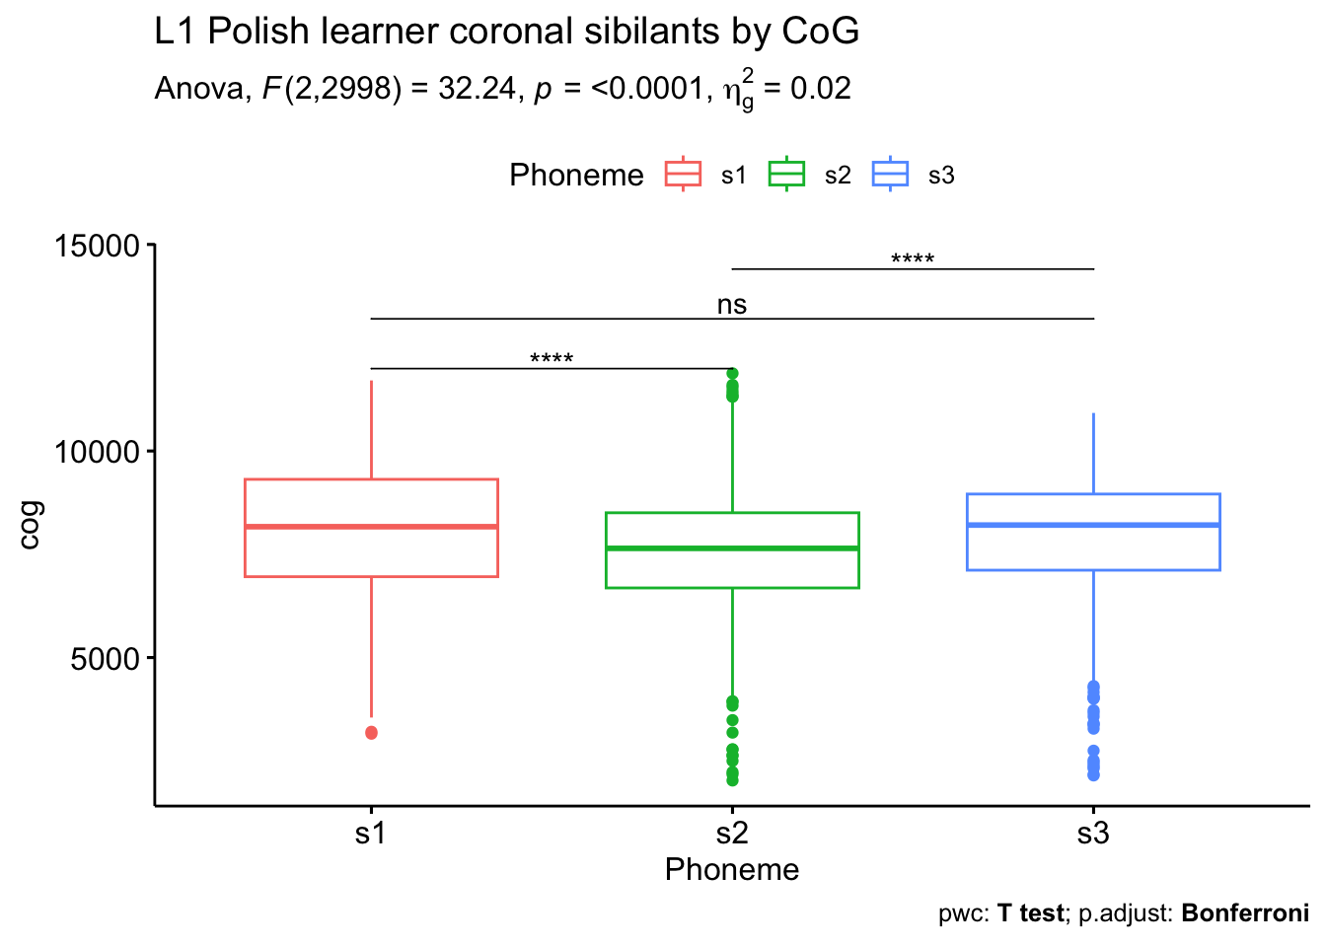
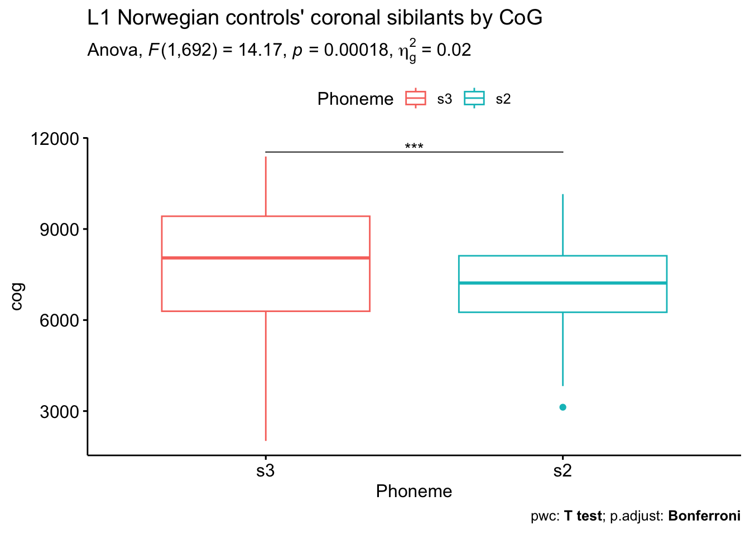
Figures if we exclude outliers <2000 Hz

Slide 62
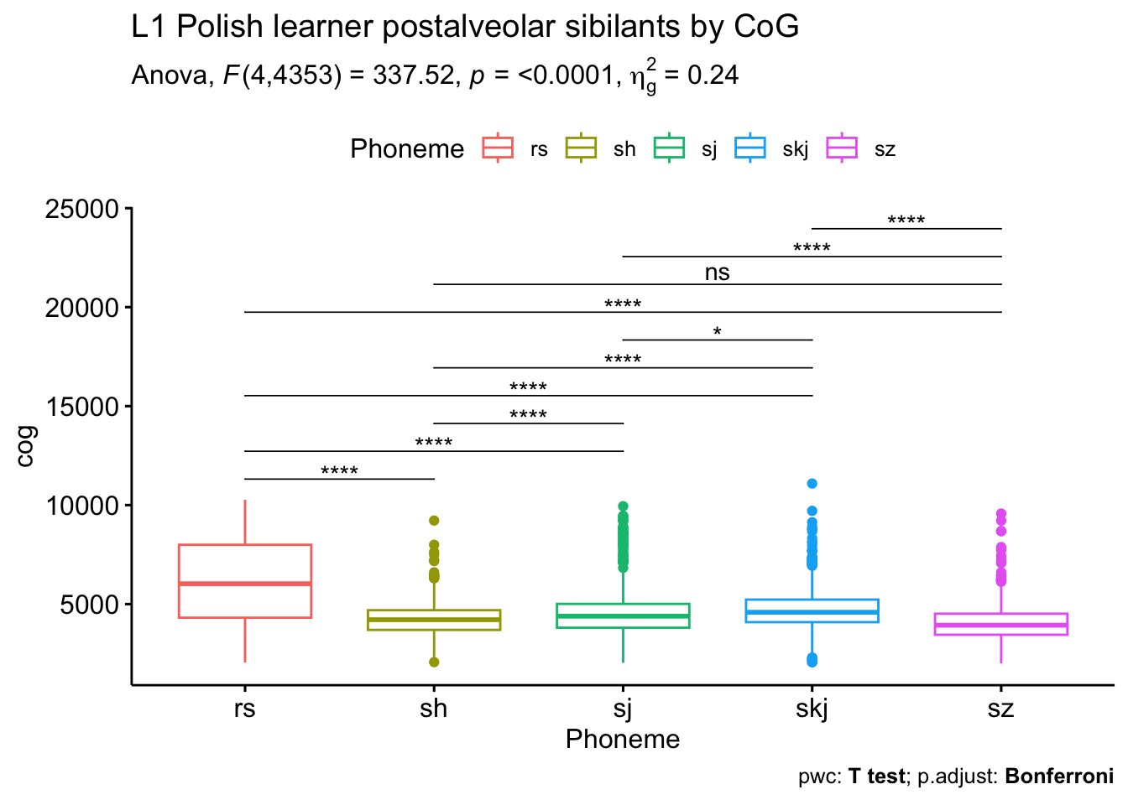
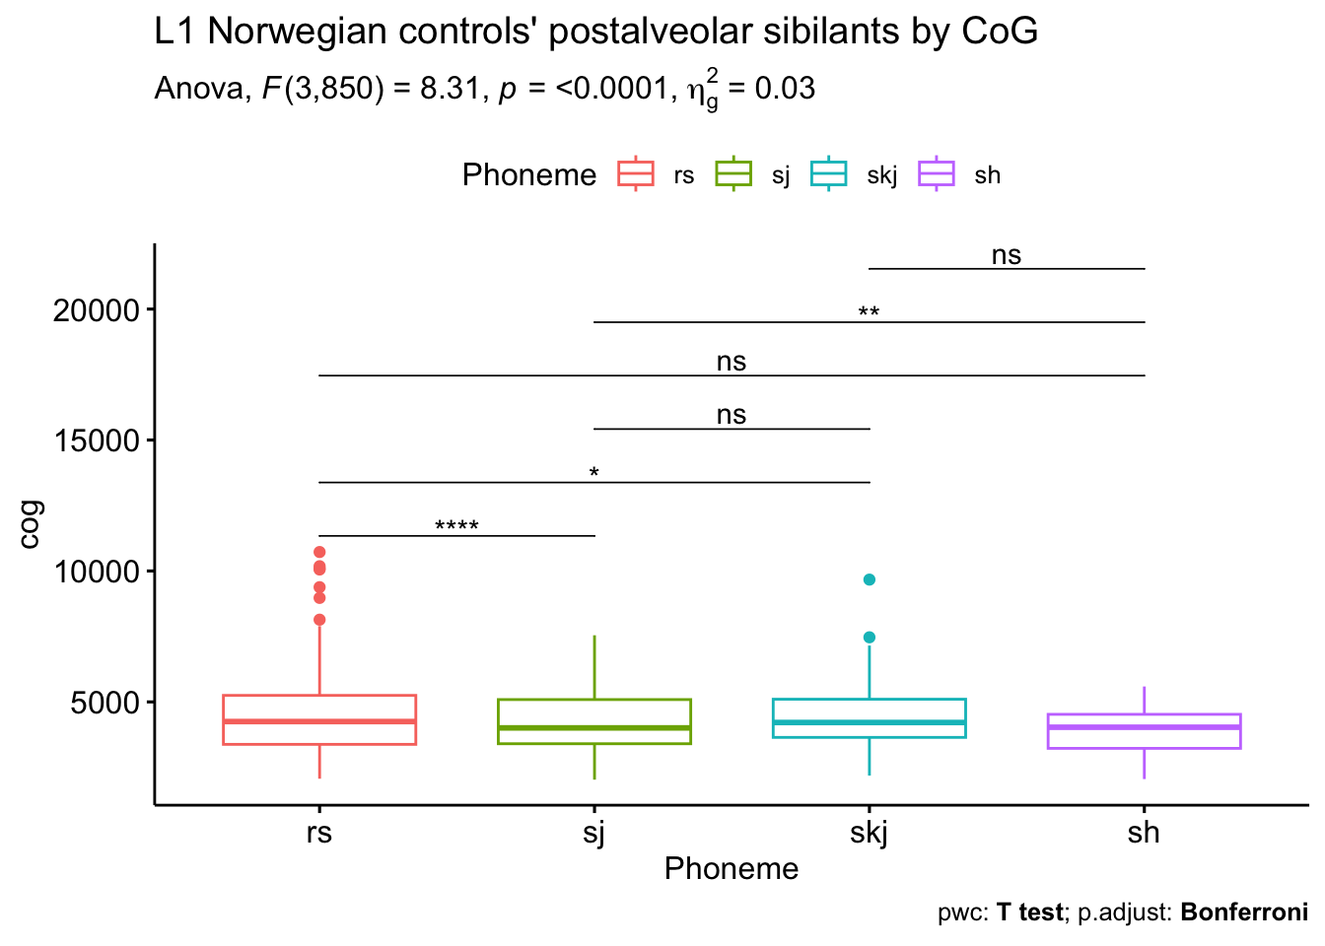
Figures if we exclude outliers <2000 Hz

Slide 63
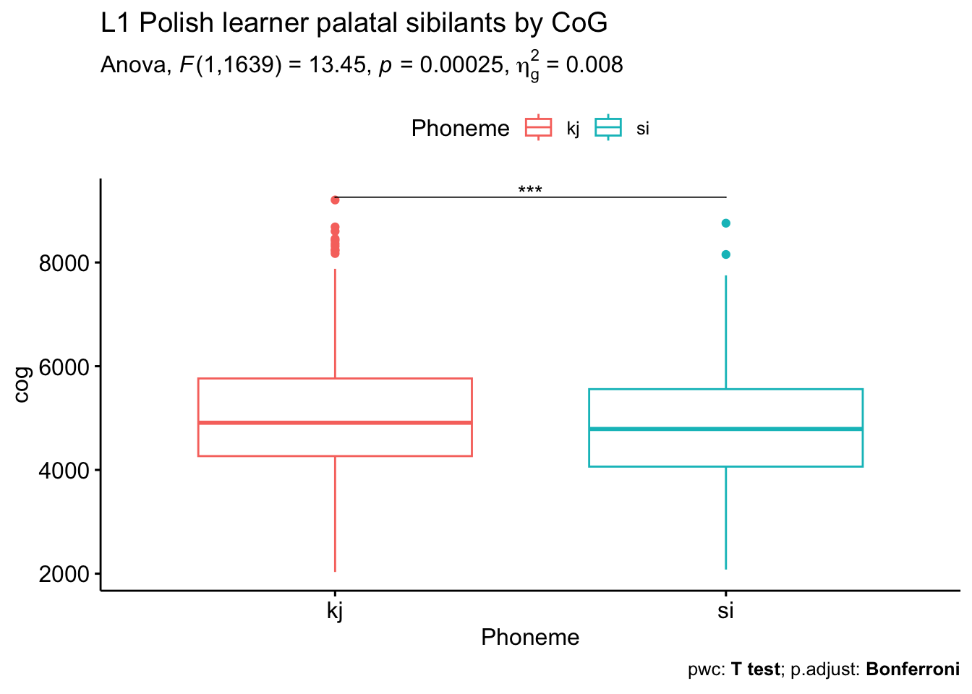
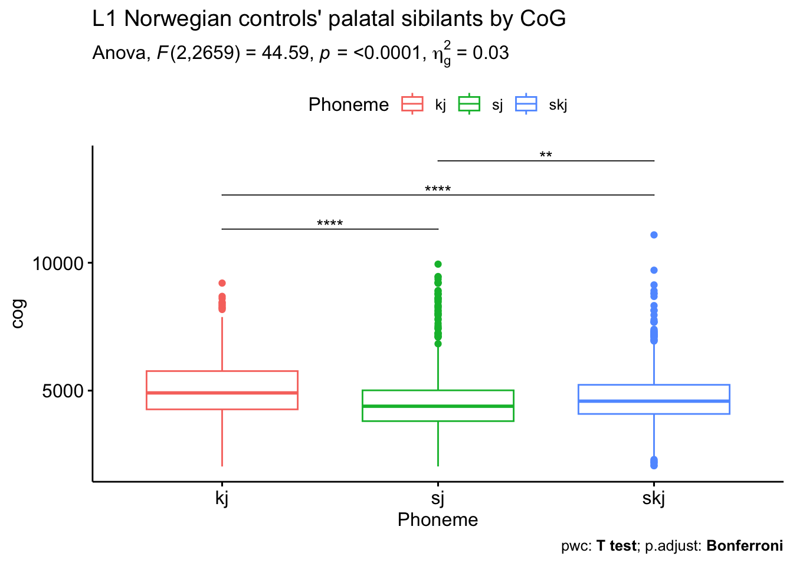
Figures if we exclude outliers <2000 Hz

Slide 64
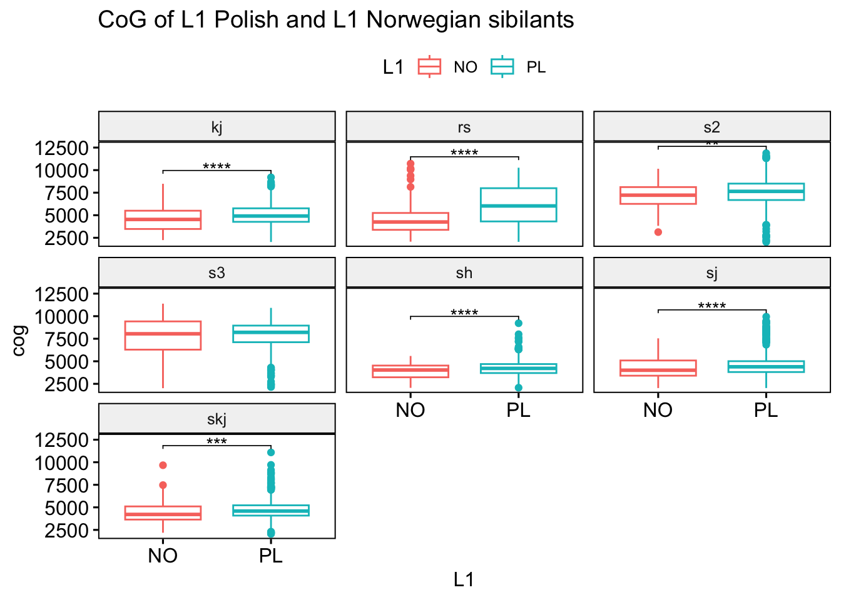
Figures if we exclude outliers <2000 Hz

Slide 65
Figures if we exclude outliers <2000 Hz

Slide 66
Figures if we exclude outliers <2000 Hz

Slide 67
Figures if we exclude outliers <2000 Hz

Slide 68
CoG vs Phoneme (/ʃ~ʂ/)
L1 Polish learners L1 Norwegian controls
Notes:
What
Fix the scaling between L1PL and L1NO; Convert from Hz into log / bark scale; !!! Include *** significance indicators!!!

Slide 69
CoG vs Phoneme (/s/)
Learner Group Native Controls
Notes:
Say that it is alphabetical
Fix the scaling between L1PL and L1NO; Convert from Hz into log / bark scale; !!! Include *** significance indicators!!!

Slide 70
Solutions to misaligned segments
Manual corrections to textgrids (very time consuming)
Script modifications to textgrids: add a 4th for grapheme
Exclude outliers in statistical analysis

Slide 71
Force Alignment issues in L2/L3
Misalignments occurred due to pauses and repeated syllables/words which interfered with force alignment (and segment extraction)
“ekstra [stua]_{error} stue”: resulted in a misalignmed pause during the first ‘s’ in ‘ekstra’
This misalignment does not influence the analysis but some will

Slide 72
L2/L3 scores from language proficiency questionnaire

Slide 73
L2/L3 scores from language proficiency questionnaire
AB7731AB

Slide 74
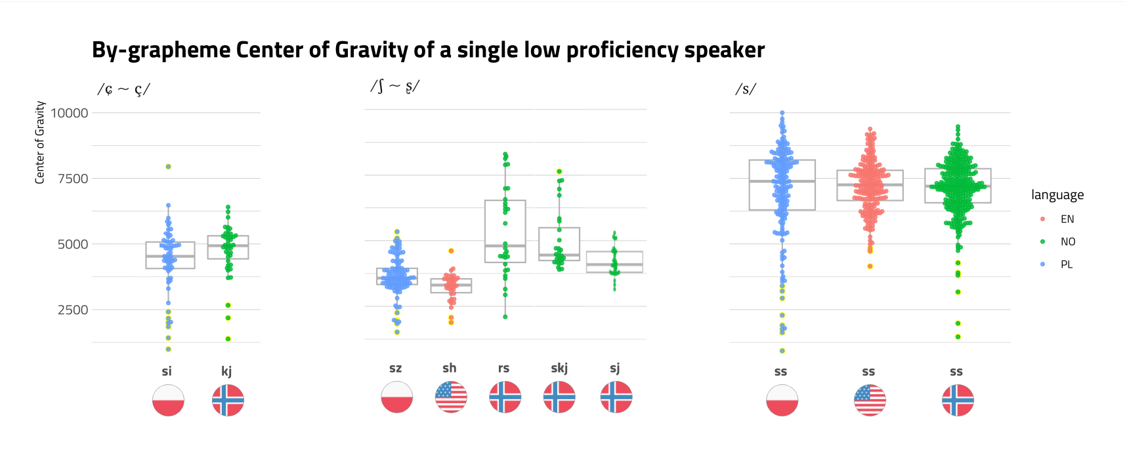
Sibilants produced by a low Proficiency learner of Norwegian (AB7731AB)
(spectral moments extracted via praat script:
2013, Christian DiCanio, Haskins Laboratories & SUNY Buffalo)
(Figure by Kamil Kaźmierski)

Slide 75
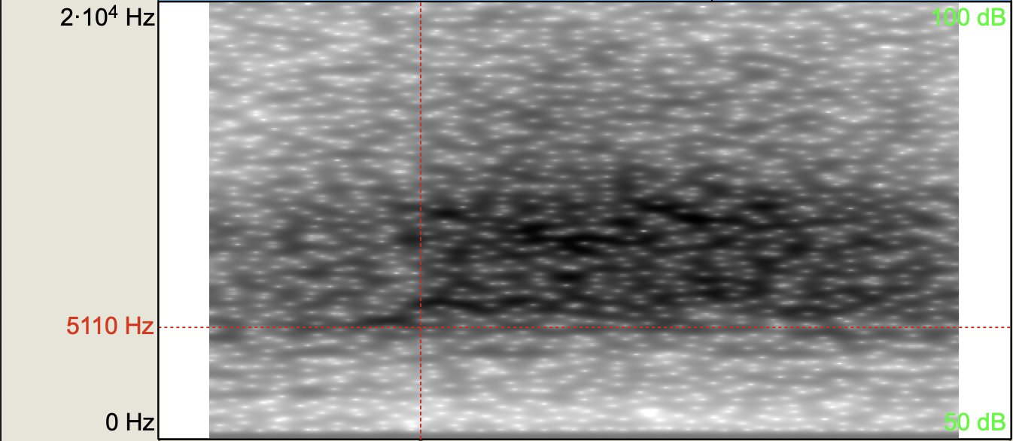
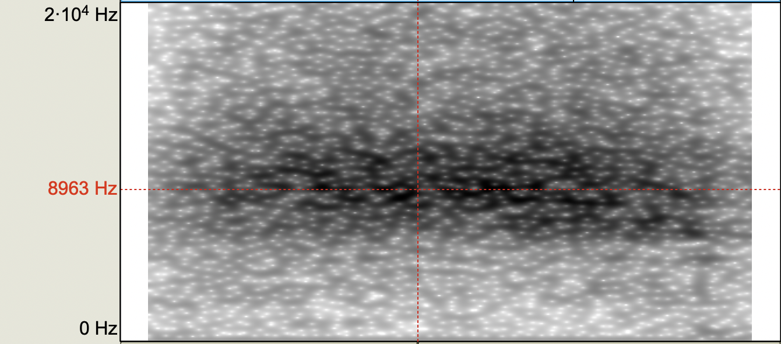
AB7731AB: /s/
L1SS: zasady (8kHz ~ 11kHz band, peak at 10 kHz)
L2SS: viruses (5 kHz ~ 11kHz band, peaks at 6 kHz and 10 kHz)
L3SS: leser (6.5 kHz ~ 11kHz band, peak at 9 kHz)
Polish /s/
English /s/
Norwegian /s/

Slide 76
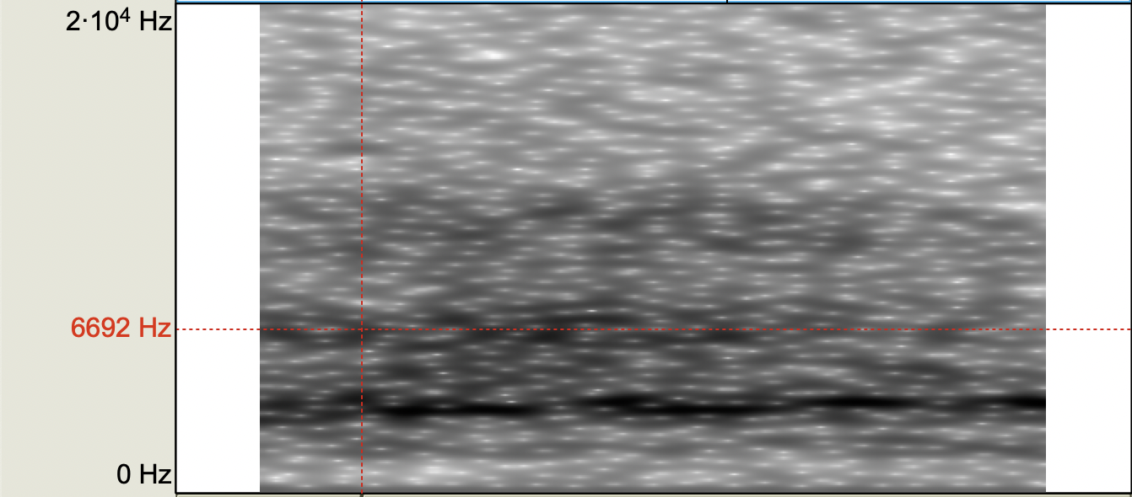
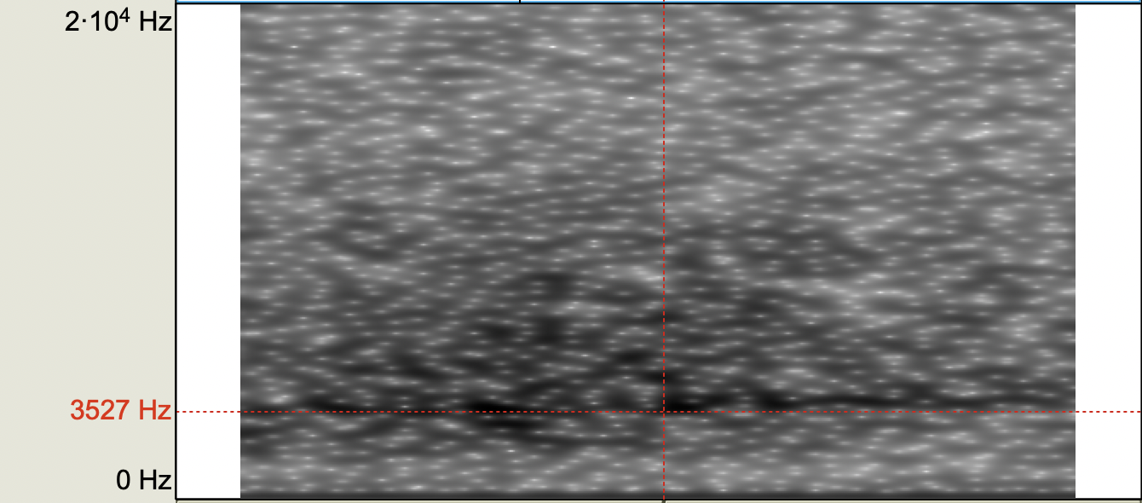
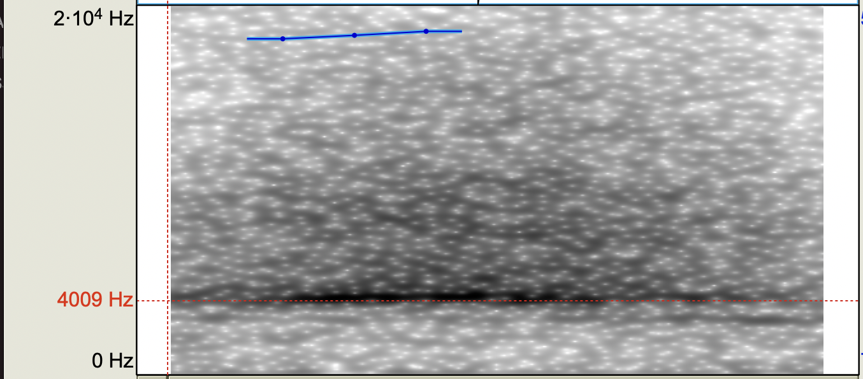
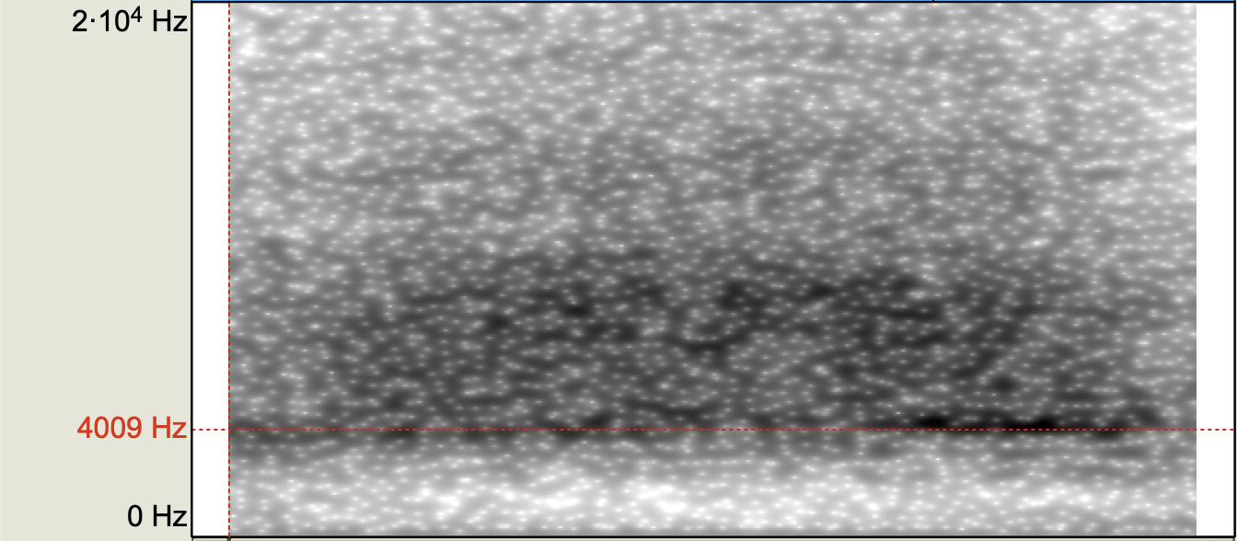
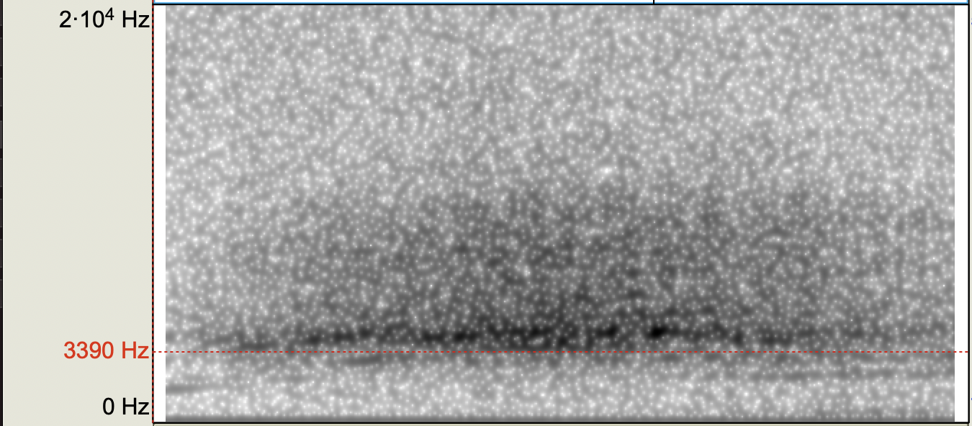
AB7731AB: /ʃ~ʂ/
L1SZ: wyszedł (2.7 kHz ~ 11 kHz band, peaks at 3.4 kHz, 6.7 kHz, 11 kHz)
L2SH: crashes ( 2.5 kHz ~ 10 kHz band, peak at 3.5 kHz, spread)
L3RS: universell (3.9 kHz ~ 10 kHz band, peak at 4 kHz)
Polish <sz>
English <sh>
Norwegian <rs>
L3SJ: etasje (3 kHz ~ 10 kHz band, peak at 4 kHz)
L3SK: skjebne ( 3 kHz ~ 10 kHz band, peak at 3.4 kHz- 4.7 kHz)
Norwegian <sj>
Norwegian <skj>

Slide 77
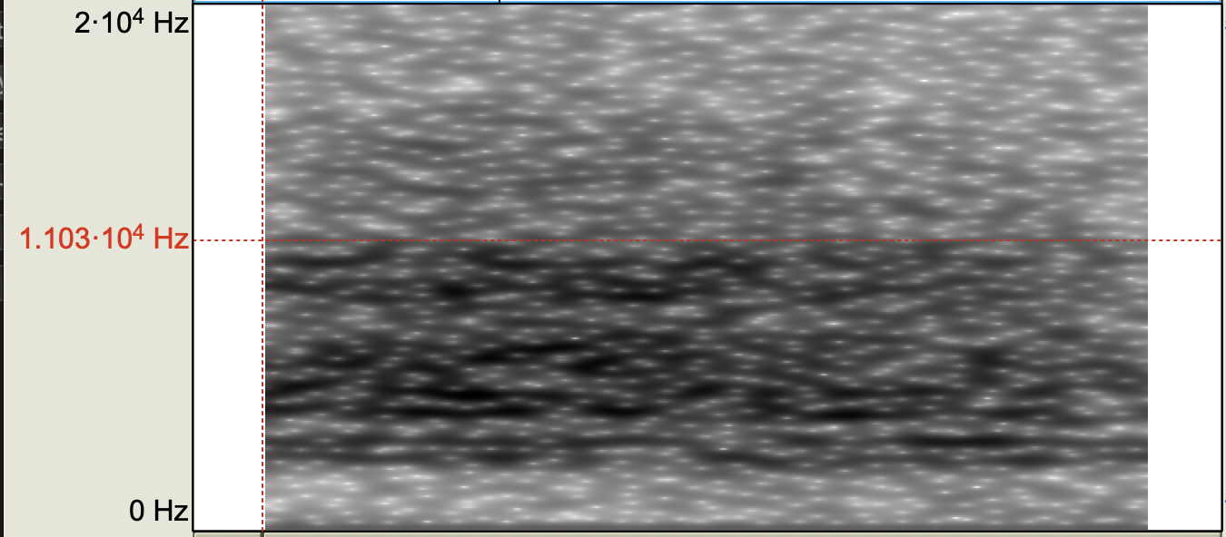
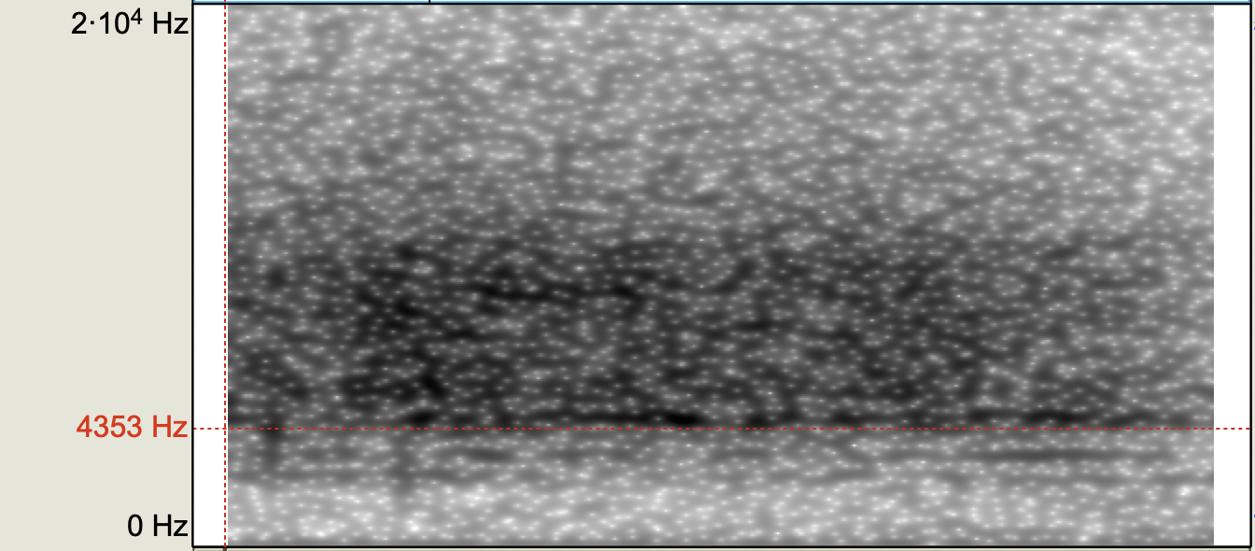
AB7731AB: / ɕ~ç/
L1SZ: wisi ( 2.5 kHz ~ 11 kHz band, peaks at 3.2 kHz, 4.8 kHz, 6.8 kHz, 9.2 kHz)
L3SK: kjelleren ( 2.5 kHz ~ 12 kHz band, peaks 4.4 kHz, 9.4 kHz, spread between)
Polish <si>
Norwegian <kj>
Notes:
Jarek thinks she has new polish ‘si’ fricative

Slide 78
Methodology (Peppa Task)
Each language mode induced via the Peppa (video watching and retelling) Task in the respective language
L3 Norwegian:
”Se denne korte videoen veldig nøye.”
L2 English:
“Watch the movie clip very closely.”
L1 Polish:
“Obejrzyj dokładnie krótki fragment kreskówki.”
“Fortell med dine egne ord hva som skjedde i avsnittet du så.”
”In your own words, tell us what happened in the video you saw.”
“Opowiedz własnymi słowami co wydarzyło się w obejrzanym przez ciebie fragmencie.”
Notes:
Instead of videos, have possibly still frame from peppa videos so it is obvious that they are not the same language (no more than 10 seconds)

Slide 79
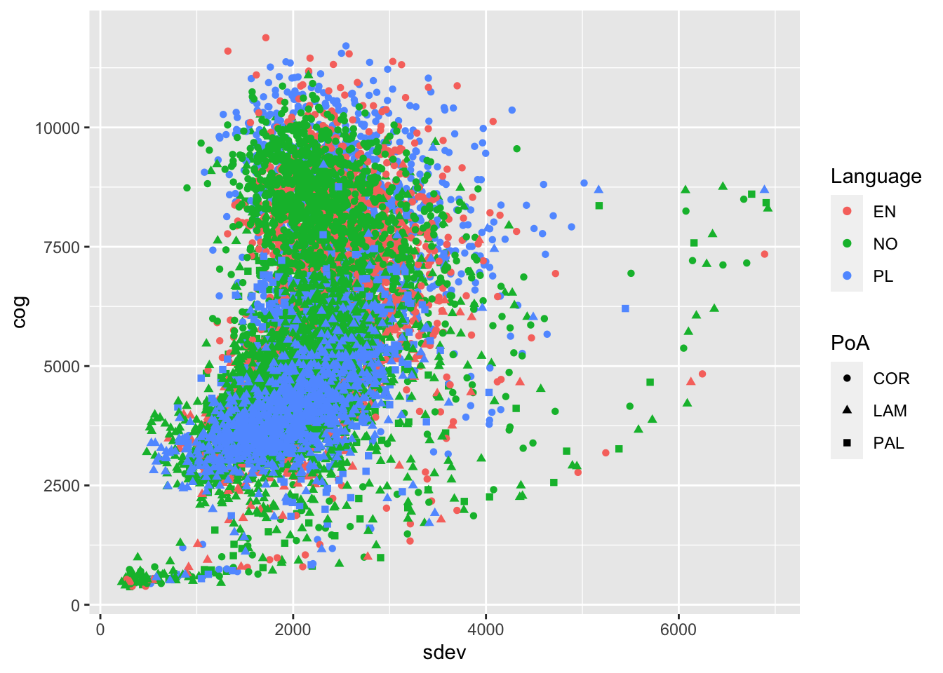
Cog v SDev (Language) L1 Polish L1 Norwegian
Notes:
Not color blind friendly

Slide 80
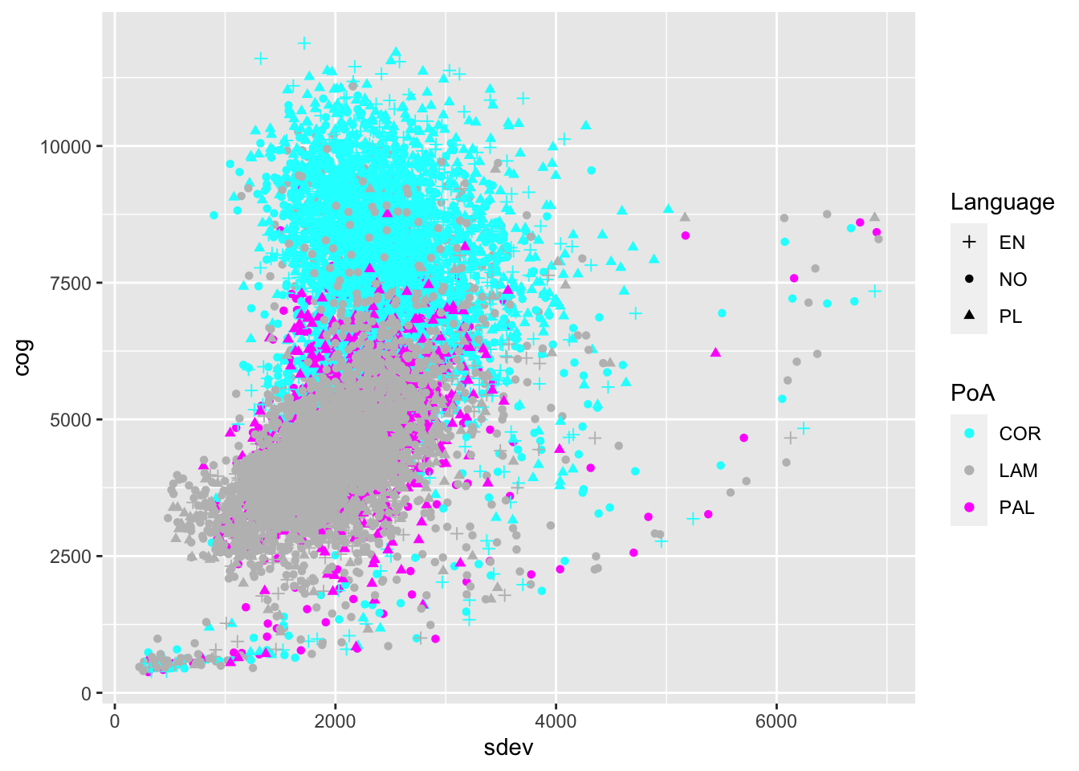
Cog v SDev (Place of Artic.) L1 Polish L1 Norwegian

Slide 81
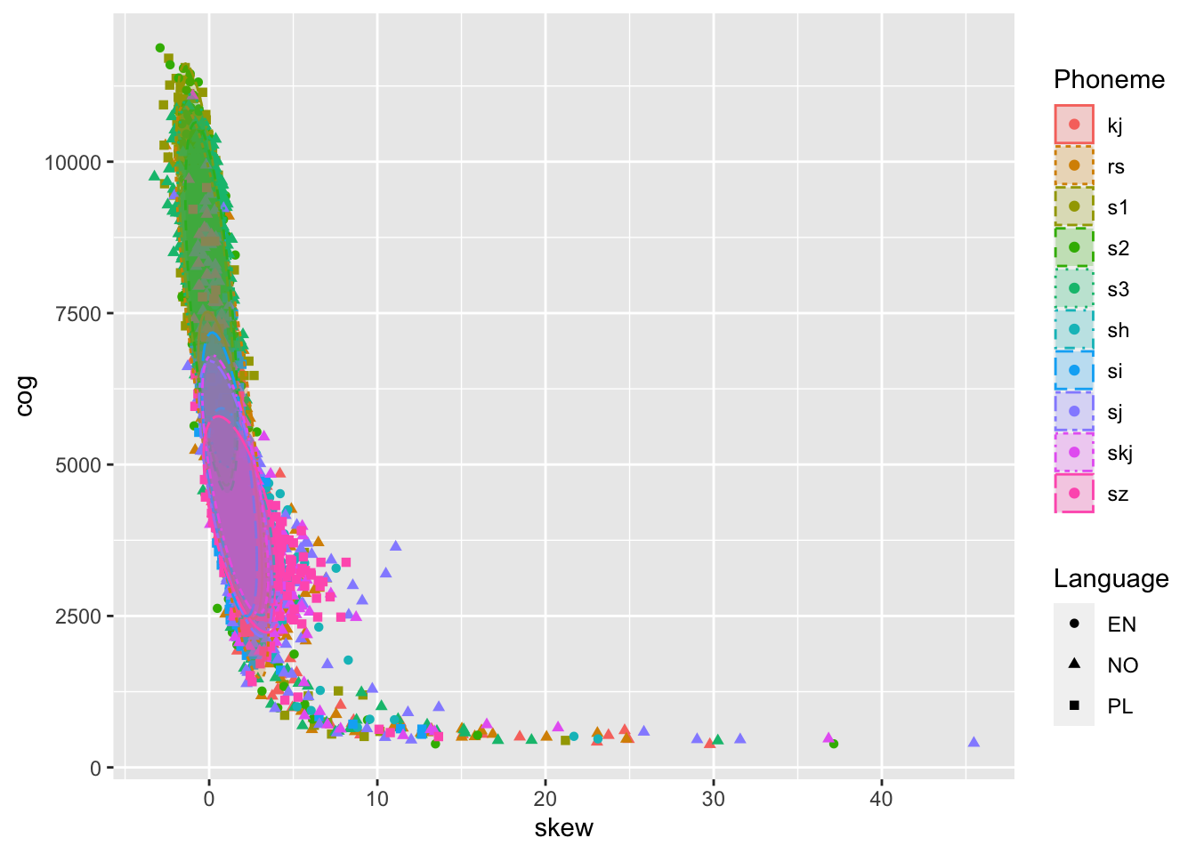
Kurtosis v Skew L1 Polish L1 Norwegian

Slide 82
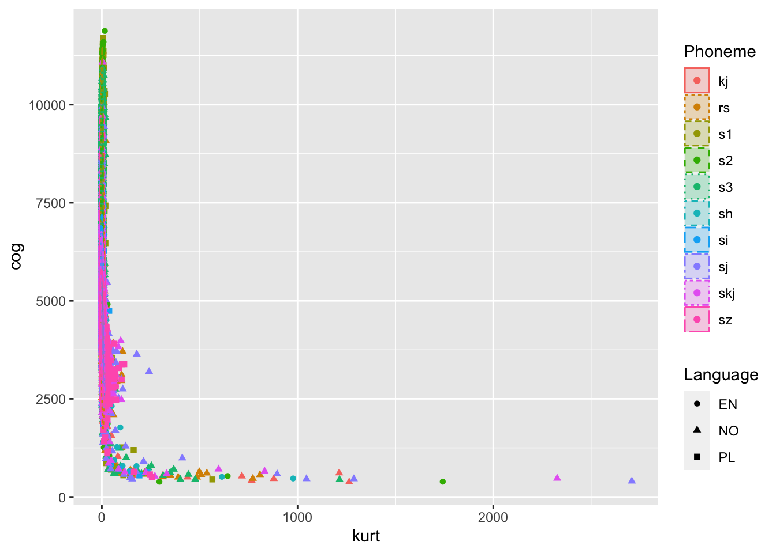
Cog v Kurtosis L1 Polish L1 Norwegian

Slide 83
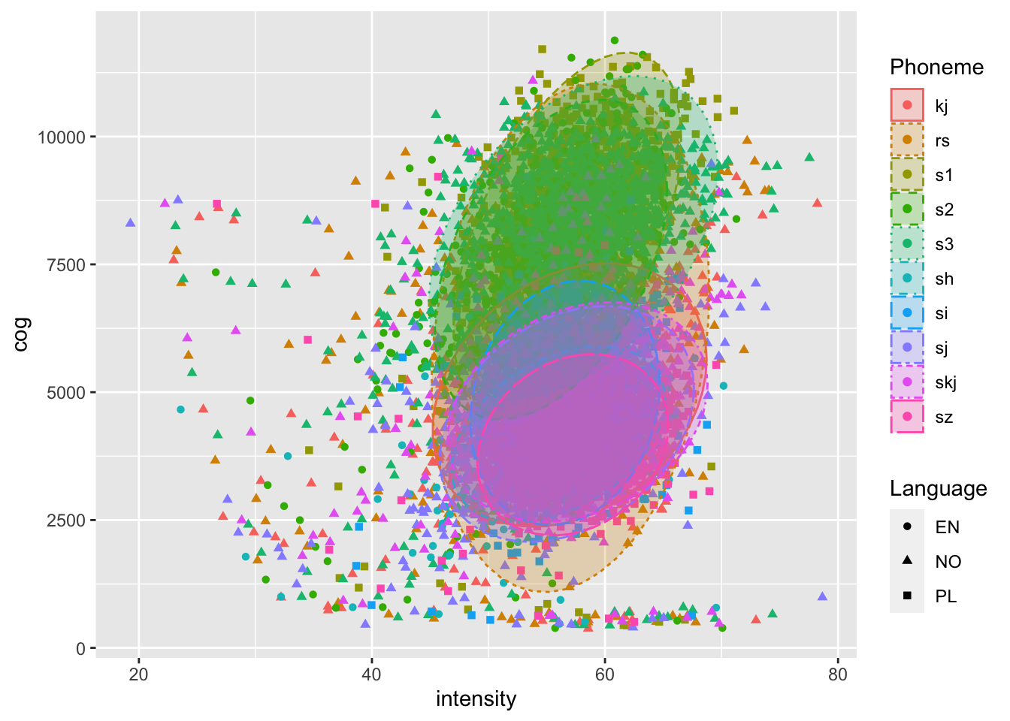
Cog v Intensity L1 Polish L1 Norwegian

Slide 84
L1 Polish CoG vs Proficiency by phoneme (data points with linear regressions)

Slide 85
Proficiency and Sibilants
The current stage of the analysis is to evaluate the data using linear mixed effects models
Additional analyses will be necessary to include the L1 Norwegian controls

Slide 86
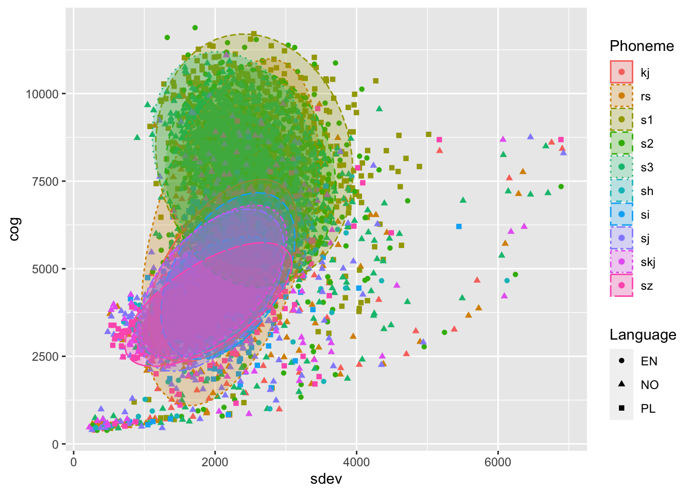
CoG vs SDev Learner Group Native Controls

Slide 87
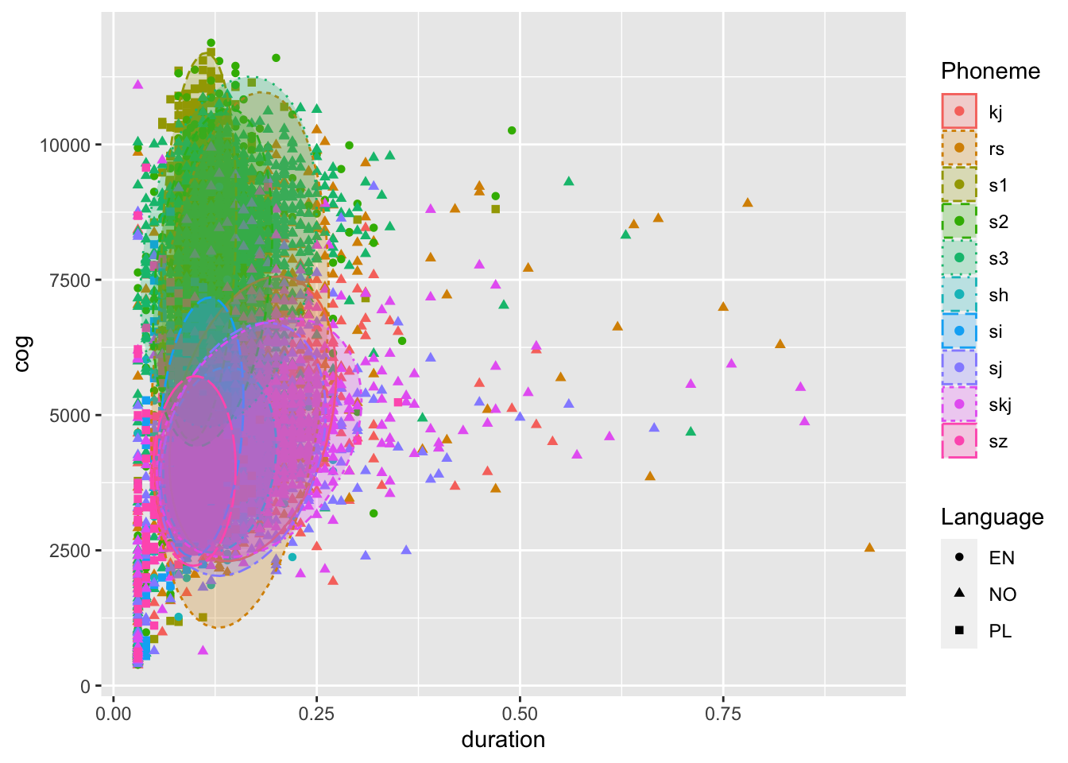
Cog v Duration L1 Polish L1 Norwegian
L1
L2/L3
L1
L2
Notes:
Fix the scaling
L1 Duration Vs L2/L3 duration (L1 durations are shorter); the duration of the force alignment in norwegian is not fully continuous, imposing vertical bands onto the data

Slide 88
Cog v Phoneme L1 Polish L1 Norwegian

Slide 89
Descriptive Statistics of sibilants produced by L1 Polish Participants
 | Norwegian Proficiency | English Proficiency | Duration | Intensity | CoG | Sdev | Skew | Kurtosis
Min. | 0.25 | 0.25 | 0.030 | 19.27 | 378.5 | 222 | -3.26 | -1.80
Median | 0.78 | 0.76 | 0.130 | 56.76 | 5220.4 | 2144 | 0.98 | 2.54
Mean | 0.77 | 0.77 | 0.139 | 56.41 | 5727.1 | 2198 | 1.17 | 8.76
Max. | 0.97 | 1.0 | 0.930 | 78.66 | 11879.9 | 6924 | 45.47 | 2708.58

Slide 90
Effect of Phoneme on CoG across Norwegian proficiency levels Learner Group

Slide 91
Effect of Phoneme on CoG across Norwegian proficiency levels L1 Polish L1 Norwegian
Notes:
There are no participants with 0.2 no_proficiency

Slide 92
Descriptive statistics by phoneme
Notes:
This should be a table right?

Slide 93
Descriptive statistics by phoneme
Notes:
This should be a table right?

Slide 94
Descriptive statistics by phoneme
Notes:
This should be a table right?

Slide 95
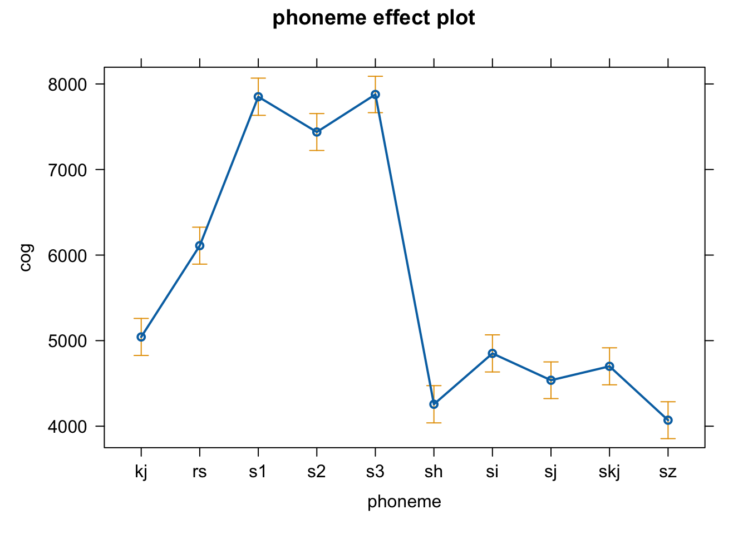
General effect of Phoneme on CoG in L1 Polish learners

Slide 96
Effect of Phoneme on CoG across Norwegian proficiency levels (<rs>)
L1 Polish Learners L1 Norwegian Controls
Notes:
Put letter labels under each tick for each box (there appears to be a leveling effect; in higher proficiency people, they are developing a system where all of the laminals fall into one basket); in lower proficiency spelling seems to be the driving force

Slide 97
Phoneme trajectories across Norwegian proficiency levels L1 Polish L1 Polish + L1 NO

Slide 98
Phoneme trajectories across Norwegian proficiency levels L1 Polish L1 Polish + L1 NO
Low Proficiency
High Proficiency
Notes:
Talk to Kamil (ask him whether the points from norwegian should be imposed onto the model right image, or should they be added as points to the left image?)
Keep the left Learner groups and add the dot points from the Native controls
Convert to bark scale? / or normalize using log transform? It looks like the space between coronal phonemes is similar to the space between laminal+ palatal but that is not true perceptually… So this figure could be misleading

Slide 99
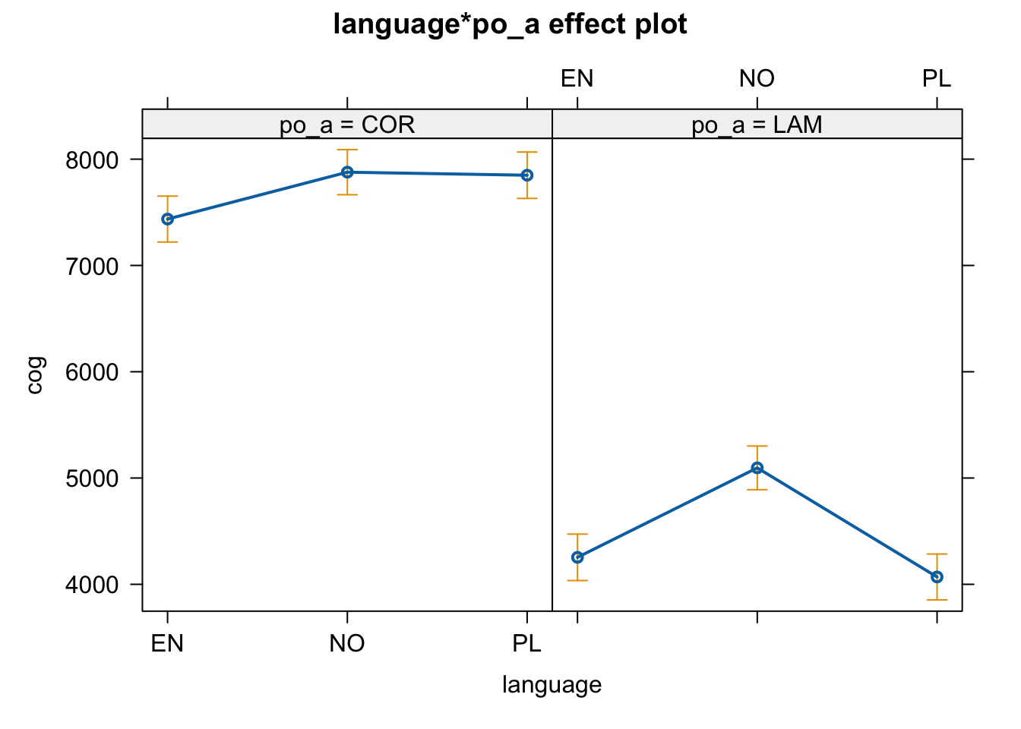
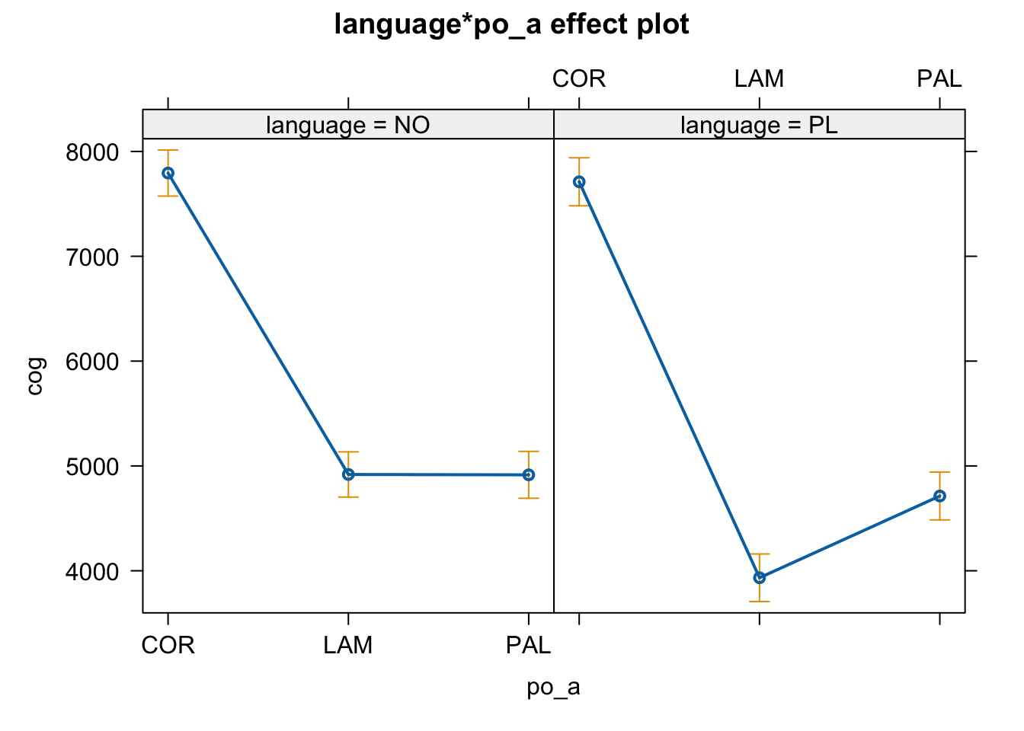
Place effect for L1 Polish, L3 Norwegian learners
COR: Soft evidence that phonemes differ across languages; dental (PL/NO) versus alveolar (EN)
Notes:
The Lam is influenced by the /rs/ which is either /s/ or /S/ (Comment that they need to be recoded)
Insert second figure from Kamil

Slide 100
L1 Polish /s/
# | IPA | Orthography | Sentence | Word
20 | s | s | Pisarz rysuje słowami. | rysuje
 | s | s | Żaba chętnie pląsa w deszczu. | pląsa
 | s | s | Sportowiec masuje swoje mięśnie. | masuje
 | s | s | Chłopiec złamał zasady gry. | zasady
 | s | s | Kucharz gotuje kiełbasę z grzybami. | kiełbasę
 | s | s | Chora kobieta nie nosi maseczki. | maseczki
 | s | s | Rolnik od czasu do czasu uprawia grzyby. | czasu (second )
 | s | s | Kupiec zgubił pasek na lotnisku. | pasek
 | s | s | Aktorka nie zna osoby w okularach. | osoby
 | s | s | Jednorożec to niesamowite zwierzę. | niesamowite
 | s | s | Autor skończył pisać nową powieść. | pisać
 | s | s | Król wysyła list do swojej córki. | wysyła
 | s | s | Prawnik ma interesy do załatwienia. | interesy
 | s | s | Bałwanek miał nosek z marchewki. | nosek
 | s | s | Lwy lubią jeść mięso gazeli. | mięso
 | s | s | Kolega z innej klasy kupił nam ciasto. | klasy
 | s | s | Ten chleb jest posypany mąką. | posypany
 | s | s | To jest chiński film z polskimi napisami. | napisami
 | s | s | Pokojówka prasuje pościel. | prasuje
 | s | s | Zepsuty odkurzacz nie zasysa brudu. | zasysa (first s)

Slide 101
L1 Polish <sz>
# | IPA | Orthography |  | Word
20 | s | s | Pisarz rysuje słowami. | rysuje
 | s | s | Żaba chętnie pląsa w deszczu. | pląsa
 | s | s | Sportowiec masuje swoje mięśnie. | masuje
 | s | s | Chłopiec złamał zasady gry. | zasady
 | s | s | Kucharz gotuje kiełbasę z grzybami. | kiełbasę
 | s | s | Chora kobieta nie nosi maseczki. | maseczki
 | s | s | Rolnik od czasu do czasu uprawia grzyby. | czasu (second )
 | s | s | Kupiec zgubił pasek na lotnisku. | pasek
 | s | s | Aktorka nie zna osoby w okularach. | osoby
 | s | s | Jednorożec to niesamowite zwierzę. | niesamowite
 | s | s | Autor skończył pisać nową powieść. | pisać
 | s | s | Król wysyła list do swojej córki. | wysyła
 | s | s | Prawnik ma interesy do załatwienia. | interesy
 | s | s | Bałwanek miał nosek z marchewki. | nosek
 | s | s | Lwy lubią jeść mięso gazeli. | mięso
 | s | s | Kolega z innej klasy kupił nam ciasto. | klasy
 | s | s | Ten chleb jest posypany mąką. | posypany
 | s | s | To jest chiński film z polskimi napisami. | napisami
 | s | s | Pokojówka prasuje pościel. | prasuje
 | s | s | Zepsuty odkurzacz nie zasysa brudu. | zasysa (first s)
20 | ? | sz | Sowy słyszą myszy z daleka. | myszy
 | ? | sz | Uczeń poszukuje pracy dorywczej. | poszukuje
 | ? | sz | Student przeprasza za spóźnienie. | przeprasza
 | ? | sz | Wielbłąd ma mniejsze uszy niż słoń. | uszy
 | ? | sz | Pracownik obsługuje maszyny w fabryce. | maszyny
 | ? | sz | Handlarz sprzedaje kapelusze z Chin. | kapelusze
 | ? | sz | Mnich medytuje w ciszy na szczycie góry. | ciszy
 | ? | sz | Badacz znalazł dżdżownicę w kieszeni. | kieszeni
 | ? | sz | Złodziej ukradł nasze serca. | nasze
 | ? | sz | Rektor nie otrzymał waszych wiadomości. | waszych
 | ? | sz | Nauczyciel wyszedł ze szkoły. | wyszedł
 | ? | sz | Profesorowi brakuje fiszek. | fiszek
 | ? | sz | Barman upuścił kieliszek na podłogę. | kieliszek
 | ? | sz | Dawno nie było faszystów w Polsce. | faszystów
 | ? | sz | Skrzypek zaprzedał duszę diabłu. | duszę
 | ? | sz | Podróżnice jedzą kaszę z ziołami. | kaszę
 | ? | sz | Starsza pani trzyma naszyjnik z pereł. | naszyjnik
 | ? | sz | Grzmot przestraszył małego psa. | przestraszył
 | ? | sz | Królik spieszy się na obiad. | spieszy
 | ? | sz | Biolog zasadził gruszę w swoim ogrodzie. | gruszę

Slide 102
L1 Polish /ɕ/
# | IPA | Orthography | Sentence | Word
20 | s | s | Pisarz rysuje słowami. | rysuje
 | s | s | Żaba chętnie pląsa w deszczu. | pląsa
 | s | s | Sportowiec masuje swoje mięśnie. | masuje
 | s | s | Chłopiec złamał zasady gry. | zasady
 | s | s | Kucharz gotuje kiełbasę z grzybami. | kiełbasę
 | s | s | Chora kobieta nie nosi maseczki. | maseczki
 | s | s | Rolnik od czasu do czasu uprawia grzyby. | czasu (second )
 | s | s | Kupiec zgubił pasek na lotnisku. | pasek
 | s | s | Aktorka nie zna osoby w okularach. | osoby
 | s | s | Jednorożec to niesamowite zwierzę. | niesamowite
 | s | s | Autor skończył pisać nową powieść. | pisać
 | s | s | Król wysyła list do swojej córki. | wysyła
 | s | s | Prawnik ma interesy do załatwienia. | interesy
 | s | s | Bałwanek miał nosek z marchewki. | nosek
 | s | s | Lwy lubią jeść mięso gazeli. | mięso
 | s | s | Kolega z innej klasy kupił nam ciasto. | klasy
 | s | s | Ten chleb jest posypany mąką. | posypany
 | s | s | To jest chiński film z polskimi napisami. | napisami
 | s | s | Pokojówka prasuje pościel. | prasuje
 | s | s | Zepsuty odkurzacz nie zasysa brudu. | zasysa (first s)
20 | ɕ | si | Szofer prosi o klucze do samochodu. | prosi
 | ɕ | si | Piekarz musi kupić więcej drożdży. | musi
 | ɕ | si | W górach echo niesie się bardzo daleko. | niesie
 | ɕ | si | Pies znalazł misia na podwórku. | misia
 | ɕ | si | Dziewczyny idą dzisiaj do kina. | dzisiaj
 | ɕ | si | Małpa skacze po drzewie w lesie. | lesie
 | ɕ | si | Obraz wisi nad kominkiem. | wisi
 | ɕ | si | W zeszłym miesiącu kelner był na urlopie. | miesiącu
 | ɕ | si | Meduzy mogą żyć tysiące lat. | tysiące
 | ɕ | si | Świadek przysięga przed sądem. | przysięga
 | ɕ | si | Błazen nie posiada się z radości. | posiada
 | ɕ | si | Babcia ma siedemdziesiąt lat. | siedemdziesiąt
 | ɕ | si | Każdy pająk ma osiem nóg. | osiem
 | ɕ | si | Polityk zasiada w komisji. | zasiada
 | ɕ | si | Kasjer pracuje w kasie. | kasie
 | ɕ | si | Technik sprawdza zasięg telefonu. | zasięg
 | ɕ | si | Tam jest zasilacz do komputera. | zasilacz
 | ɕ | si | Dziecko szuka tatusia na zdęciu. | tatusia
 | ɕ | si | Większość ludzi wysiada na tej stacji. | wysiada
 | ɕ | si | Prezydent ogłosił swoją rezygnację. | ogłosił

Slide 103
L2 English /s/
# | IPA | Orthography | Sentence | Word
20 | s | s | Pisarz rysuje słowami. | rysuje
 | s | s | Żaba chętnie pląsa w deszczu. | pląsa
 | s | s | Sportowiec masuje swoje mięśnie. | masuje
 | s | s | Chłopiec złamał zasady gry. | zasady
 | s | s | Kucharz gotuje kiełbasę z grzybami. | kiełbasę
 | s | s | Chora kobieta nie nosi maseczki. | maseczki
 | s | s | Rolnik od czasu do czasu uprawia grzyby. | czasu (second )
 | s | s | Kupiec zgubił pasek na lotnisku. | pasek
 | s | s | Aktorka nie zna osoby w okularach. | osoby
 | s | s | Jednorożec to niesamowite zwierzę. | niesamowite
 | s | s | Autor skończył pisać nową powieść. | pisać
 | s | s | Król wysyła list do swojej córki. | wysyła
 | s | s | Prawnik ma interesy do załatwienia. | interesy
 | s | s | Bałwanek miał nosek z marchewki. | nosek
 | s | s | Lwy lubią jeść mięso gazeli. | mięso
 | s | s | Kolega z innej klasy kupił nam ciasto. | klasy
 | s | s | Ten chleb jest posypany mąką. | posypany
 | s | s | To jest chiński film z polskimi napisami. | napisami
 | s | s | Pokojówka prasuje pościel. | prasuje
 | s | s | Zepsuty odkurzacz nie zasysa brudu. | zasysa (first s)
20 | s | s | The planets are made of gases and rocks. | gases
 | s | c | The artist sees faces in the clouds. | faces
 | s | s | The dog chases its tail for fun. | chases
 | s | c | The driver races cars on the weekends. | races
 | s | c | The guide knows the best places to eat. | places
 | s | c | Tesla produces hybrid and electric cars. | produces
 | s | c | The girl asks about the price of the dress. | price
 | s | c | The thief regrets the choices that he made. | choices
 | s | c | The bank provided many services today. | services
 | s | c | This merchant sells fireplaces and tables. | fireplaces
 | s | c | The artist sold two pieces to the museum. | pieces
 | s | c | The musician practices her clarinet. | practices
 | s | c | He drinks different juices every day. | juices
 | s | s | The lawyer keeps cactuses on her desk. | cactuses
 | s | c | Most adults learn to process their emotions. | process
 | s | s | There is an energy crisis worldwide. | crisis
 | s | ss | We have bosses at work. | bosses
 | s | ss | The investor cut his losses last week. | losses
 | s | s | There are several cases to discuss. | cases
 | s | c | The jogger stops to tie his shoelaces again. | shoelaces

Slide 104
L2 English /ʃ/
# | IPA | Orthography | Sentence | Word
20 | s | s | Pisarz rysuje słowami. | rysuje
 | s | s | Żaba chętnie pląsa w deszczu. | pląsa
 | s | s | Sportowiec masuje swoje mięśnie. | masuje
 | s | s | Chłopiec złamał zasady gry. | zasady
 | s | s | Kucharz gotuje kiełbasę z grzybami. | kiełbasę
 | s | s | Chora kobieta nie nosi maseczki. | maseczki
 | s | s | Rolnik od czasu do czasu uprawia grzyby. | czasu (second )
 | s | s | Kupiec zgubił pasek na lotnisku. | pasek
 | s | s | Aktorka nie zna osoby w okularach. | osoby
 | s | s | Jednorożec to niesamowite zwierzę. | niesamowite
 | s | s | Autor skończył pisać nową powieść. | pisać
 | s | s | Król wysyła list do swojej córki. | wysyła
 | s | s | Prawnik ma interesy do załatwienia. | interesy
 | s | s | Bałwanek miał nosek z marchewki. | nosek
 | s | s | Lwy lubią jeść mięso gazeli. | mięso
 | s | s | Kolega z innej klasy kupił nam ciasto. | klasy
 | s | s | Ten chleb jest posypany mąką. | posypany
 | s | s | To jest chiński film z polskimi napisami. | napisami
 | s | s | Pokojówka prasuje pościel. | prasuje
 | s | s | Zepsuty odkurzacz nie zasysa brudu. | zasysa (first s)
20 | ʃ | sh | The man gave the cashier his money. | cashier
 | ʃ | sh | The student wishes for good grades. | wishes
 | ʃ | sh | The pig was ashamed of his weight. | ashamed
 | ʃ | sh | Vampires turn to ashes in sunlight. | ashes
 | ʃ | ci | The jeweler sells many precious gems. | precious
 | ʃ | ci | The store has a special deal today. | special
 | ʃ | sh | Her dress clashes with those shoes. | clashes
 | ʃ | sh | Skinny jeans are in fashion this year. | fashion
 | ʃ | sh | the cook left the dishes on the counter. | dishes
 | ʃ | sh | The wave washes away our footprints | washes
 | ʃ | ti | The nurse goes on vacation next month. | vacation
 | ʃ | sh | The cat pushes the vase off the table. | pushes
 | ʃ | sh | The dentist brushes his teeth after lunch. | brushes
 | ʃ | sh | The runner dashes towards the finish line | dashes
 | ʃ | sh | The model is wearing fake eyelashes and lipstick. | eyelashes
 | ʃ | sh | The robot crushes the tin can into a ball. | crushes
 | ʃ | sh | There are a lot of car crashes each year. | crashes
 | ʃ | sh | I heard a noise in the bushes over there. | bushes
 | ʃ | sh | Our family goes fishing twice a year. | fishing
 | ʃ | sh | This horse eats radishes and apples. | radishes
20 | ? | sz | Sowy słyszą myszy z daleka. | myszy
 | ? | sz | Uczeń poszukuje pracy dorywczej. | poszukuje
 | ? | sz | Student przeprasza za spóźnienie. | przeprasza
 | ? | sz | Wielbłąd ma mniejsze uszy niż słoń. | uszy
 | ? | sz | Pracownik obsługuje maszyny w fabryce. | maszyny
 | ? | sz | Handlarz sprzedaje kapelusze z Chin. | kapelusze
 | ? | sz | Mnich medytuje w ciszy na szczycie góry. | ciszy
 | ? | sz | Badacz znalazł dżdżownicę w kieszeni. | kieszeni
 | ? | sz | Złodziej ukradł nasze serca. | nasze
 | ? | sz | Rektor nie otrzymał waszych wiadomości. | waszych
 | ? | sz | Nauczyciel wyszedł ze szkoły. | wyszedł
 | ? | sz | Profesorowi brakuje fiszek. | fiszek
 | ? | sz | Barman upuścił kieliszek na podłogę. | kieliszek
 | ? | sz | Dawno nie było faszystów w Polsce. | faszystów
 | ? | sz | Skrzypek zaprzedał duszę diabłu. | duszę
 | ? | sz | Podróżnice jedzą kaszę z ziołami. | kaszę
 | ? | sz | Starsza pani trzyma naszyjnik z pereł. | naszyjnik
 | ? | sz | Grzmot przestraszył małego psa. | przestraszył
 | ? | sz | Królik spieszy się na obiad. | spieszy
 | ? | sz | Biolog zasadził gruszę w swoim ogrodzie. | gruszę

Slide 105
L3 Norwegian /s/
# | IPA | Orthography | Sentence | Word
20 | s | s | De leser nyheter i sosiale medier. | leser
 | s | s | Han holder en presentasjon om klimaendringer. | presentasjon
 | s | s | Du burde se den vakre solnedgangen i kveld. | se
 | s | s | Hun ble rasende da hun mistet mobilen. | rasende
 | s | s | Disse bøkene er veldig interessante å lese. | interessante
 | s | s | Han har en følsom nese som reagerer på sterk lukt. | nese
 | s | s | Vi bor i det gamle huset i enden av gaten. | huset
 | s | s | Jeg fant passet mitt i jakkelommen. | passet
 | s | s | Barna leker og svømmer i bassenget på hotellet. | bassenget
 | s | s | Jeg spiser middag med familien min nå. | spiser
 | s | s | Denne databasen inneholder informasjon om kundene. | databasen
 | s | s | Jeg snyter nesen min når jeg er forkjølet. | nesen
 | s | s | Vi skal besøke bestefaren vår i helgen. | besøke
 | s | s | Disse skjortene passer i hverdagen. | passer
 | s | s | De to brødrene slåss ofte om lekene sine. | slåss
 | s | s | Kua sover og drømmer i båsen sin. | båsen
 | s | s | Betalingen kan gjøres ved kassen på butikken. | kassen
 | s | s | Jeg lærer nye ting i klassen og hjemme. | klassen
 | s | s | Vår professor har dyp kunnskap om historie. | professor
 | s | s | Den nye presidenten taler om nasjonale spørsmål. | presidenten

Slide 106
L3 Norwegian <rs>
# | IPA | Orthography | Sentence | Word
20 | s | s | De leser nyheter i sosiale medier. | leser
 | s | s | Han holder en presentasjon om klimaendringer. | presentasjon
 | s | s | Du burde se den vakre solnedgangen i kveld. | se
 | s | s | Hun ble rasende da hun mistet mobilen. | rasende
 | s | s | Disse bøkene er veldig interessante å lese. | interessante
 | s | s | Han har en følsom nese som reagerer på sterk lukt. | nese
 | s | s | Vi bor i det gamle huset i enden av gaten. | huset
 | s | s | Jeg fant passet mitt i jakkelommen. | passet
 | s | s | Barna leker og svømmer i bassenget på hotellet. | bassenget
 | s | s | Jeg spiser middag med familien min nå. | spiser
 | s | s | Denne databasen inneholder informasjon om kundene. | databasen
 | s | s | Jeg snyter nesen min når jeg er forkjølet. | nesen
 | s | s | Vi skal besøke bestefaren vår i helgen. | besøke
 | s | s | Disse skjortene passer i hverdagen. | passer
 | s | s | De to brødrene slåss ofte om lekene sine. | slåss
 | s | s | Kua sover og drømmer i båsen sin. | båsen
 | s | s | Betalingen kan gjøres ved kassen på butikken. | kassen
 | s | s | Jeg lærer nye ting i klassen og hjemme. | klassen
 | s | s | Vår professor har dyp kunnskap om historie. | professor
 | s | s | Den nye presidenten taler om nasjonale spørsmål. | presidenten
20 | ? | rs | Jeg forsøkte å reparere bilen min selv. | forsøkte
 | ? | rs | Vi så en morsom film på kino. | morsom
 | ? | rs | De tror at årsaken til ulykken var regnet. | årsaken
 | ? | rs | Deres advarsel om viruset var veldig tydelig. | advarsel
 | ? | rs | Jeg møtte en person som var veldig hyggelig. | person
 | ? | rs | Jeg liker å ha personlig kontakt med folk. | personlig
 | ? | rs | Jeg undersøker saken nærmere nå. | undersøker
 | ? | rs | Vi må forsøke å fullføre prosjektet i tide. | forsøke
 | ? | rs | Vi synes at forsiden av boken er veldig fin. | forsiden
 | ? | rs | Vennligst oversett denne teksten til norsk. | oversett
 | ? | rs | Jeg overså advarselen og gjorde det likevel. | advarselen
 | ? | rs | De sier at universell utforming er viktig. | universell
 | ? | rs | Det var diverse saker i skapet. | diverse
 | ? | rs | Hans oppførsel på festen var upassende. | oppførsel
 | ? | rs | Jeg har sendt en forespørsel om informasjon. | forespørsel
 | ? | rs | Vi var samlet i en stor forsamling i dag. | forsamling
 | ? | rs | Denne saken er svært kontroversiell for oss. | kontroversiell
 | ? | rs | Terapeuten sier at forsoning er vanskelig. | forsoning
 | ? | rs | Vårt datterselskap i Tyskland går bra. | datterselskap
 | ? | rs | Han kjørte motorsykkel på veien i dag. | motorsykkel

Slide 107
L3 Norwegian <kj>
# | IPA | Orthography | Sentence | Word
20 | s | s | De leser nyheter i sosiale medier. | leser
 | s | s | Han holder en presentasjon om klimaendringer. | presentasjon
 | s | s | Du burde se den vakre solnedgangen i kveld. | se
 | s | s | Hun ble rasende da hun mistet mobilen. | rasende
 | s | s | Disse bøkene er veldig interessante å lese. | interessante
 | s | s | Han har en følsom nese som reagerer på sterk lukt. | nese
 | s | s | Vi bor i det gamle huset i enden av gaten. | huset
 | s | s | Jeg fant passet mitt i jakkelommen. | passet
 | s | s | Barna leker og svømmer i bassenget på hotellet. | bassenget
 | s | s | Jeg spiser middag med familien min nå. | spiser
 | s | s | Denne databasen inneholder informasjon om kundene. | databasen
 | s | s | Jeg snyter nesen min når jeg er forkjølet. | nesen
 | s | s | Vi skal besøke bestefaren vår i helgen. | besøke
 | s | s | Disse skjortene passer i hverdagen. | passer
 | s | s | De to brødrene slåss ofte om lekene sine. | slåss
 | s | s | Kua sover og drømmer i båsen sin. | båsen
 | s | s | Betalingen kan gjøres ved kassen på butikken. | kassen
 | s | s | Jeg lærer nye ting i klassen og hjemme. | klassen
 | s | s | Vår professor har dyp kunnskap om historie. | professor
 | s | s | Den nye presidenten taler om nasjonale spørsmål. | presidenten
20 | ?? | kj | Moren lager mat på kjøkkenet. | kjøkkenet
 | ?? | kj | Hun må kjøpe melk og brød. | kjøpe
 | ?? | kj | Det er en ukjent person som står ved døren. | ukjent
 | ?? | kj | Jeg spiser ikke kjøtt fordi jeg er vegetarianer. | kjøtt
 | ?? | kj | Vi så kjeppen i skogen. | kjeppen
 | ?? | kj | Jeg traff min gamle bekjente på gaten. | bekjente
 | ?? | kj | Jeg kjøpte nye klær på kjøpesenteret i dag. | kjøpesenteret
 | ?? | kj | Han liker å kjører for fort på motorveien. | kjører
 | ?? | kj | Vi kjenner ikke henne så godt. | kjenner
 | ?? | kj | Vi har en ekstra stue i kjelleren vår. | kjelleren
 | ?? | kj | Vi så to kjekke menn på kino. | kjekke
 | ?? | kj | Denne kjære vennen har pengene mine. | kjære
 | ?? | kj | Hun har på seg kjolen på festen | kjolen
 | ?? | kj | Vi må bekjempe kapitalismen. | bekjempe
 | ?? | kj | Jeg trodde kjennelsen ble opphevet. | kjennelsen
 | ?? | kj | Hun vil kaste disse kjedelige bøkene. | kjedelige
 | ?? | kj | Moren hans spiser eplekjerner av og til | eplekjerner
 | ?? | kj | Byen mase og kjase dagen lang | kjase
 | ?? | kj | Vi må kjøle ned maten. | kjøle
 | ?? | kj | Han drog den gyldne kjede frem under skjorten. | kjede

Slide 108
L3 Norwegian <sj>
# | IPA | Orthography | Sentence | Word
20 | s | s | De leser nyheter i sosiale medier. | leser
 | s | s | Han holder en presentasjon om klimaendringer. | presentasjon
 | s | s | Du burde se den vakre solnedgangen i kveld. | se
 | s | s | Hun ble rasende da hun mistet mobilen. | rasende
 | s | s | Disse bøkene er veldig interessante å lese. | interessante
 | s | s | Han har en følsom nese som reagerer på sterk lukt. | nese
 | s | s | Vi bor i det gamle huset i enden av gaten. | huset
 | s | s | Jeg fant passet mitt i jakkelommen. | passet
 | s | s | Barna leker og svømmer i bassenget på hotellet. | bassenget
 | s | s | Jeg spiser middag med familien min nå. | spiser
 | s | s | Denne databasen inneholder informasjon om kundene. | databasen
 | s | s | Jeg snyter nesen min når jeg er forkjølet. | nesen
 | s | s | Vi skal besøke bestefaren vår i helgen. | besøke
 | s | s | Disse skjortene passer i hverdagen. | passer
 | s | s | De to brødrene slåss ofte om lekene sine. | slåss
 | s | s | Kua sover og drømmer i båsen sin. | båsen
 | s | s | Betalingen kan gjøres ved kassen på butikken. | kassen
 | s | s | Jeg lærer nye ting i klassen og hjemme. | klassen
 | s | s | Vår professor har dyp kunnskap om historie. | professor
 | s | s | Den nye presidenten taler om nasjonale spørsmål. | presidenten
20 | ??? | sj | Livet bringer mange situasjoner og valg. | situasjoner
 | ??? | sj | Jeg møtte ham på stasjonen i går. | stasjonen
 | ??? | sj | Jeg tok en drosje til flyplassen. | drosje
 | ??? | sj | Hun bor i første etasje også. | etasje
 | ??? | sj | Dette prosjektet er viktig for vår bedrift. | prosjektet
 | ??? | sj | Den internasjonale konferansen var vellykket. | internasjonale
 | ??? | sj | Vi må ta sjanser for å oppnå suksess. | sjanser
 | ??? | sj | Dagens diskusjon om dette temaet var interessant. | diskusjon
 | ??? | sj | Hans imitasjon av Elvis var fantastisk. | imitasjon
 | ??? | sj | Hun lider av depresjon og trenger hjelp. | depresjon
 | ??? | sj | Mat er viktig for kognisjon og kreativitet. | kognisjon
 | ??? | sj | Denne garasjen er full av gamle ting. | garasjen
 | ??? | sj | Det er mange passasjerer om bord i flyet. | passasjerer
 | ??? | sj | Dette er din siste sjanse til å være lykkelig. | sjanse
 | ??? | sj | Den nye sjefen er en god leder. | sjefen
 | ??? | sj | I dag er det alle sjelers dag i Polen. | sjelers
 | ??? | sj | Vi er på sjøen akkurat nå. | sjøen
 | ??? | sj | Jeg valgte sjokoladeisen fremfor jordbærisen. | sjokoladeisen
 | ??? | sj | Hun ga sjåføren pengene på flyplassen. | sjåføren
 | ??? | sj | Jeg vil ha sjekken snart. | sjekken

Slide 109
L3 Norwegian <skj>
# | IPA | Orthography | Sentence | Word
20 | s | s | De leser nyheter i sosiale medier. | leser
 | s | s | Han holder en presentasjon om klimaendringer. | presentasjon
 | s | s | Du burde se den vakre solnedgangen i kveld. | se
 | s | s | Hun ble rasende da hun mistet mobilen. | rasende
 | s | s | Disse bøkene er veldig interessante å lese. | interessante
 | s | s | Han har en følsom nese som reagerer på sterk lukt. | nese
 | s | s | Vi bor i det gamle huset i enden av gaten. | huset
 | s | s | Jeg fant passet mitt i jakkelommen. | passet
 | s | s | Barna leker og svømmer i bassenget på hotellet. | bassenget
 | s | s | Jeg spiser middag med familien min nå. | spiser
 | s | s | Denne databasen inneholder informasjon om kundene. | databasen
 | s | s | Jeg snyter nesen min når jeg er forkjølet. | nesen
 | s | s | Vi skal besøke bestefaren vår i helgen. | besøke
 | s | s | Disse skjortene passer i hverdagen. | passer
 | s | s | De to brødrene slåss ofte om lekene sine. | slåss
 | s | s | Kua sover og drømmer i båsen sin. | båsen
 | s | s | Betalingen kan gjøres ved kassen på butikken. | kassen
 | s | s | Jeg lærer nye ting i klassen og hjemme. | klassen
 | s | s | Vår professor har dyp kunnskap om historie. | professor
 | s | s | Den nye presidenten taler om nasjonale spørsmål. | presidenten
20 | ???? | skj | Jeg fikk en beskjed fra sjefen min. | beskjed
 | ???? | skj | Jenta kjøpte skjørtet til en fest. | skjørtet
 | ???? | sky | De uskyldige ble feilaktig arrestert. | uskyldige
 | ???? | skj | Vi har forskjellige meninger om dette. | forskjellige
 | ???? | skj | Det skjedde en ulykke i går. | skjedde
 | ???? | skj | Jeg skjønner ikke hva du mener. | skjønner
 | ???? | skj | Jeg vil ha en teskje sukker i kaffen min. | teskje
 | ???? | skj | Jeg må skjøte sammen de to delene. | skjøte
 | ???? | skj | Jeg tror på skjebne og på fri vilje. | skjebne
 | ???? | skj | Vi burde begrave skjelettet i morgen. | skjelettet
 | ???? | skj | Jeg tenker at du kanskje burde prøve noe annet. | kanskje
 | ???? | skj | Jeg ser på skjermen og leser e-posten. | skjermen
 | ???? | skj | Han har på seg skjorten til bryllupet. | skjorten
 | ???? | skj | Hun så skjeen på bordet. | skjeen
 | ???? | skj | Kokken trenger å skjære fisken. | skjære
 | ???? | skj | Forsteren beskjærer trær i skogen. | beskjærer
 | ???? | skj | Det er ikke skjellig å tro på spøkelser. | skjellig
 | ???? | skj | Han var den største skjensel i landsbye. | skjensel
 | ???? | skj | Vi skjøv sofaen inn i rommet. | skjøv
 | ???? | skj | En helt må skjelne mellom rett og galt. | skjelne

Slide 110
Dental/Alveolar /s/
L1PL
L2EN
L3NO
Word
rysuje
pląsa
masuje
zasady
kiełbasę
maseczki
czasu
pasek
osoby
niesamowite
pisać
wysyła
interesy
nosek
mięso
klasy
posypany
napisami
prasuje
zasysa
Word
gases
faces
chases
races
places
produces
price
choices
services
fireplaces
pieces
practices
juices
cactuses
process
crisis
bosses
losses
cases
shoelaces
Word
leser
presentasjon
se
rasende
interessante
nese
huset
passet
bassenget
spiser
databasen
nesen
besøke
passer
slåss
båsen
kassen
klassen
professor
presidenten
42 participants*20 words per phoneme =
840 tokens per language phoneme (/s/)

Slide 111
Postalveolar: /sz~ʃ~ rs/
L1PL
L2EN
L3NO
myszy
poszukuje
przeprasza
uszy
maszyny
kapelusze
ciszy
kieszeni
nasze
waszych
wyszedł
fiszek
kieliszek
faszystów
duszę
kaszę
naszyjnik
przestraszył
spieszy
gruszę
cashier
wishes
ashamed
ashes
precious
special
clashes
fashion
dishes
washes
vacation
pushes
brushes
dashes
eyelashes
crushes
crashes
bushes
fishing
radishes
forsøkte
morsom
årsaken
advarsel
person
personlig
undersøker
forsøke
forsiden
oversett
advarselen
universell
diverse
oppførsel
forespørsel
forsamling
kontroversiell
forsoning
datterselskap
motorsykkel
42 participants*20 words per phoneme =
840 tokens per language phoneme (/sz/,/ʃ/,/rs/)

Slide 112
Alveopalatal/palatal: / ɕ~sj~skj~kj /
L1PL
L2EN
L3NO
prosi
musi
niesie
misia
dzisiaj
lesie
wisi
miesiącu
tysiące
przysięga
posiada
siedemdziesiąt
osiem
zasiada
kasie
zasięg
zasilacz
tatusia
wysiada
ogłosił
situasjoner
stasjonen
drosje
etasje
prosjektet
internasjonale
sjanser
diskusjon
imitasjon
depresjon
kognisjon
garasjen
passasjerer
sjanse
sjefen
sjelers
sjøen
sjokoladeisen
sjåføren
sjekken
beskjed
skjørtet
uskyldige
forskjellige
skjedde
skjønner
teskje
skjøte
skjebne
skjelettet
kanskje
skjermen
skjorten
skjeen
skjære
beskjærer
skjellig
skjensel
skjøv
skjelne
kjøkkenet
kjøpe
ukjent
kjøtt
kjeppen
bekjente
kjøpesenteret
kjører
kjenner
kjelleren
kjekke
kjære
kjolen
bekjempe
kjennelsen
kjedelige
eplekjerner
kjase
kjøle
kjede
42 participants*20 words = 840 tokens per phoneme (/ɕ/, /sj/, /skj/, /kj/)

Slide 113
Experimental Stimuli
42 randomized lists containing:
(stimuli for the sibilant production experiment)
L3NO: 260 sentences (S = 100)
L2EN: 160 sentences (S = 40)
L1PL: 180 sentences (S = 60)

Slide 114
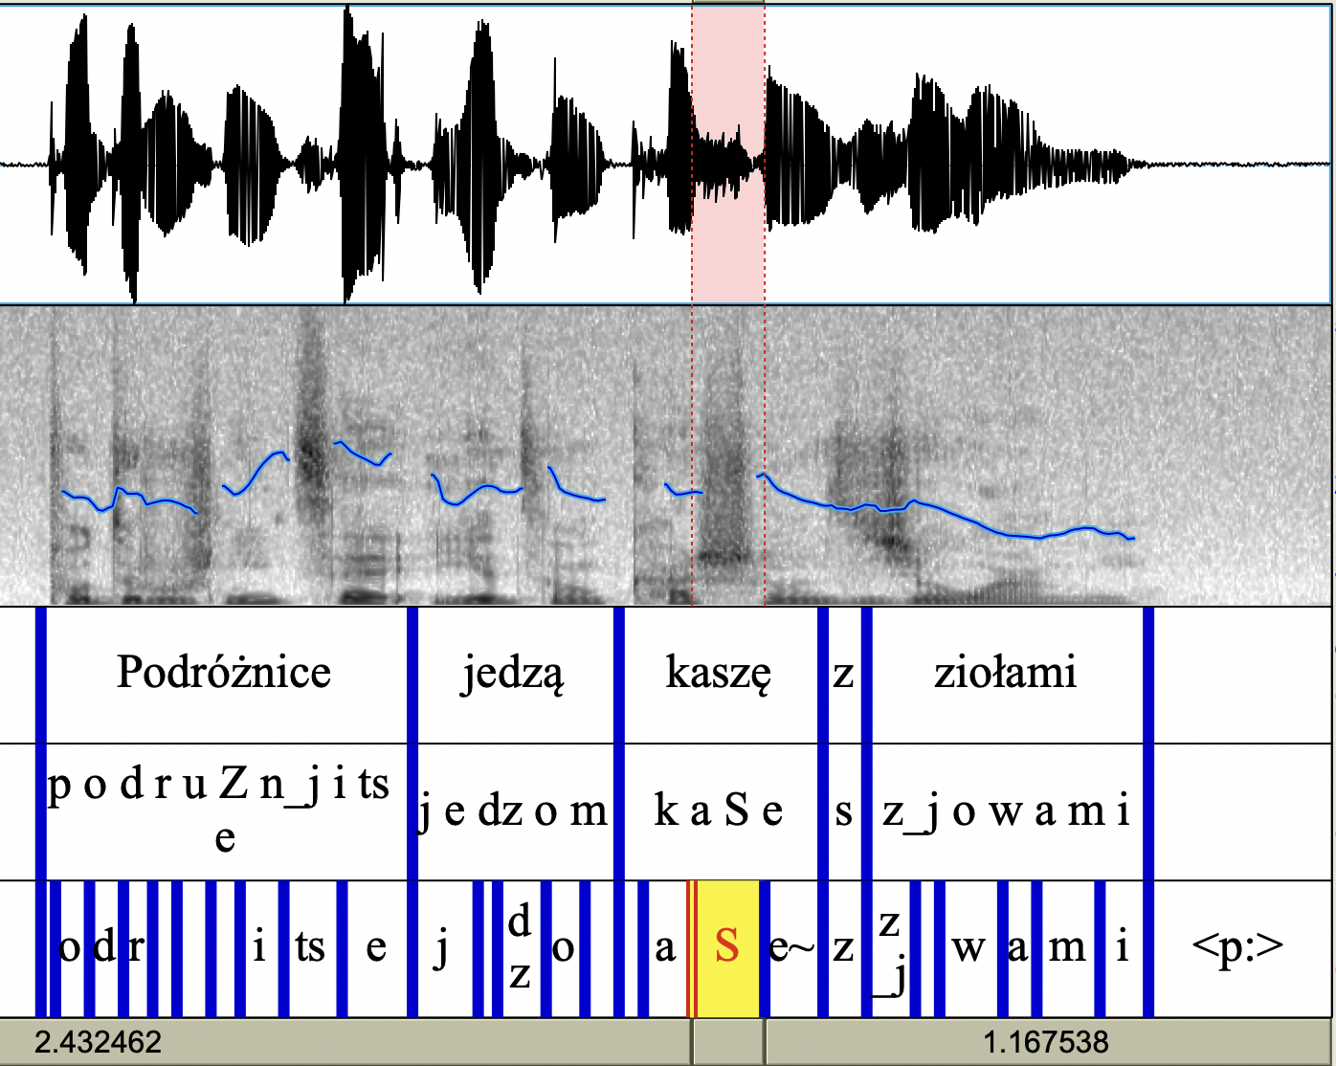
Data Processing (Polish Sample)
Notes:
Redo this photo different sentence (podrożnice is not correct)

Slide 115
Example of randomized stimuli list
1
2
3
4
5
6
7
8
9
10
160
Prezydent ogłosił swoją rezygnację. Sibilant study
Szef idzie na galę wieczorem. VOT
Zatopiony wrak ekscytuje nurków głębinowych VOT
Tam jest zasilacz do komputera. VOT
Zepsuty odkurzacz nie zasysa brudu. Sibilant study
Topniejący śnieg arktyczny to następstwo zmian klimatu. VOT
Kierowca pokazuje gest przez okno. VOT
Świadek przysięga przed sądem. VOT
Jubiler wyciąga perłę z kieszeni. VOT
Każdy pająk ma osiem nóg. Sibilant Study
….
Prawnik ma interesy do załatwienia. VOT

