Slide 1
The perception of Norwegian retroflexes by L1 Polish L3 Norwegian speakers: ​Discrimination and rated dissimilarity tasks
KRZYSZTOF HWASZCZ
Anna balas
Magdalena wrembel
Kamil Kaźmierski

Slide 2
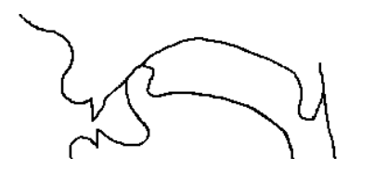
theoretical background
Retroflexion is traditionally described as an articulation involving the bending backwards of the tongue tip (e.g., Ladefoged and Maddieson 1996, Trask 1996).
Criteria for retroflexes Hamann (2003: 32): :
Apicality
Posteriority
Sublingual cavity
Retraction
N.B. bending backwards of the tongue is not universally valid.
Cross-linguistically, retroflexes are considered to be marked (Greenberg 1966)
Retroflexes occur relatively infrequently and only in large inventories (Maddieson 1984); they are acquired late.
The degree of perceived cross-linguistic similarity between the learner’s L1 and L2 is claimed to mediate discrimination of L2 sounds (Best, 1995, Flege and Bohn 2021, Cebrian 2022).
Perceived cross-linguistic similarity has not been investigated from multilingual perspective.

Slide 3
Retroflexes in Norwegian, English and Polish: no full agreement
Norwegian
a series of coronal consonants distinguished by retroflexion: alveolar /t, d, s, l, n/ and retroflex /ʈ, ɖ, ʃ, ɭ, ɳ/ (cf. Kristoffersen 2000: 23 controversy about /ʂ/ʃ/)
Polish
sibilants have a controversial retroflex status (Hamann (2002, 2004), Lorenc (2018), Hall (1997a, 1997b) Żygis and Hamann (2003), Żygis (2005), Żygis et al. (2012), Padgett and Żygis (2007), Żygis and Padgett (2010)).
cues to retroflexion are argued to be manifested in /ʂ/, /ʐ/, /͡tʂ/ and /d͡ʐ/;
cues to allophonic retroflexion – in [ʈ] and [ɖ] (Żygis 2005; Żygis, Pape & Jesus 2012);
American English only has /ɽ/;

Slide 4
Retroflexes in Norwegian, English and Polish
Hypotheses:
Polish /ʂ/ vs. Norwegian /ʂ/ – potentially closer counterparts;
Norwegian /ʈ, ɖ/ vs. Polish allophonic [ʈ, ɖ];
Remaining Norwegian retroflex sounds /ɭ, ɳ/ – no close retroflex counterparts in Polish;
We hypothesize gradiance in perceptual salience.
 | Norwegian | Polish | English
nasal | /ɳ/
plosive (voiceless) | /ʈ/ | [ʈ]
plosive (voiced) | /ɖ/ | [ɖ]
fricative (voiceless) | /ʂ-ʃ/ | /ʂ/
fricative (voiced) |  | /ʐ/
affricate (voiceless) |  | /t͡ʂ/
affricate (voiced) |  | /d͡ʐ/
approximant | /ɭ/ |  | /ɽ/

Slide 5
Study Objectives
We aim to investigate the perception of Polish and Norwegian retroflexes by L1 Polish L2 English L3 Norwegian learners; specifically:
Assessment of cross-linguistics (dis)similarity of retroflexes and similar non-retroflex sounds;
How the perceived similarity is mediated by the presence or absence of retroflexion.
Discrimination of Norwegian retroflexes/non-retroflexes;

Slide 6
RESEARCH QUESTIONS
What is the degree of perceived similarity between Norwegian retroflexes and similar retroflex/non-retroflex sounds in Polish and English?
What are the discrimination rates for different pairs of Norwegian retroflexes: /ʂ-s/, /ʈ-t/, /ɖ-d/, /ɳ-n/ and /ɭ-l/? Are there significant differences in the discrimination of the five experimental retroflex – non-retroflex pairs, and if so, do relative difficulties differ with experience?

Slide 7
Study design
PsychoPy
Tasks:
Rated (dis-)similarity task (RDT)
Oddity categorial discrimination
Participants: subtracted language group design (Westergaard, Mitrofanova, Rodina, Slabakova 2023)
Experimental trilingual group: L1 Polish, L2 English, L3 Norwegian: 33
Control bilingual group: L1 Polish, L2 English: 35
Control native group: L1 Norwegian, L2 English: 13

Slide 8
Rated (DIS-)SIMILARITY TASK: procedure
Participants: experimental trilingual group & control bilingual group .
Task: grade the perceived similarity between Norwegian and Polish or between Norwegian and English sounds on a 7-point scale.
very
dissimilar
very similar
1 - 2 - 3 - 4 - 5 - 6 - 7
Focus on the consonant in the middle.
example NO token 1A
example PL token 1B
example NO token 2A
example EN token 2B
example NO token 3A
example PL token 3B
example NO token 3A
example EN token 4B

Slide 9
RATED (DIS-)SIMILARITY TASK: stimuli
The subjects hear a pair of nonce words: one with a Norwegian consonant, another with either a Polish or an English consonant.
W1 | W2
Norwegian | Polish |  | English
/ʈ/: /'gɑʈɑ/ | /t/: /'gata/ | /tʂ/: /'gatʂa/ | /t/: /'gʌtə/ | /tʃ/: /'gʌtʃə/
/t/: /'gata/ | /t/: /'gata/ | /tʂ/: /'gatʂa/ | /t/: /'gʌtə/ | /tʃ/: /'gʌtʃə/
/ɖ/: /'gɑɖɑ/ | /d/: /'gada/ | /d͡ʐ/: /'gad͡ʐa/ | /d/: /'gʌdə/ | /dʒ/: /'gʌdʒə/
/d/: /'gɑdɑ/ | /d/: /'gada/ | /d͡ʐ/: /'gad͡ʐa/ | /d/: /'gʌdə/ | /dʒ/: /'gʌdʒə/
/ʂ-ʃ/: /'gɑʂɑ/ | /s/: /'gasa/ | /ʂ/: /'gaʂa/ | /s/: /'gʌsə/ | /ʃ/ /'gʌʃə/
/s/: /'gɑsɑ/ | /s/: /'gasa/ | /ʂ/: /'gaʂa/ | /s/: /'gʌsə/ | /ʃ/ /'gʌʃə/
/ɭ/: /'gaɭa/ | /l/: /'gala/ | /r/: /'gara/ | /l/: /'gʌlə/ | /r/: /'gʌrə/
/l/: /'gala/ | /l/: /'gala/ | /r/: /'gara/ | /l/: /'gʌlə/ | /r/: /'gʌrə/
/ɳ/: /'gaɳa/ | /n/: /'gana/ | /ɲ/: /'gaɲa/ | /n/: /'gʌnə/ | /ŋ/: /'gʌŋə/
/n/: /'gana/ | /n/: /'gana/ | /ɲ/: /'gaɲa/ | /n/: /'gʌnə/ | /ŋ/: /'gʌŋə/

Slide 10
RATED (DIS-)SIMILARITY task: stimuli grouping
Conditions:
light green: matching with regard to retroflexion and the same place and manner of articulation (match, same_P&MoA)
dark green: matching with regard to retroflexion and with different place and/or manner of articulation (match, diff P&MoA)
white: non-matching with regard to retroflexion and the same place and manner of articulation (non-match, same P&MoA)
grey: non-matching with regard to retroflexion with different place and/or manner of articulation (non-match, diff P&MoA)
W1 | W2
Norwegian | Polish |  | English
/ʈ/: /'gɑʈɑ/ | /t/: /'gata/ | /tʂ/: /'gatʂa/ | /t/: /'gʌtə/ | /tʃ/: /'gʌtʃə/
/t/: /'gata/ | /t/: /'gata/ | /tʂ/: /'gatʂa/ | /t/: /'gʌtə/ | /tʃ/: /'gʌtʃə/
/ɖ/: /'gɑɖɑ/ | /d/: /'gada/ | /d͡ʐ/: /'gad͡ʐa/ | /d/: /'gʌdə/ | /dʒ/: /'gʌdʒə/
/d/: /'gɑdɑ/ | /d/: /'gada/ | /d͡ʐ/: /'gad͡ʐa/ | /d/: /'gʌdə/ | /dʒ/: /'gʌdʒə/
/ʂ/: /'gɑʂɑ/ | /s/: /'gasa/ | /ʂ/: /'gaʂa/ | /s/: /'gʌsə/ | /ʃ/ /'gʌʃə/
/s/: /'gɑsɑ/ | /s/: /'gasa/ | /ʂ/: /'gaʂa/ | /s/: /'gʌsə/ | /ʃ/ /'gʌʃə/
/ɭ/: /'gaɭa/ | /l/: /'gala/ | /r/: /'gara/ | /l/: /'gʌlə/ | /r/: /'gʌrə/
/l/: /'gala/ | /l/: /'gala/ | /r/: /'gara/ | /l/: /'gʌlə/ | /r/: /'gʌrə/
/ɳ/: /'gaɳa/ | /n/: /'gana/ | /ɲ/: /'gaɲa/ | /n/: /'gʌnə/ | /ŋ/: /'gʌŋə/
/n/: /'gana/ | /n/: /'gana/ | /ɲ/: /'gaɲa/ | /n/: /'gʌnə/ | /ŋ/: /'gʌŋə/

Slide 11
RATED (DIS-)SIMILARITY task: HYPOTHESIS
We hypothesized a hierarchy which demonstrates the gradation of phonological proximity based on retroflexion and place and/or manner of articulation (P&MoA):
no. | condition | retroflexion | place and/or manner of articulation
1 | match, same P&MoA | + | +
2 | non-match, same P&MoA | – | +
3 | match, diff P&MoA | + | –
4 | non-match, diff P&MoA | – | –
gradually from the most similar (1)
to the least similar (4)
What will take precedence?
matching retroflexion
matching place
and/or manner of articulation?

Slide 12
RATED (DIS-)SIMILARITY TAsk: results according to MATCHING retroflexion and P&M OF ARTICULATION
Matching place and/or manner of articulation > matching retroflexion.
NO vs. PL
+
NO vs. EN
the degree of similarity
match, same P&MoA
non-match, same P&MoA
match, diff P&MoA
non-match, diff P&MoA
1
2
3
4
The proposed hierarchy of phonological proximity ✔

Slide 13
RATED (DIS-)SIMILARITY: HYPOTHESIS ON THE ROLE OF LANGUAGE
Do (dis-)similarity ratings in each condition differ according to the language (L1/L2)?
We hypothesize that the dissimilarity ratings for both L1 Polish and L2 English will be arranged according to the proposed hierarchy of phonological proximity.
 | condition | retroflexion | place and/or manner of articulation
1 | match, same P&MoA | + | +
2 | non-match, same P&MoA | – | +
3 | match, diff P&MoA | + | –
4 | non-match, diff P&MoA | – | –
gradually from the most similar (1)
to the least similar (4)
Will matching place and/or manner
of articulation take precedence over
matching retroflexion for both
L1 Polish and L2 English?
Are there differences between L1 and L2?

Slide 14
RATED (DIS-)SIMILARITY TASK RESULTS: split by language
trend line across
conditions for L1 Polish
PL
trend line across
conditions for L2 English
EN
PL
EN
PL
EN
EN
PL
Reaction times [s]:
match, same P&MoA
non-match, same P&MoA
match, diff P&MoA
non-match, diff P&MoA
condition | PL | EN
match, same P&MoA | 1.397 | 1.524
non-match, same P&MoA | 1.758 | 1.612
match, diff P&MoA | 1.686 | 1.533
non-match,_diff P&MoA | 1.476 | 1.780
1
2
3
4
For L2 English, matching retroflexion yielded lower similarity ratings than non-matching retroflexion in the case of different P&MoA.
Comparing matching retroflexion (match, same P&MoA and match, diff P&MoA) with non-matching retroflexion (non-match, same P&MoA and non-match, diff P&MoA), we found that matching retroflexion elicited higher perceived similarity values for L1 than for L2, whereas non-matching retroflexion elicited higher perceived similarity values for L2 than for L1 .

Slide 15
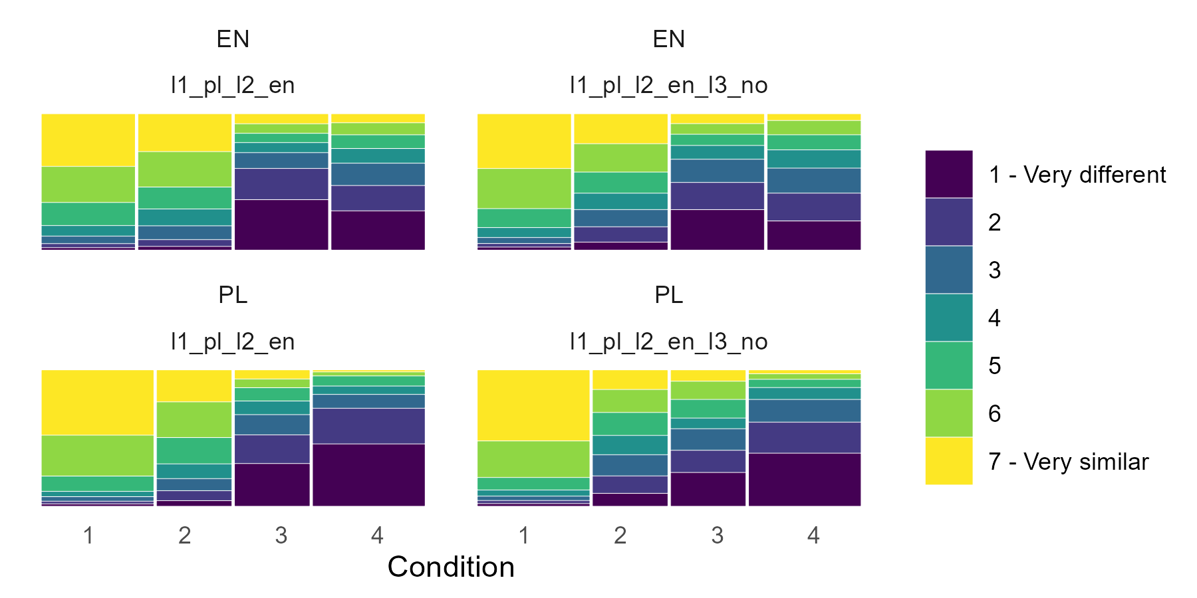
RATED (DIS-)SIMILARITY TASK RESULTS
Are there differences across groups in similarity ratings as a function of condition and language?
A mixed-effects ordinal logistic regression of similarity ratings as a function of three treatment-coded categorical predictors: condition (matching/non-matching retroflexion and P and/or manner of articulation), language of the non-Norwegian phone, group vs. and their three-way interaction. By-participant random intercept.
Significant effect of group: Pr(>Chisq) < 0.01 ***
Significant effect of language: Pr(>Chisq) < 0.01 ***
Significant effect of condition: Pr(>Chisq) < 0.01 ***
Significance of language:condition:group interaction: Pr(>Chisq) < 0.01 ***

Slide 16
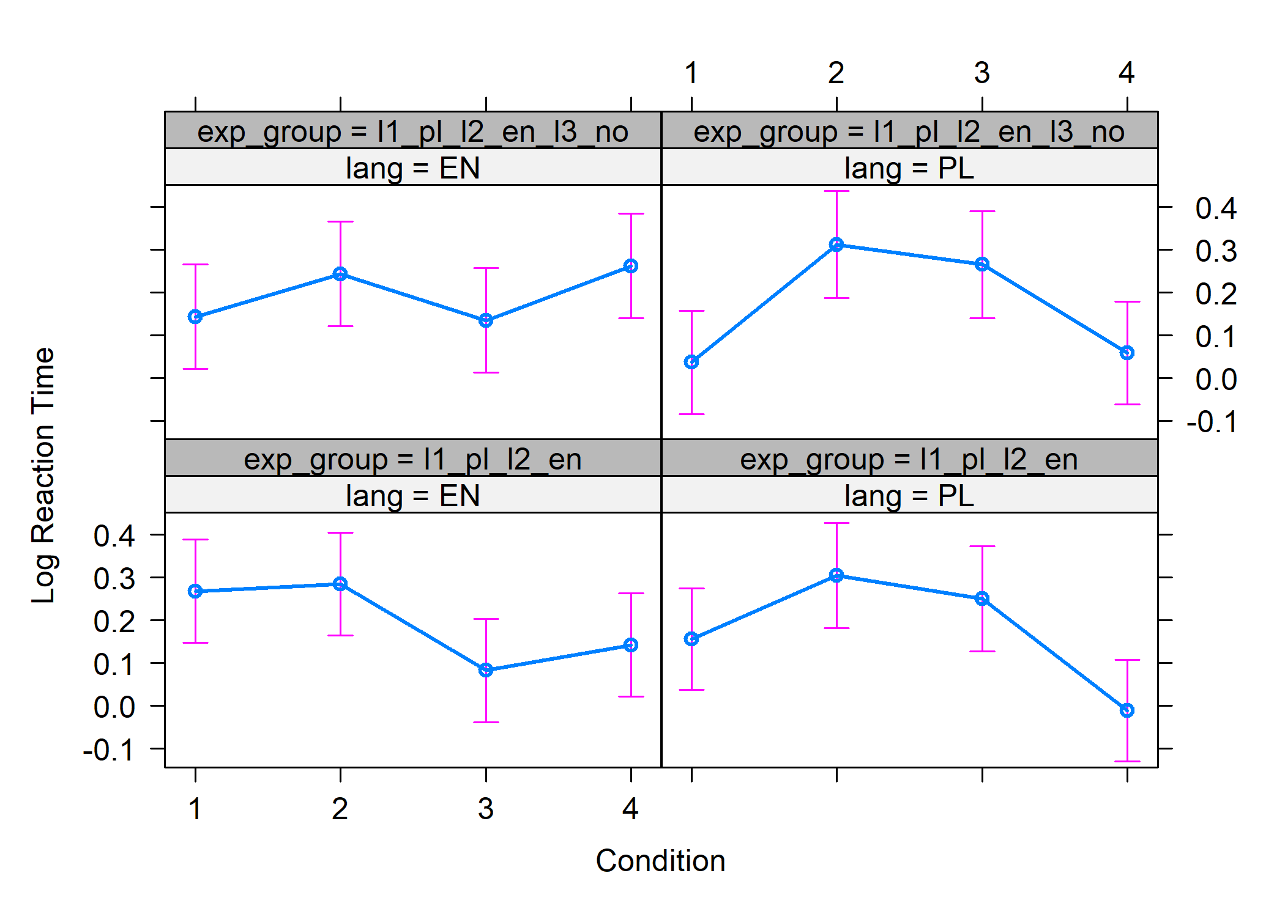
RATED (DIS-)SIMILARITY TASK RESULTS: LINEAR regression of reaction times
A mixed-effects linear regression model of log-transformed reaction times a function of three treatment-coded categorical predictors: condition, language of the non-Norwegian phone, group vs. and their three-way interaction. By-participant random intercept.
Significance of group: Pr(>Chisq) < 0.01 ***
Significance of condition: Pr(>Chisq) < 0.01 ***
Significance of language: Pr(>Chisq) < 0.01 ***

Slide 17
RATED (DIS-)SIMILARITY task: Focus on norwegian stop retroflexes
A cross-linguistic comparison between /ʈ/-/t/ and /ɖ/-/d/, taking all four conditions together.
We hypothesize that there should be no statistically significant differences between the similarity ratings for NO /ʈ/-/t/ and /ɖ/-/d/ both when compared to L1 Polish and when compared to L2 English.
We assume, though, that there will be differences between similarity ratings for NO /ʈ/-/t/ and /ɖ/-/d/ compared to L1 and L2 sounds .

Slide 18
RATED (DIS-)SIMILARITY task: results for norwegian stop retroflexes
L1 Polish
L2 English
The perceived similarity between /ɖ/-/d/ and the counterparts was slightly higher than between /ʈ/-/t/ and the counterparts, in the case of comparisons with both Polish and English sounds.
Ratings for /ɖ/-/d/ are higher than ratings for /ʈ/-/t/ when compared to counterparts in both languages (0.25 point); yet overall similarity ratings were higher for L1 Polish than for L2 English (approx. 0.4 point).

Slide 19
RATED (DIS-)SIMILARITY task: stops vs. sonorants
Are there differences in (dis-)similarity ratings for stops (/ʈ/-/t/, /ɖ/-/d/) and sonorants (/ɭ/-/l/, /ɳ/-/n/)?
We hypothesize that sonorants (/ɭ/-/l/, /ɳ/-/n/) will exhibit different patterns than stops (/ʈ/-/t/, /ɖ/-/d/) across conditions due to their different phonological nature?
We compared a balanced pair across conditions for /ʈ/-/t/, /ɖ/-/d/ vs. /ɭ/-/l/, /ɳ/-/n/ in L1 Polish and L2 English.

Slide 20
RATED (DIS-)SIMILARITY task: stops vs. sonorants

Slide 21
DISCRIMINATION TASK IN l3 norwegian
Categorial Discrimination task (e.g., A1 A2 B1): Which of the words is different?
A1 *garla /gɑɭɑ/ A2 *garla /gɑɭɑ/ B1 *gala /gɑlɑ/
Oddity paradigm
All twelve possible combinations were presented randomly over trials within a test
A1A2B1, A1B1A2, B1A1A2, A1B1B2, B1A1B2, B1B2A1
A2A1B1, A2B1A1, B1A2A1, A1B2B1, B2A1B1, B2B1A1
where:
A1 and A2 – a retroflex embedded in a token read by two different speakers
B1 and B2 – a non-retroflex embedded in a token read by two different speakers
each trial consisted of three tokens read by three different speakers

Slide 22
DISCRIMINATION TASK: stimuli
Stimuli:
retroflexes embedded in non-existing words in [C]/a/[Cr]/a/ pattern and their non-retroflex counterparts [C]/a/[Cn-r]/a/,
investigated retroflexes: /ʈ, ɖ, ɭ, ɳ, ʂ/, e.g.,
*varta /vɑʈɑ/ vs. *vata /vɑtɑ/
*farda /fɑɖɑ/ vs. *fada /fɑdɑ/
*karla /kɑɭɑ/ vs. *kala /kɑlɑ/
*garna /gɑɳɑ/ vs. *gana /kɑnɑ/
*farsa /fɑʂɑ/ vs. *fasa /fɑsɑ/
/a/ – the vowel /a/
[C] – one of the consonants /g/ /v/ /k/ or /f/
[Cr] – one of the consonants which is a retroflex: /ʈ, ɖ, ɭ, ɳ, ʂ/
[Cn-r] – one of the consonants which is a non-retroflex: /t, d, l, n, s/

Slide 23
DISCRIMINATION TASK: HYPOTHESIS
We hypothesize that discrimination in pairs involving the retroflex /ʂ-ʃ/ as opposed to the non-retroflex /s/ may be enhanced compared to other retroflex-non-retroflex pairs, as learners are familiar with this phonemic distinction from their L1 or L2.
Disrimination accuracy for stop retroflexes is hypothesized to be intermediate, because of similarity to allophonic realizations.
Lowest accuracy rates are hypothesized for sonorant /ɭ, ɳ/ retroflexes than for other retroflex-non-retroflex pairs, as learners are not familiar with the former either from their L1 or L2.
Additionally, /ɭ,-l/ has been undergoing neutralization in Norwegian.

Slide 24
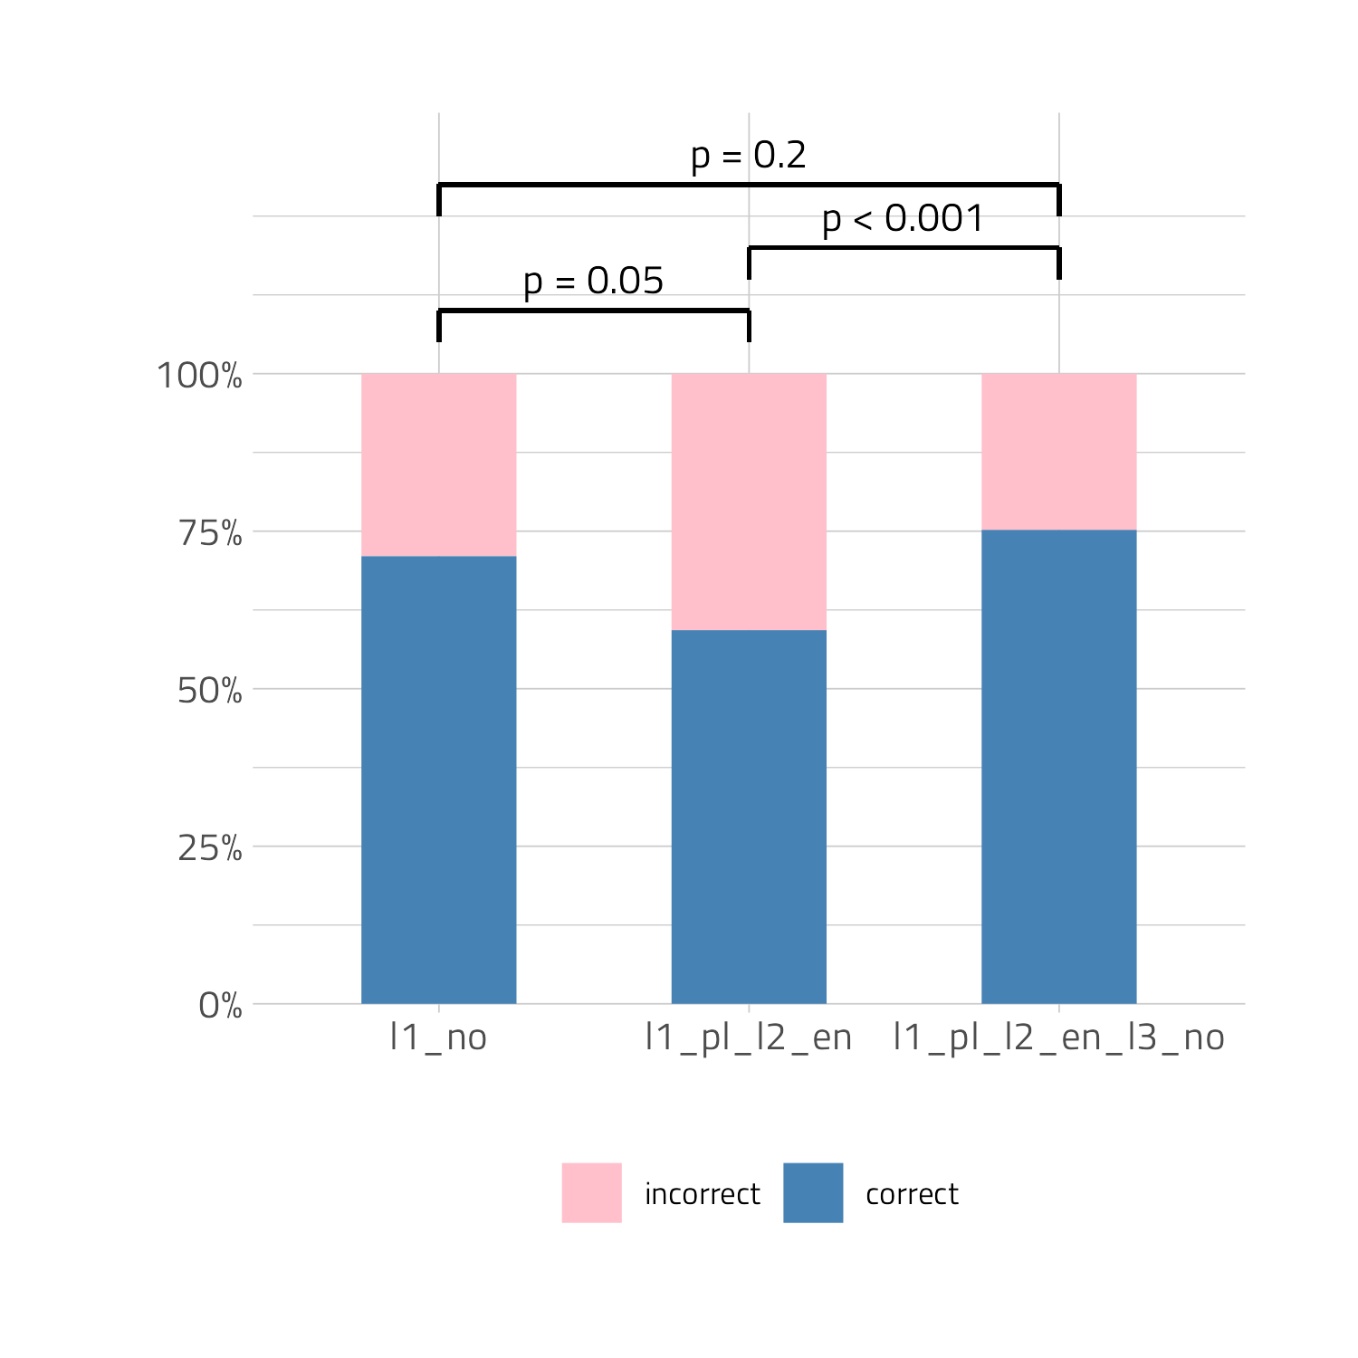
DISCRIMINATION task: accuracy scores across groups
Binomial regression model.
Significance of groups: Pr(>Chisq) < 0.01R
P value adjustment: tukey method for comparing
a family of 3 estimates was used.
Accuracy hierarchy: trilinguals > natives > bilinguals
Term | Estimate | p-value
native vs. biliguals | 0.450 | 0.0518
native vs. trilinguals | -0.334 | 0.2013
bilinguals vs. trilingual | -0.785 | <.0001

Slide 25
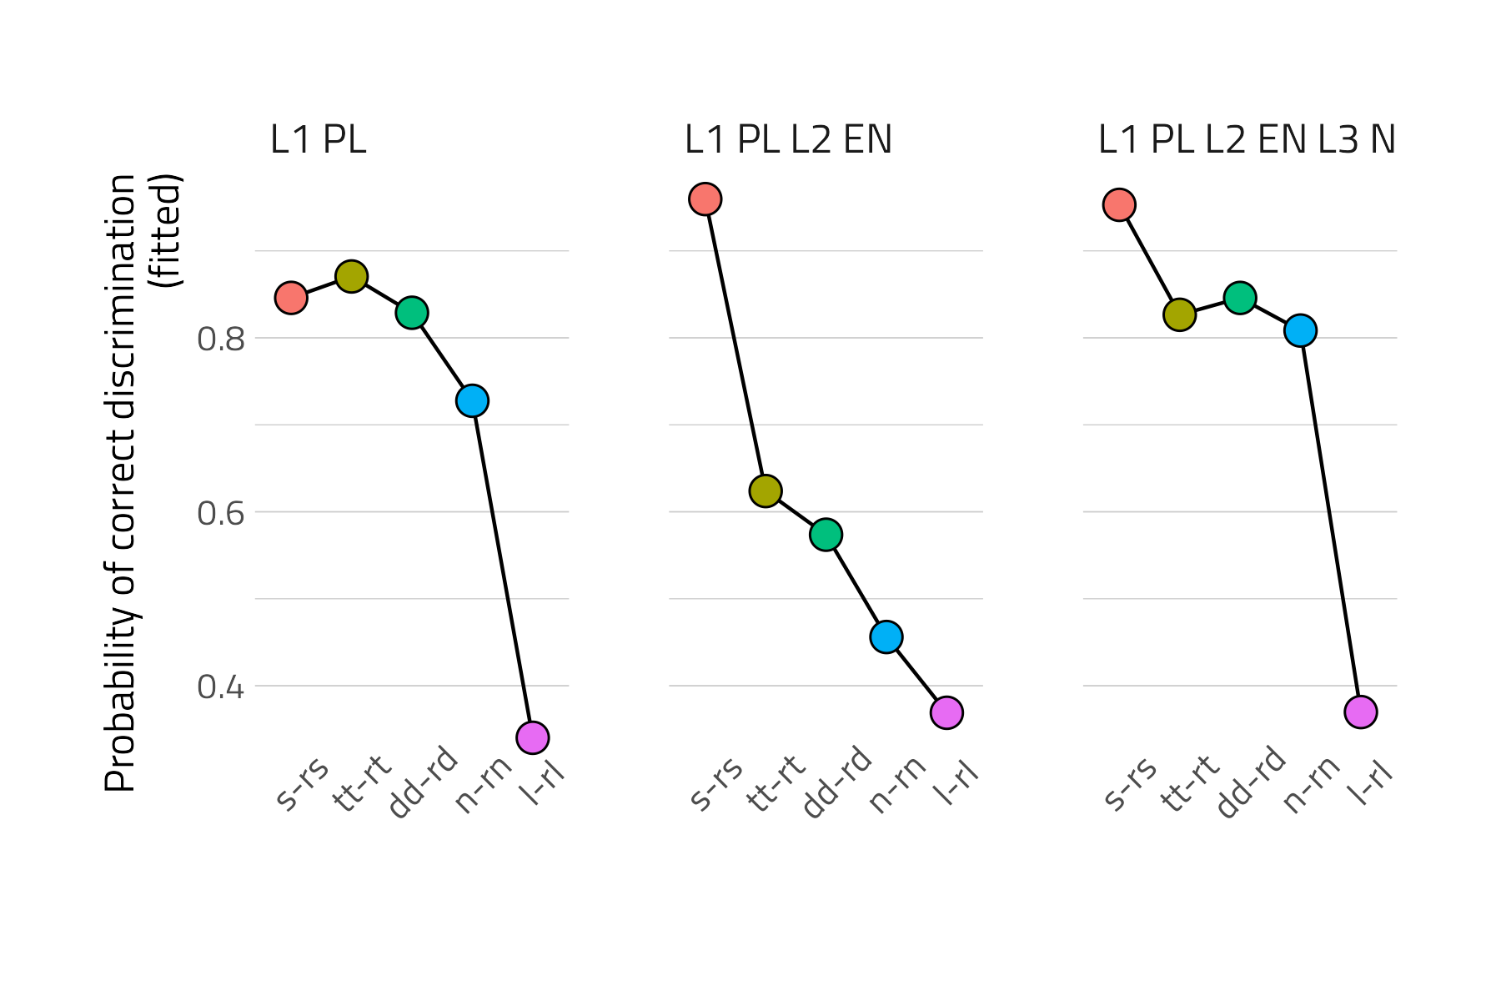
DISCRIMINATION TASK: results
Ceiling discrimination of /ʂ/-/s/ in the case of trilinguals and bilinguals
Trilinguals and native listeners have highly accurate scores for /ʈ/-/t/ and /ɖ/-/d/ pairs; slightly lower results for /ɳ/-/n/.
Bilinguals performed worse for the Norwegian pairs where there isn’t a a similar retroflex phoneme in L1 Polish.
Below chance level discrimination rates for /ɭ/-/l/; the much lower accuracy for /ɭ/-/l/ compared to all other conditions is what trillinguals have in common with native listeners , not with bilinguals, also because the accuracy for /ʈ/-/t/ and /ɖ/-/d/ and /ɳ/-/n/ for trilinguals is higher than for bilinguals.
The results can generally be accounted for by the familiarity with L1 retroflexion patterns. Phonemic vs. allophonic status of retroflex sounds in Polish surfaces in Norwegian retroflex perception.

Slide 26
DISCRIMINATION task: results across groups in accuracy scores as a function of condition
Are there differences between groups in accuracy scores as a function of condition?
Hypotheses are confirmed, accuracy /ʂ/-/s/> retroflex stop > sonorants, but there is an unexpected difference between /ɳ/-/n/ and /ɭ-l/ perception.
Only significant contrasts were selected:
condition = /ʂ/-/s/:
- p <.0001***
- p <.0001***
condition = /ʈ/-/t/:
- p <.0001***
- p <.0001***
condition = /ɖ/-/d/:
- p <.0001***
– - p <.0001***
condition = /ɳ/-/n/:
- p <.0001***
- p <.0001***

Slide 27
Low accuracy of /ɭ/ discrimination
Frequency (corups and dictionary frequency): around 1% of items, at least four times less frequent than other retroflexes in Norwegian.
Articulatory similarity of dark [ɫ] and retroflex /ɭ/?
Ongoing change from a denti-alveolar laminal type into an alveolar apical, which has led to neutralization of the unmarked lateral and the one from the retroflex series.
The product of the neutralization is ’ slightly retroflex’ (Vanvik 1972, Jahr 1981).
Endresen (1991): varying between alveolar and postalveolar.
Kristoffersen (2000): it corresponds to the retroflex series of stops and sibilants.

Slide 28
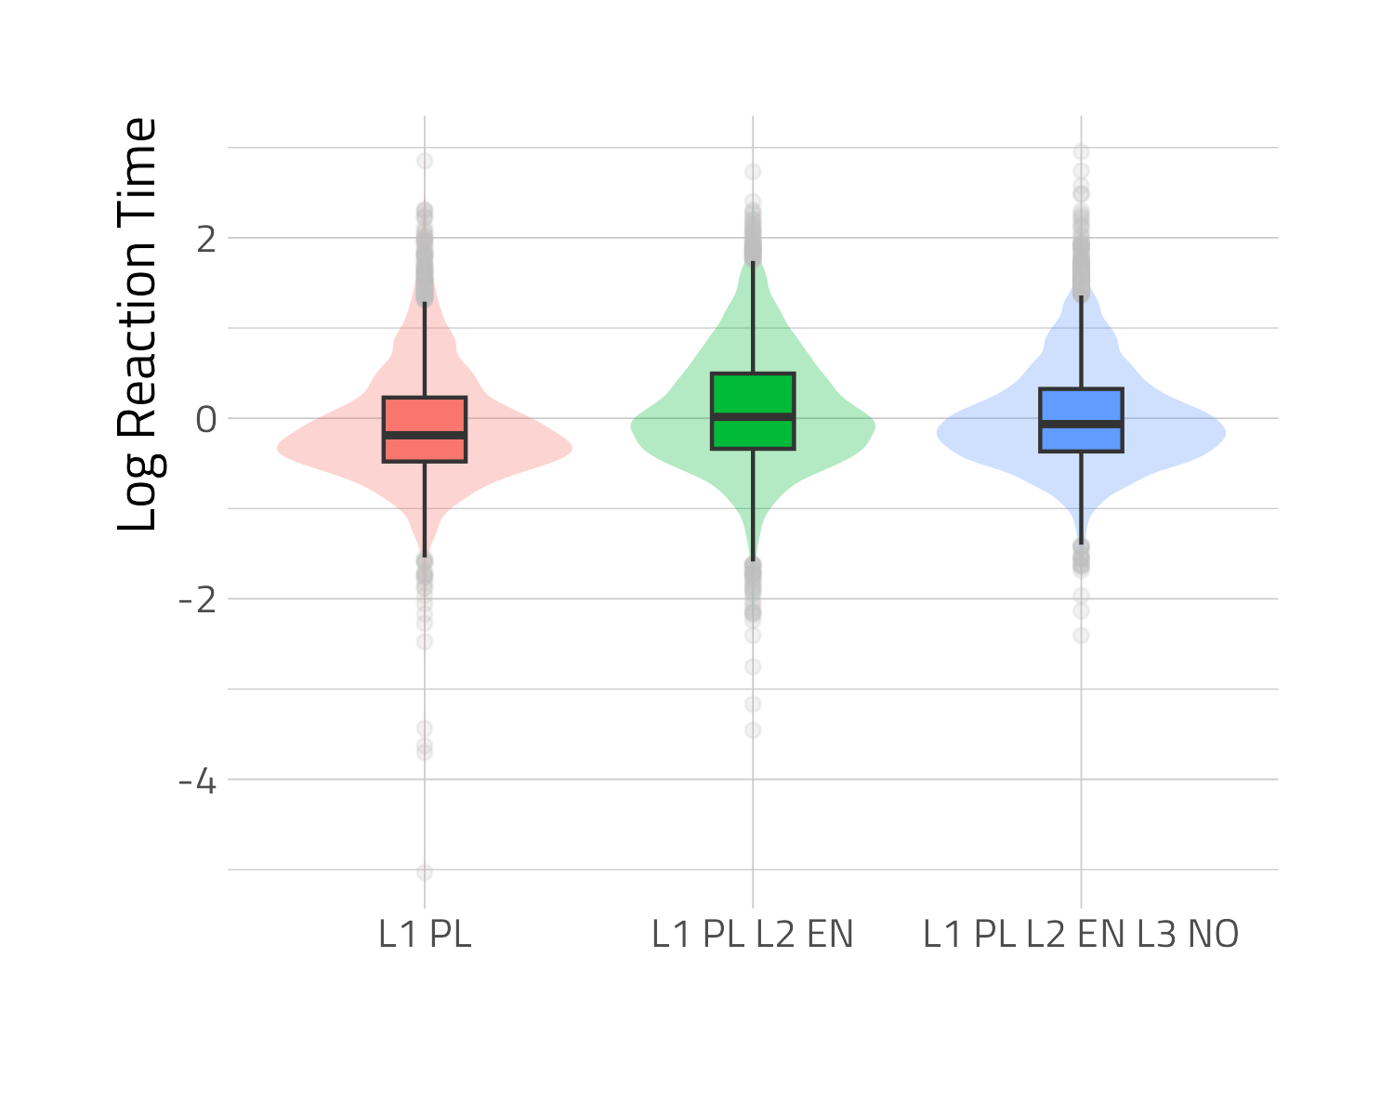
DISCRIMINATION task: reaction time results across groups
Pr(>Chisq) < 0.01***
A likelihood ratio test shows that the model with group (and its interaction with condition) is significantly different from a model without group. Groups are different in terms of reaction times.

Slide 29
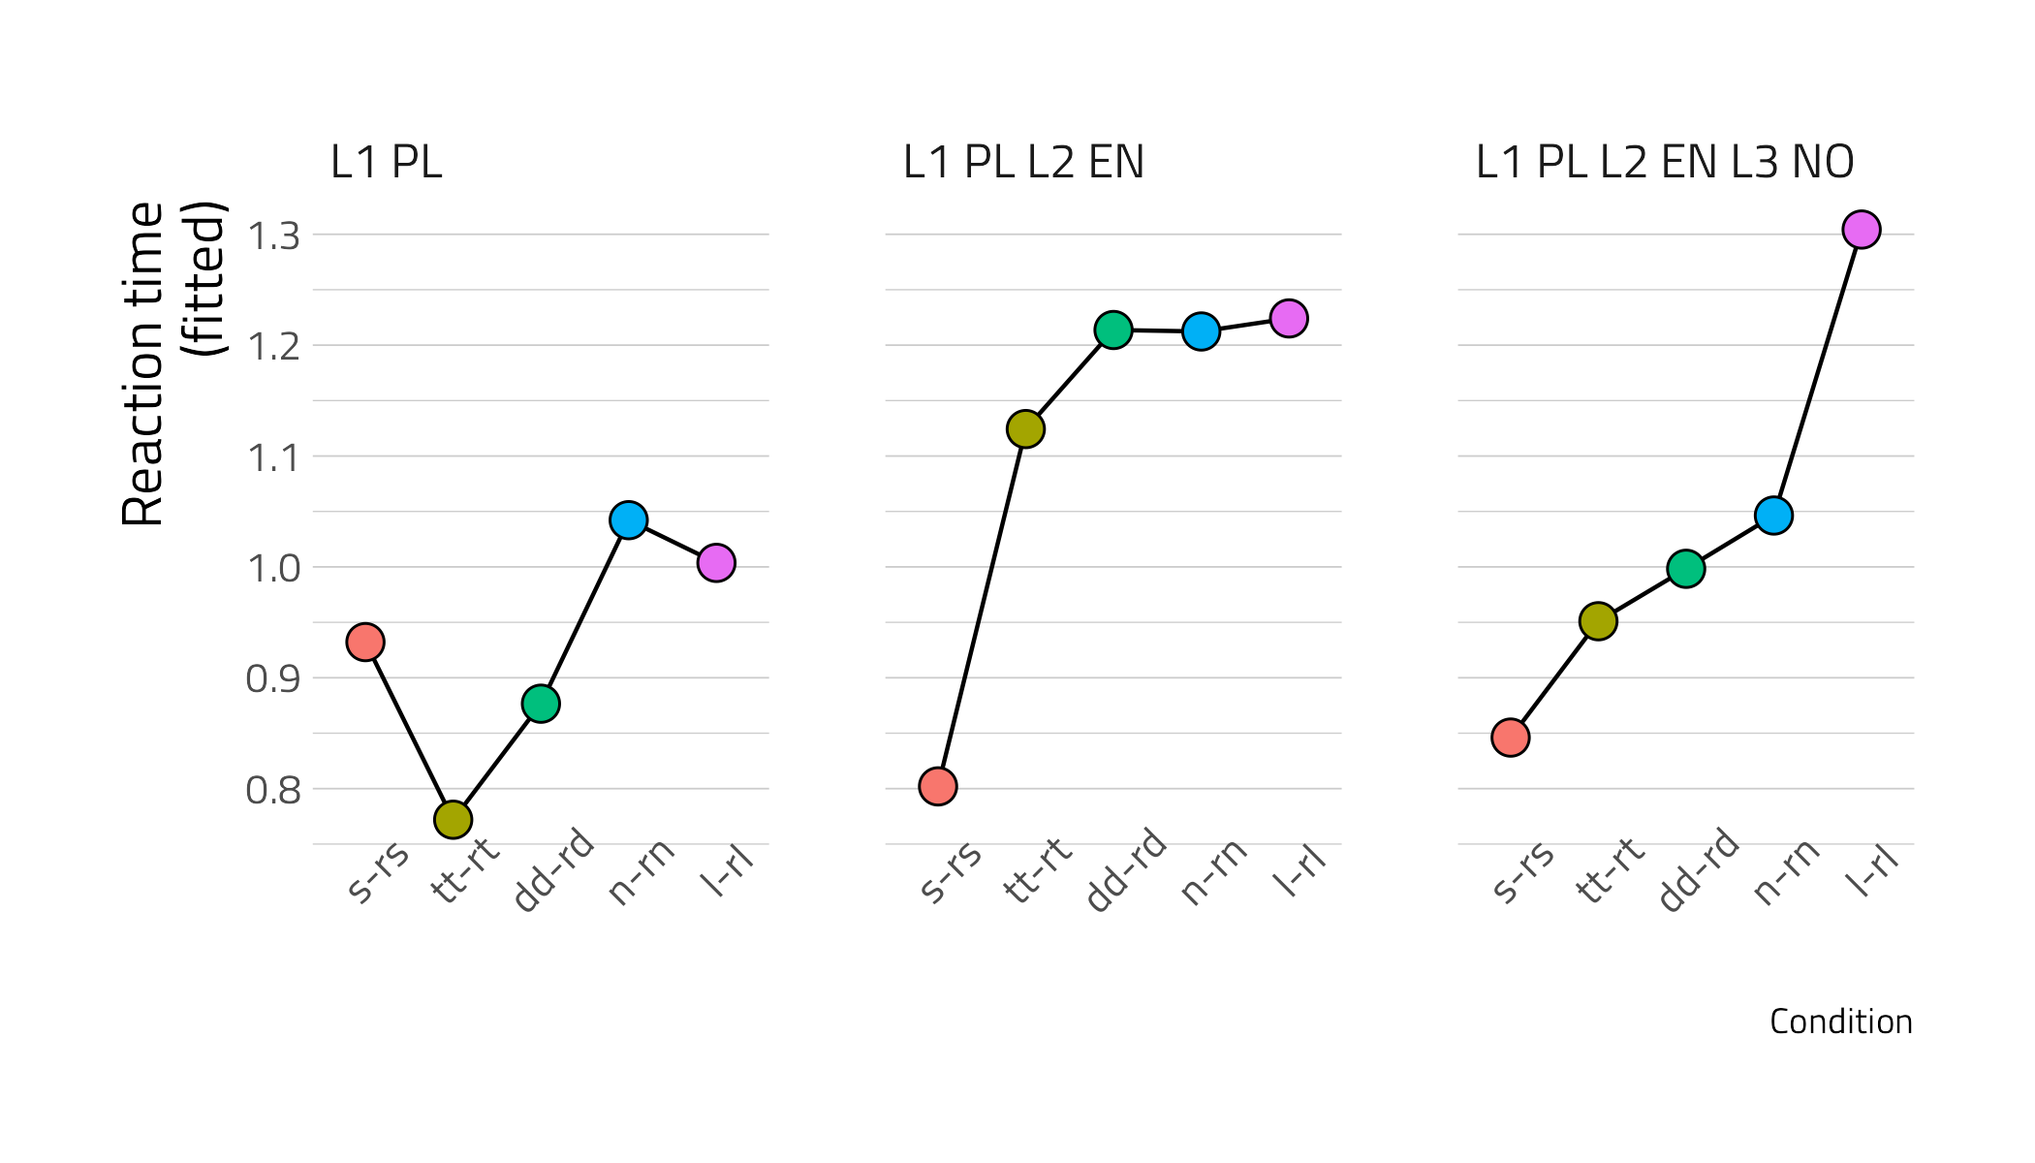
DISCRIMINATION task: reaction time results across groups as a function of condition
Generally, the lower the accuracy of discrimination, the higher the RTs.
Are there differences between groups in reaction times as a function of condition?
Only significant contrasts were selected:
condition = /ʈ/-/t/:
native – bilingual p <.0001
native – trilingual p=0.0432
bilingual – trilingual p=0.0252
condition = /ɖ/-/d/:
native – bilingual p = 0.0005
bilingual – trilingual p = 0.0068
condition = /ɭ-l/ :
native – trilingual p = 0.0072

Slide 30
Discussion: discrimination
Hypotheses are confirmed, accuracy /ʂ/-/s/> retroflex stop > sonorants, but there is a difference between /ɳ/-/n/ and //ɭ-l/ perception, due to neutralization of /ɭ-l/.
Trilingual and target language advantage in wholesale comparison: trilinguals were more accurate than native speakers and native speakers were more accurate than bilinguals.
There are significant differences in accuracy of perception of Norwegian pairs of retroflexes: /ʂ-s/, /ʈ-t/, /ɖ-d/, /ɳ-n/ and /ɭ-l/ and relative difficulties diminish with experience with Norwegian.
Higher reaction times for bilinguals.
Higher reaction times for contrasts with lower discrimination accuracy/ for more challenging contrasts.

Slide 31
Discussion: rated (dis-)similarity task
The attested hierarchy of phonological proximity: matching retroflexion, same P&M > non-matching retroflexion, same P&M > matching retroflexion, different P&M > non-matching retroflexion, different P&M
All: language, group and condition turned out to be significant factors in the case of both rated (dis)similarity scores and reaction times.
Matching retroflexion elicited higher goodness ratings in the case of trilinguals, familiar with retroflexion from both L1 and L3 than for bilinguals from whom only/mainly the L1 can be the source of CLI.

Slide 32
Discussion: RDT vs. discrimination
The sounds that were judged to be more similar in RDT had lower accuracy scores in the discrimination task -> perceived cross-linguistic similarity mediates discrimination, not only in L2 perception (Cebrian 2022, Flege and Bohn 2021, Best 1995), but also in cross-linguistic perception by multilinguals, with all its complexities.
Both tasks:
Additional evidence that there are retroflexes in Polish.
Gradiance in perceptual salience.
The importance of experience with a given contrast.

Slide 33
Further research
Frequency vs. accuracy in discrimination: the study revealed that /ʂ/-/s/ which are phonemes in Polish are much more accurately discriminated than /ʈ/-/t/ or /ɖ/-/d/, the retroflex stop variants having an allophonic, but not a phonemic status in L1 Polish. Future disentangle the role of phonemic/allophonic status vs. the effects of frequency of occurrence.
Cf. the above with the 1st hypothesis of the SLM (Flege 1995, Flege and Bohn 2021): „Sounds in the L1 and L2 are related perceptually to one another at a position·sensitive allophonic level, rather than at a more abstract phonemic level.”

Slide 34
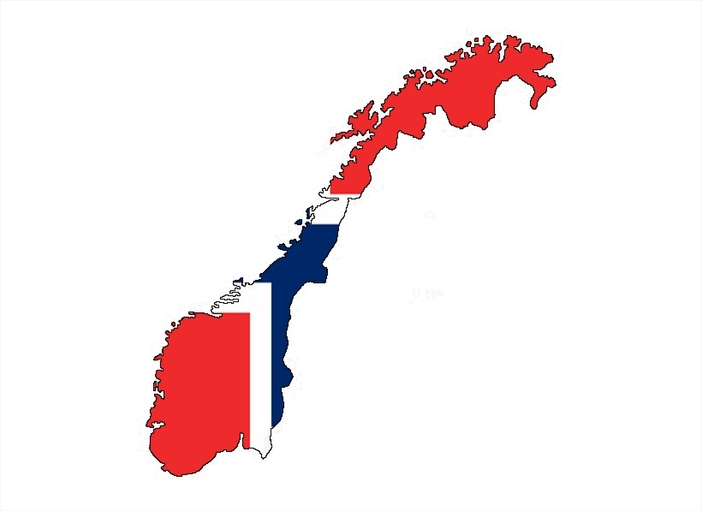
THANK YOU!!

Slide 35
SELECTED REFERENCES
Cebrian, J. (2022). Perception of English and Catalan vowels by English and Catalan listeners: Part II. Perceptual vs ecphoric similarity. Journal of the Acoustical Society of America, 152(5), 2781-2793.
Flege, J.E. & Bohn, O-S. (2021). The revised speech learning model (SLM-r). In: R. Wayland (ed.) Second language speech learning: Theoretical and empirical progress. Cambridge: Cambridge University Press, pp. 3-83.
Greenberg, J. (1966). Universals of language. Cambridge, MA: MIT Press.
Maddieson, I. (1984) Patterns of sounds. Cambridge: Cambridge University Press.
Westergaard, M., Mitrofanova, N., Rodina, Y. & Slabakova, R. 2023. Full transfer potential in L3/Ln acquisition: Cross-linguistic influence as a property-by-property process. In Cabrelli, J. Chauch-Orozco, A., González Alonso, J. Pereira Soares, S.M., Puig-Mayenco, E. & Rothman, J. The Cambridge handbook in thrid language acquisition. Pp. 219-242. Cambridge: Cambridge University Press.
Żygis, M. (2005). Non(retroflexivity) of Slavic affricates and its motivation. The case of Polish and Czech. ZAS Papers in Linguistics, 42, 69-115.
Żygis, M., Pape D. L., & Jesus L. (2012). (Non)retroflex Slavic affricates and their motivation. Evidence from Czech and Polish. Journal of International Phonetic Association, 42, 281–329.

Slide 36
ACKNOWLEDGEMENTS:
ACKNOWLEDGEMENTS:
This research is supported by Norway funds/ NCN project grant GRIEG-1 (UMO-2019/34/H/HS2/00495) ADIM “Across-domain investigations in multilingualism: Modeling L3 acquisition in diverse settings”.
Special thanks should also go to Jarosław Weckwerth and Agnieszka Pludra for their idea of shading and help with the execution.
We would also like to thank Hanna Kędzierska for her help with data collection in Wrocław and Sylwiusz Żychliński, Anna Skałba and Zuzanna Cal for cooperation during data collection in Poznań and Szczecin.
Last but not, least we are grateful to all the project team members for discussions of the research design and analysis.

