Slide 1
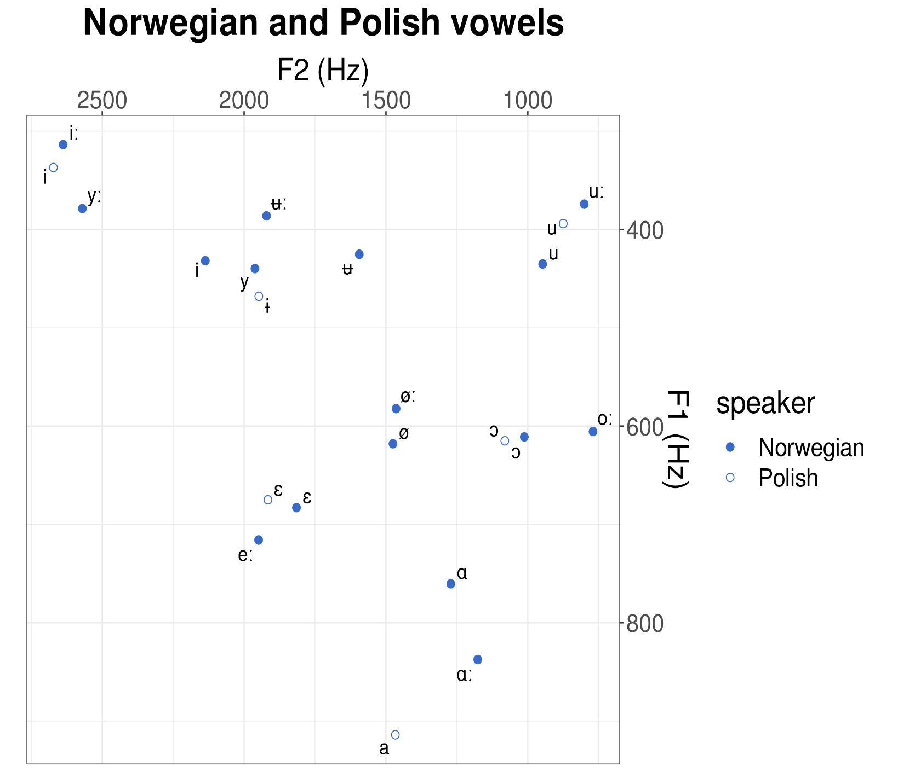
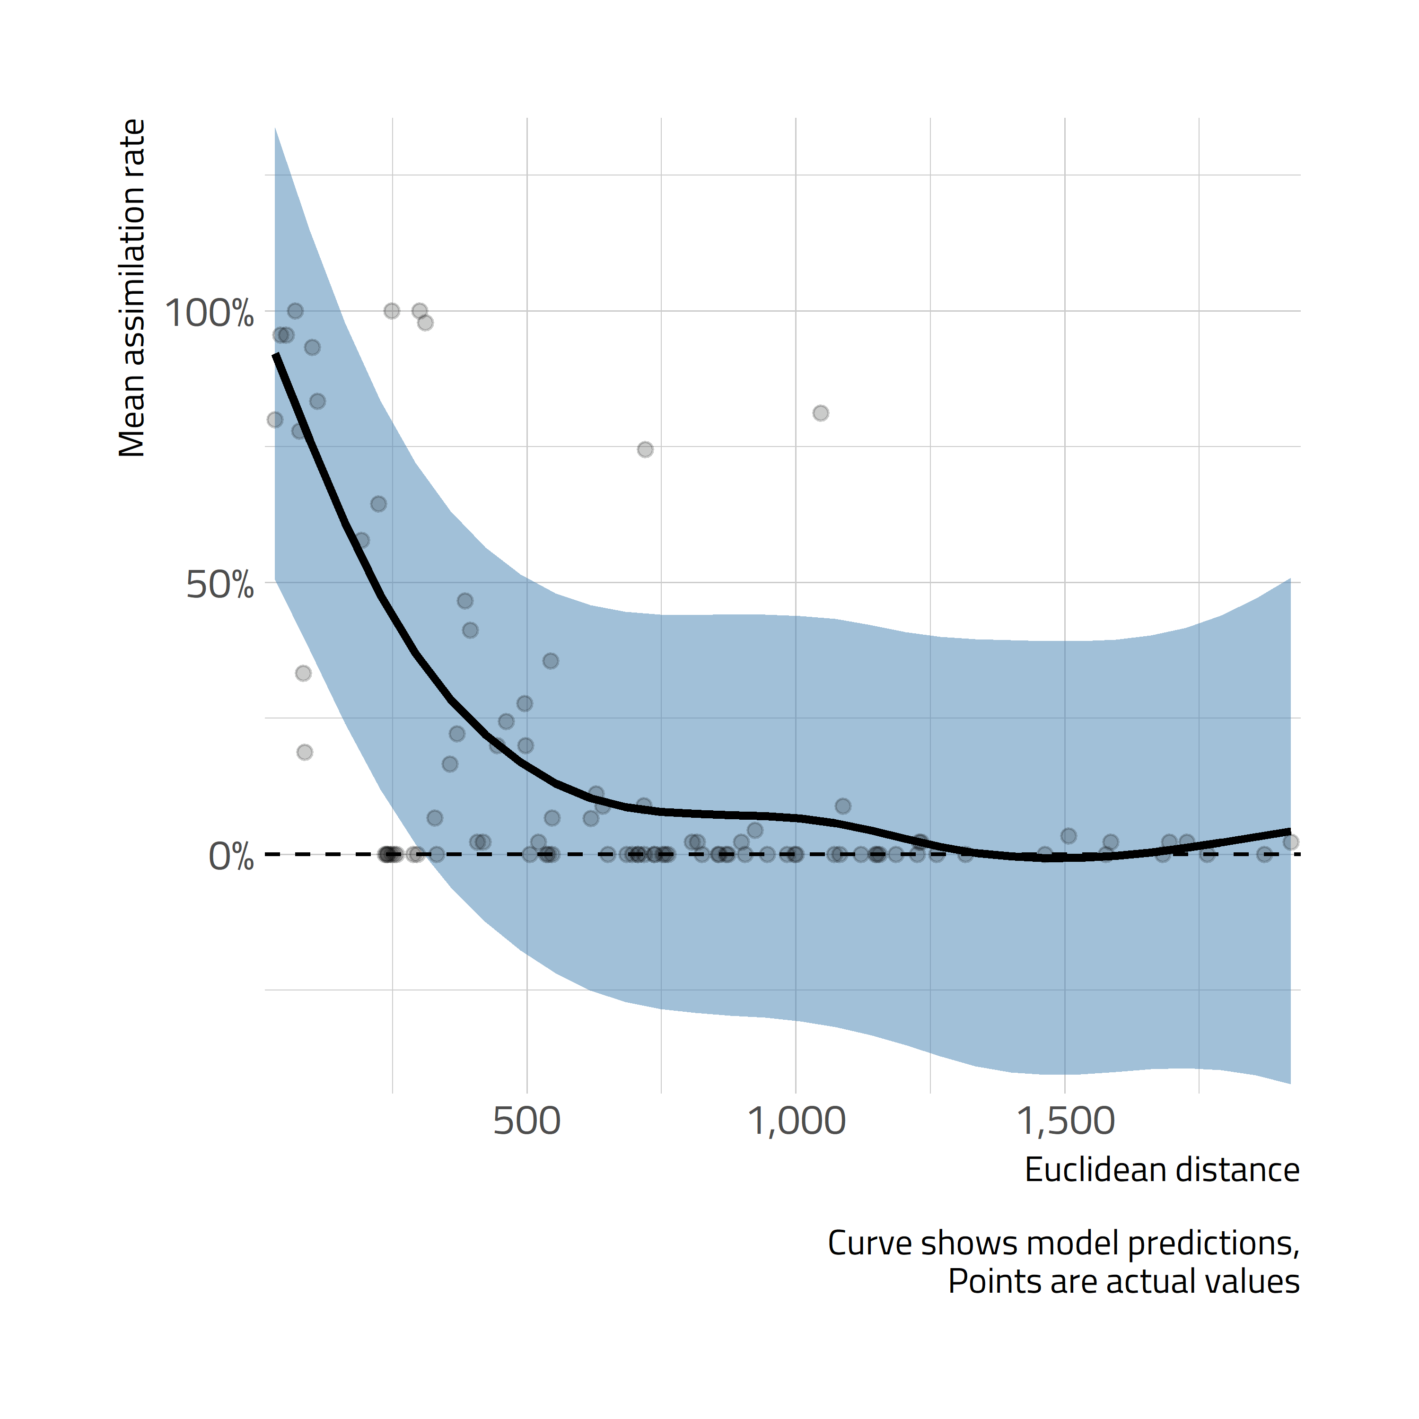
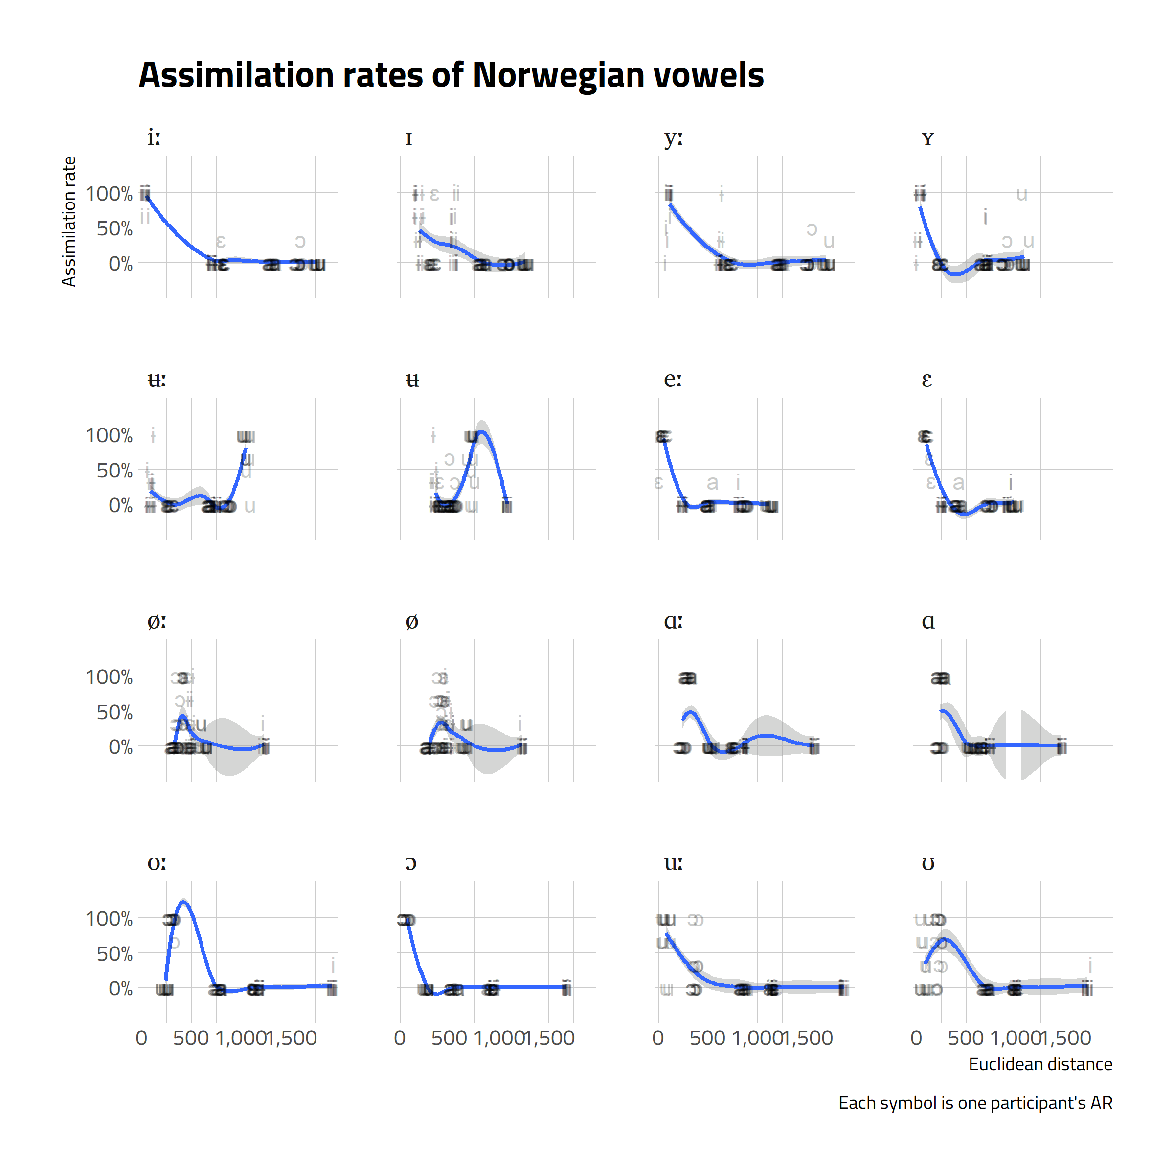
Perceptual vs. acoustic similarity in L3: The relationship between Norwegian vowel assimilation patterns
and the Euclidean distances
Anna Balas, Zuzanna Cal, Nicole Rodriquez, Karolina Rataj
Adam Mickiewicz University, Poznań, Poland
Introduction and hypotheses
Methods
This pilot perception study is a part of a battery of tests within CLIMAD project dealing with phonological and syntactic aspects of L3 acquisition.
The relationship between L3 Norwegian vowel assimilation to L1 Polish vowel categories and the acoustic distance between Norwegian and Polish vowels by examining Euclidean distance and lip rounding as explanatory factors in the observed patterns of cross-linguistic similarity.
So far studies focused on L2: perceptual assimilation (Best & Tyler 2007, Tyler et al. 2014) and the relationship between vowel perception and their acoustic parameters (Strange et al. 2003, Escudero et al. 2012, Alispahic et. al. 2017).
Hypotheses for L3 perceptual and acoustic similarity:
The smaller the Euclidean distance between the two vowels, the higher the likelihood of assimilating a given Norwegian vowel to a Polish category.
Assimilation patterns are influenced by marked lip rounding and long vowel durations.
Participants: 15 L1 Polish, L2 English, L3 Norwegian (B1)
Tasks: assimilation of 16 Norwegian vowels to 6 Polish vowel categories and goodness of fit rating
Stimuli: 16 Norwegian vowels
Presented in /dVd/ framework
3 times each (e.g., dåd, dedd, did)
Orthographic labels for 6 Polish
vowel categories /i, ɨ, e, a, ɔ, u/
Likert scale:
1 (weak fit) -- 7 (good fit)
Results and analysis
Norwegian stimuli | Polish vowel labels
 | <i> | <y> | <e> | <a> | <o> | <u>
TID /iː/ | 95.56% |  | 2.22% |  | 2.22%
 | 5.6 |  | 3 |  | 4
FIN /i/ | 35.56% | 57.78% | 6.67%
 | 4.25 | 5.12 | 4.33
LYS /yː/ | 84.09% | 11.36% |  |  | 2.27% | 2.27%
 | 4.62 | 3.6 |  |  | 1 | 3
SYND /y/ | 8.89% | 80% |  |  | 2.22% | 8.89%
 | 3.25 | 4.67 |  |  | 1 | 4.5
STED /eː/ | 2.22% |  | 95.56% | 2.22%
 | 4 |  | 5.05 | 7
BEST /e/ | 4.44% |  | 93.33% | 2.22%
 | 4 |  | 5.83 | 5
LØP /øː/ | 2.22% | 20% | 24.44% |  | 46.67% | 6.67%
 | 2 | 4 | 2,91 |  | 3.67 | 4.67
SØNN /ø/ | 2.27% | 27.27% | 20.45% |  | 40.91% | 9.09%
 | 6 | 4.42 | 3.22 |  | 4.17 | 4
DAG /ɑː/ |  |  |  | 1%
 |  |  |  | 5.02
TAKK /ɑ/ |  |  |  | 100%
 |  |  |  | 5.13
RAD /oː/ | 2.22% |  |  |  | 97.78%
 | 7 |  |  |  | 5.07
NOK /o/ |  |  |  |  | 100
 |  |  |  |  | 5.05
BOK /uː/ |  |  |  |  | 22.22% | 77.78%
 |  |  |  |  | 4.7 | 4.94
ROM /u/ | 2.22% |  |  |  | 64.44% | 33.33%
 | 5 |  |  |  | 4.55 | 5.33
GUD /ʉː/ |  | 16.67% |  |  |  | 83.33%
 |  | 4 |  |  |  | 3.91
SLUTT /ʉ/ |  | 15.91% | 2.27% |  | 6.82% | 75%
 |  | 4.28 | 2 |  | 4.33 | 4.15
Norwegian stimuli | Polish vowel labels
 | <i> | <y> | <e> | <a> | <o> | <u>
TID /iː/ | 95.56% |  | 2.22% |  | 2.22%
 | 5.6 |  | 3 |  | 4
FIN /i/ | 35.56% | 57.78% | 6.67%
 | 4.25 | 5.12 | 4.33
LYS /yː/ | 84.09% | 11.36% |  |  | 2.27% | 2.27%
 | 4.62 | 3.6 |  |  | 1 | 3
SYND /y/ | 8.89% | 80% |  |  | 2.22% | 8.89%
 | 3.25 | 4.67 |  |  | 1 | 4.5
STED /eː/ | 2.22% |  | 95.56% | 2.22%
 | 4 |  | 5.05 | 7
BEST /e/ | 4.44% |  | 93.33% | 2.22%
 | 4 |  | 5.83 | 5
LØP /øː/ | 2.22% | 20% | 24.44% |  | 46.67% | 6.67%
 | 2 | 4 | 2,91 |  | 3.67 | 4.67
SØNN /ø/ | 2.27% | 27.27% | 20.45% |  | 40.91% | 9.09%
 | 6 | 4.42 | 3.22 |  | 4.17 | 4
DAG /ɑː/ |  |  |  | 1%
 |  |  |  | 5.02
TAKK /ɑ/ |  |  |  | 100%
 |  |  |  | 5.13
RAD /oː/ | 2.22% |  |  |  | 97.78%
 | 7 |  |  |  | 5.07
NOK /o/ |  |  |  |  | 100
 |  |  |  |  | 5.05
BOK /uː/ |  |  |  |  | 22.22% | 77.78%
 |  |  |  |  | 4.7 | 4.94
ROM /u/ | 2.22% |  |  |  | 64.44% | 33.33%
 | 5 |  |  |  | 4.55 | 5.33
GUD /ʉː/ |  | 16.67% |  |  |  | 83.33%
 |  | 4 |  |  |  | 3.91
SLUTT /ʉ/ |  | 15.91% | 2.27% |  | 6.82% | 75%
 |  | 4.28 | 2 |  | 4.33 | 4.15
Discussion
References
References
To answer the research questions we fitted a mixed-effects model in R (R Core Team, 2015), using the lmer function from the lme4 package (Bates et al. 2015) to predict assimilation rating as a function of Euclidean distance, length of a Norwegian vowel, markedness with regard to lip rounding and Norwegian vowels.
The effect of the Euclidean distance is statistically significant (β= -0.03590, p < 0.001): the larger the Euclidean distance, the lower the assimilation rate.
No statistically significant effects were observed for vowel length or vowels with more marked lip rounding, but looking at the empirical data, we can see deviations from the general rule of assimilating Norwegian vowels to the closest Polish category in terms of the Euclidean distance: /ʉ(ː)/, /oː/ /ø(ː)/ or /u/.
Alispahic, S., Mulak K.E.., & Escudero P. 2017. Acoustic properties predict perception of unfamiliar Dutch vowels by adult Australian English and Peruvian Spanish listeners.Frontiers in Psychology 8 (52).
Best C. & Tyler, M. (2007). Non-native and second language speech perception: Commonalities and complementarities. In M. Munro & O-S. Bohn (Eds.), Language experience in second language speech learning: In honor of James Emil Flege (pp. 13-34). Amsterdam: John Benjamins.
Escudero, P., Simon, E., & Mitterer, H. (2012). The perception of English front vowels by North Holland and Flemish listeners: acoustic similarity predicts and explains cross-linguistic and L2 perception. Journal of Phonetcis 40 (2), 280-288.
R Core Team (2015). R: A Language and Environment for Statistical Computing. R Foundation for Statistical Computing, Vienna, Austria. URL http://www.R-project.org/.
Strange, W., Bohn, O-S., Trent, S. & Nishi K. (2004). Acoustic and perceptual similarity of North German and American English vowels. Journal of the Acoustical Society of America, 115(4), 1791-1807.
Tyler, M.D., Best C.T., Faber, A. & Levitt, A.G. (2014). Perceptual Assimilation and Discrimination of Non-Native Vowel Contrasts. Phonetica 71, 4-21.
Acknowledgements
We would like to thank Kamil Kaźmierski for the statistical analysis.
Research presented on this poster has been a result of a project: OPUS-19-HS (UMO-2020/37/B/HS2/00617) CLIMAD "Cross-linguistic influence in multilingualism across domains: Phonology and syntax” financed by by the National Science Centre, Poland.
Notes:
Prints as 33.1 x 46.8 (A0) at 100%. When printed using the library printing service, this will require trimming from 36 inch wide paper. To fill 36 inch paper roll, scale to 108.5% (prints as ~ 36 X 51).

